Slide 1
Integration of Goods Markets
Oldřich Dědek
Institute of Economic Studies, Charles University

Slide 2
Arguments in favour of free trade
Ricardian theory of comparative advantage
  A country should specialise in the production and export of the good where its comparative advantage is greater and import the product where its comparative advantage is lower (win-win game)
Heckscher-Ohlin theorem
  A country should specialise on a commodity whose production is intensive of the factor in which the country is relatively abundant (source of comparative advantage)
Intra-industry trade
  Countries can benefit from trade in close substitutes (i.e. in similar but slightly different products)
Economies of scale
  A free trade allows firms to operate on a larger and more efficient scale and allows to capture learning effects
2
Notes:
2

Slide 3
Ricardian theory of comparative advantage
Note: utility for consumer = price of good = unit labour costs (according to
labour theory)
Units: wine in gallons, cloth in yards, time in hours
Notes:
Ricardo theory
Absolute advantage = a country is more efficient in the production of a good than the other country
Comparative advantage = even if a country has an absolute advantage in the production of all goods, it should specialize in the production and export of the good where its absolute advantage is greater and import goods for which its absolute advantage is smaller
If the USA has an absolute advantage in the production of grain and clothing compared with the EU, but its absolute advantage is greater for grain, it should specialize in grain production and export grain in exchange for clothing

Slide 4
Heckscher-Ohlin theorem
Closed economies Open economies
X₁
X₁
A
Ex_{A1}
Im_{B1}
B
Im_{A2}
Ex_{B2}
X₂
X₂
Explanation of the source of comparative advantage: pattern of different endowments of factors of productions
Trade along price line improves welfare in both economies
Trade acts as a substitute for the international mobility of factors (liberalization of trade will bring about the equalization of relative and absolute returns to factors of production)
4
Notes:
4
Heckscher-Ohlin theorem:
Abundance of labour to capital means that the ratio of labour to capital is higher in a country
China has abundance in cheap labour ⇒ specialisation on clothing, USA has abundance i skilled labour ⇒ specialisation on computers
H-O can explain certain trade flows between developing and industrialised countries, it works less well for trade between similar countries

Slide 5
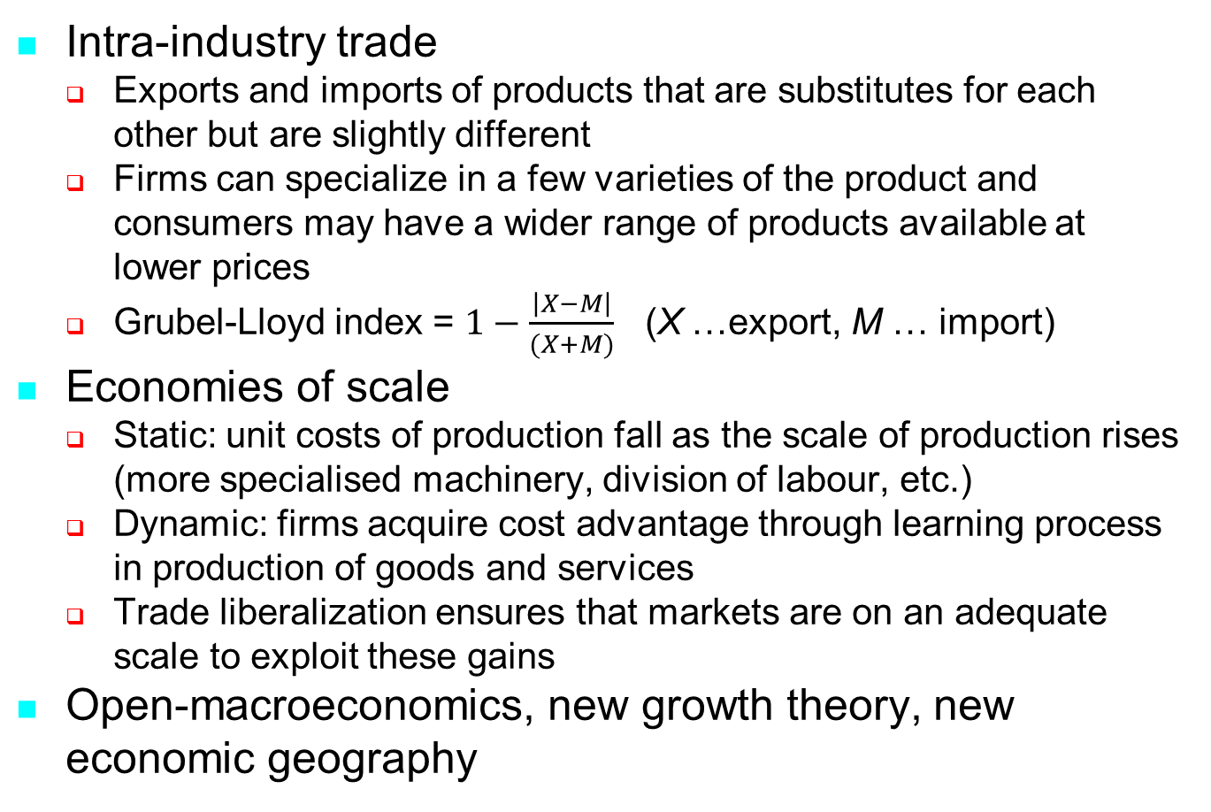
New trade theories
Intra-industry trade
  Exports and imports of products that are substitutes for each other but are slightly different
  Firms can specialize in a few varieties of the product and consumers may have a wider range of products available at lower prices
  Grubel-Lloyd index = $1−\frac{\left|X−M\right|}{(X+M)}$ (X …export, M … import)
Economies of scale
  Static: unit costs of production fall as the scale of production rises (more specialised machinery, division of labour, etc.)
  Dynamic: firms acquire cost advantage through learning process in production of goods and services
  Trade liberalization ensures that markets are on an adequate scale to exploit these gains
Open-macroeconomics, new growth theory, new economic geography
5
Notes:
5
Grubel-Lioyd index
GL = 1 ⇨ there is only intra-industry trade and no inter-industry trade (X = M)
GL = 0 ⇨ there is no intra-industry trade and only inter-industry trade (M = 0 or X = 0)
Example of intra-industry trade
Italy exports Fiat and imports BMW from Germany and Renault from France

Slide 6
Arguments in favour of protection
Infant industry
  A new industry is not able to compete with established firms and therefore needs time to acquire experience or to reach a sufficient size to benefit from economies of scale
  Problems with practical implementation: ensuring competitiveness at free trade world prices, eventual benefits should exceed the cost of protection
  Abuse for protectionism: politicized selection of protected industries, pressure to continue with protection, protection of non-viable industries
Second best
  If conditions of perfect competition are violated in some part of the world it need not be optimal for others to stick to the rules of perfect competition; protection may be welfare improving
  A move to free trade should be decided case by case
Optimal tariff
  A tariff introduced on a widely used good reduces consumption causing the world price to fall, foreign producers bear part of the cost of tariff (John Stuart Mill)
  Critique: retaliation on the part of other countries
Strategic trade theory
  Countries can gain comparative advantage irrespective of the initial endowments of factors of production
  Comparative advantage can be created by an active trade policy and strategies to promote investment (promotion of high-tech industries, research and development, investment in infrastructure, etc.)
6
Notes:
6

Slide 7
Tariff and non-tariff trade barriers
Import tariff is a tax or duty levied on imported goods (ad valorem, specific, compound)
Quota is a quantitative restriction imposed on imports of a particular product or on imports from a particular country
Voluntary export restraint (VER) is restriction imposed unilaterally by the exporting country, usually to avoid hostile measures by the importing country
Dumping occurs when the price charged by an exporter to a foreign market is lower than the domestic price
Export subsidies take various forms of assistance to exporters (direct payments, tax brakes, low-interest or subsidised loans, etc.)
Technical barriers to trade (TBT) are specified modifications of products that make entry to national markets possible (safety regulation, health and environmental requirements, labelling, customs formalities, etc.)
7
Notes:
7

Slide 8
Consumer and producer surplus (rent)
Demand curve (D) Supply curve (S)
P
P
S
a
c
b
D
d
Q
Q
Total utility = a + b Total revenue = c + d
Total expenditure = b Total cost = d
Consumer surplus = a Producer surplus = c
Notes:
Consumer surplus
Is the difference between the price a consumer is prepared to pay for a certain quantity of a product and the price that is effectively paid for that quantity
The concept can be applied to an individual or to the overall demand curve in a particular market
Producer surplus
Is the difference between the total revenue and total cost of producing a certain quantity and can be considered as the profits of the producer

Slide 9
Measuring benefits of tariff reduction
Price elasticity of imports
Lower price (ΔT)
Trade creation
Increase of imports (ΔM)
Numerical example:
9
Notes:
9

Slide 10
Import demand and export supply
D (demand) MD (import demand)
S (supply) XS (export supply)
P
S
P
XS
P₁
a
b
c
d
P₀
MD
D
Q
M, X
Welfare effects of price increase from P₀ to P₁
  Decline in consumer surplus = - a - b
  Increase in producer surplus = a
  Total loss = - b = - (c + d)
Decomposition of welfare effect into price and quantity effects
  Price effect = c (higher expenditures on imported goods)
  Quantity effect = d (loss due to lower imports)
Notes:
Economy is net importer
Domestic demand exceeds domestic supply
Price is below its equilibrium level
A higher prices lowers total surplus (loss for consumers is higher than gain for producers)
Economy is net exporter
Domestic supply exceeds domestic demand
Price is above its equilibrium level
A higher price increases total surplus (loss for consumers is smaller than gain for producers)

Slide 11
Free trade equilibrium
Foreign economy (F) Home economy (H)
XS_{H}
P
P
XS_{F}
XS_{F}
P_{FT}
MD_{H}
MD_{F}
MD_{F}
X_{FT}
M_{FT}
Free trade equilibrium price P_{FT} makes domestic import demand MD_{H} equal to foreign export supply XS_{F}

Slide 12
Impact of tariff – price and quantity effects
Foreign economy (F) Home economy (H)
XS_{F}+T
XS_{F}+T
P_{T}
XS_{F}
XS_{F}
P_{FT}
T
P_{X}
MD_{H}
X_{T}
X_{FT}
M_{T}
M_{FT}
Tariff T (specific) shifts foreign export supply by same amount
Properties of new equilibrium (after levying T)
  Home economy lowers imports (from M_{FT} to M_{T})
  Home consumers pay higher price P_{T} and cut consumption
  Home producers get higher price P_{T} and raise production
  Foreign importers get lower price P_{X} and cut imports
Notes:
Import tariff
Ad valorem = a percentage increase in the price of the imported product [(1+t)*P]
Specific = a fixed lump sum added to the price [x+ P]
Compound = combination of ad valorem and specific tariff

Slide 13
Impact of tariff – welfare effects
Foreign economy (F) Home economy (H)
XS_{F}+T
XS_{F}+T
P_{T}
XS_{F}
c
d
XS_{F}
P_{FT}
a
b
a
b
T
P_{X}
MD_{H}
X_{T}
X_{FT}
M_{T}
M_{FT}
Welfare decline in foreign economy = - a - b
Decline of private welfare in home economy = - c - d (consumers’ loss exceeds producers’ gain)
Tariff revenue for home government = a + c (a is extra tax on foreigners, c is extra tax on home residents)
Ambiguous impact on total welfare in home economy = a - d = (- c - d) + (a + c)
Drop in global welfare = - b - d = (- a - b) + (a - d )

Slide 14
Import quota
Price and quantity Welfare effects
XS_{F} + TE
P_{Q}
XS_{F}
XS_{F}
P_{FT}
c
d
T
a
b
TE
MD_{H}
MD_{H}
M_{Q}
M_{FT}
M_{Q}
M_{FT}
Holder of import licence is recipient of a rent a + c
Tariff equivalent of quota is hypothetical tariff with same outcome on imported quantity as given quota
Import quota offers a better guarantee that quantity of imports will be limited

Slide 15
Voluntary export restraint
Price and quantity Welfare effects
XS_{NT}
P_{VER}
XS_{F}
c
d
XS_{F}
P_{FT}
T
b
a
T
MD_{H}
MD_{H}
M_{VER}
M_{FT}
M_{VER}
M_{FT}
VERs are bilaterally negotiated agreements (operated through quotas or minimum export prices)
VER is equivalent to import quota
The recipient of rent a + c is the importer, which may make him more tolerant to this trade restriction
Notes:
Examples of VER
USA applied VER to limit exports of steel, electronic products, cars from Japan and Korea
EU applied VER to limit exports of steel, textiles and some agricultural products from Central and Eastern European countries during 1970s and 1980s

Slide 16
Non-discriminatory tariff – prices and quantities
Rest (R) Partner (P) Home economy (H)
P
XS_{NT}
P_{NT}
XS_{R}
XS_{P}
XS_{FT}
P_{FT}
T
MD_{H}
X_{NT}
X_{FT}
X_{NT}
X_{FT}
M_{NT}
M_{FT}
Total import supply function is derived by horizontal addition of individual foreign import supplies
Non-discriminatory tariff is levied on all importers at same rate
Non-discriminatory liberalisation means removing tariffs equally for all importers

Slide 17
Viner’s effects
Trade creation arises when domestic production is replaced by cheaper imports from partner country
Trade diversion arises when low-cost imports from suppliers in the third countries are replaced by more expensive imports from a partner country
The two effects were introduced by Canadian economist Jacob Viner in 1950
A B C
Production costs 60 50 35
Tariff 100 % 60 100 70
Tariff 50 % 60 50 52,5
Non-discriminatory elimination of 100 % tariff ⇨ trade creation (imports from C at a price 35)
Creation of customs union between A and B with 50 % common tariff
trade creation (imports from B at price 50)
trade diversion (termination of imports from C at potential price 35)
17
Notes:
17

Slide 18
Discriminatory tariff – prices and quantities
Rest (R) Partner (P) Home economy (H)
P
P
XS_{NT}
P_{NT}
XS_{R}
XS_{P}
XS_{DT}
P_{DT}
XS_{FT}
P_{FT}
T
MD_{H}
X_{DT}
X_{NT}
X_{FT}
X_{NT}
X_{FT}
X_{DT}
M_{NT}
M_{DT}
M_{FT}
Discriminatory (preferential) liberalisation lowers prices in home economy (removal of tariffs on part of imports), lowers prices in partner economy (total removal of tariffs) and possibly lowers prices in rest of world (pressure from lower prices in CU)
Higher imports into home economy (trade creation)
Higher exports from partner economy and lower exports from rest of world (trade diversion)

Slide 19
Discriminatory tariff – welfare effects
Rest (R) Partner (P) Home economy (H)
P_{NT}
P_{DT}
f
e
c
T
XS_{R}
g
XS_{P}
d
b
h
a
MD_{H}
X_{DT}
X_{NT}
X_{NT}
X_{DT}
X_{R,DT}
M_{NT}
M_{DT}
Lower welfare in rest of world (negative price and quantity effect)
Higher welfare in partner economy (positive price and quantity effect)
Ambiguous impact on home economy (Viner ambiguity)
  Higher private welfare = c + e + f
  Loss of non-discriminatory tariff revenue = b + d + e + f
  Income from discriminatory tariff = a + d
  Total change in welfare = (c + e + f ) – (b + d + e + f) + (a + d) = a – b + c
Gain for partner (g) and loss for rest of world (h)

Slide 20
Formation of customs union – plans and reality
Removal of internal tariffs
  Plan: three stages each spanning 4 years (1958-61, 1962-65, 1966-69) with tolerated delay of 3 years
  Reality: completion of tariff elimination 1.5 years ahead (January 1962 40 %, January 1966 80 %, July 1968 100 %)
  Favourable surrounding macroeconomic conditions (Golden Age) soothing political and economic costs of restructuring
  Transition to the second stage was associated with the replacement of unanimity by qualified majority voting (blocked by France)
Removal of internal quotas
  Transformation of bilateral quotas into global ones (available to all), piecemeal reduction and then complete abolition
  Objectives achieved as early as 1961
  National quotas against third countries were addressed later in SEA
Common external tariff
  CET was set at arithmetic average of tariffs of Six valid before creation of EEC ⇨ FR, IT reduction, Benelux increase, DE preservation of current level (setting new tariff level is more difficult than abolition of tariffs)
  Tariff revenue became key financial source for European budget (now approx. 10% of total revenues)
  Complicating element: preferential trade arrangement with former colonies
  Piecemeal reduction in tariffs was also the result of GATT/WTO negotiation rounds

Slide 21
CU versus FTA
Trade deflection in FTA
  Channelling of imports into FTA through a member with lowest tariffs and subsequent re-export to other FTA members in tariff-free regime ⇨ all tariff revenue is collected by lowest tariff country
  Standard defence: rules of origin (only goods produced in FTA members can enjoy tariff-free regime)
  High administrative costs of the regulation (difficult to comply in case of complex products with a wide network of international suppliers) ⇨ arbitrary limits for „domestic content“ (e.g. 50 %)
  Easy misuse for protectionist practices
  Customs union with CET eliminates trade deflection but at cost of a deeper integration some countries may not be willing to accept
Supranational features of CU
  Pressure to centralise decision-making (joint position in GATT/WTO negotiations, conclusion of trade treaties, joint antidumping policy, fair distribution of tariff revenue)
  Without supranational authority CU becomes clumsy body
  Well functioning CU thus presupposes some political integration
21
Notes:
21

Slide 22
CU versus GATT
CU represents codified form of discriminatory liberalisation subject to certain conditions (to minimise trade diversion)
  Removal of tariff for large part of mutual trade (approx. 80%)
  Transition period must be reasonably short (approx. 10 years)
  CET is not allowed to lead to higher average tariff protection after CU is established
Arguments in favour of CU
  CU may be seen as legitimate process of creation of larger economic units with common policies and stronger negotiating powers against rest of world
  Dynamic effects (decline in tariff protection in GATT/WTO negotiations, inclusion of other countries, participation of non-members in CU growth effects)
  Functioning CU serves as springboard to higher forms of integration
22
Notes:
22

Slide 23
Technical barriers to trade (TBT)
Many of technical specifications serve legitimate goals of public policy (protecting the environment, human health, safety, etc.)
Product standards have an important inﬂuence on market access and the export performance of businesses
They can be costly and burdensome by design or restrict international trade
Widespread form of protectionism applied after tariff barriers were removed (1970s suffered from stagflation)
Depressing impression from functioning of common market, in contrast with growing industrial might of USA and Japan (“euro-sclerosis”, “uncommon market”)

Slide 24
High publicity cases of TBT
Germany‘s beer purity law
  Regulation prohibiting beers containing chemical catalysts and preservatives
  Suitable for beers with a short lifespan and produced in small volumes
  Unsuitable for imports of large scale beer production with long-distance supply and storage
Italy‘s pasta purity law
  Ban on imports under the law requiring that all pasta be made with durum wheat
Dassonville (1974)
  Rule of Belgian authorities that products such as Scotch whisky must not be sold without a British certificate of authenticity
  Trader Dassonville that re-exported the whisky from France to Belgium made his own certificate of authenticity and was accused of forging
  The ECJ ruled that the measure had equivalent effect of restricting trade
Cassis de Dijon (1979)
  German ban on importing fruit liqueurs with alcohol content of less than 25 %
  Risks for public health (low alcohol drinks may strengthen the tolerance of alcohol among the young) and consumer protection (consumers may feel cheated because they expect a certain amount of alcohol)
  The case led the ECJ to formulate the principle of mutual recognition
Poitiers case (1982)
  Decree of French government that all packages with Japanese VCRs should undergo inspection in the town of Poitiers whether the manual in French is accompanied
  Poitiers was far from all main ports of entry

Slide 25
TBT – graphical representation
Price and quantity Welfare effects
XS_{F} + T
XS_{F}
P_{TBT}
XS_{F}
P_{FT}
a
b
T
MD_{H}
MD_{H}
M_{TBT}
M_{FT}
M_{TBT}
M_{FT}
TBT are so-called friction barriers which do not create rents (no lost tariff income due to TBT liberalisation)
Removing TBT increases welfare of home economy (positive price effect a, positive quantity effect b)

Slide 26
EU regulatory regimes for TBT
Harmonization of standards (old approach)
  Detailed technical regulation for individual product or product groups implemented through directives
  Time-consuming and clumsy procedures for removing existing TBT in face of flourishing new ones (average time for new directive 8-10 years)
  Limited progress under condition of unanimous decision-making
Principle of mutual recognition
  All goods lawfully manufactured and marketed in one MS should be accepted also in other MS
  Baseline idea: MS have equivalent objectives in safety, environmental and consumer protection irrespective of details between national rules
Minimum standards (new approach)
  EU directive defines only the essential requirements that goods must meet when they are placed on the market
  Task of drawing up the corresponding technical specifications is entrusted to the standardisation bodies
  Products manufactured in conformity with harmonized standards are allowed to enter the markets of MS

