Slide 1

Analysis of yield curve
Institute of Economic Studies
Faculty of Social Sciences
Charles University in Prague
Financial markets instruments

Slide 2
Concept of yield curve
Definition
Yield curve (term structure of interest rates) is the relationship between a particular yield measure and a bond’s maturity
rate of
return
%
rising YC
humped YC
horizontal (flat) YC
declining (falling, inverted) YC
1
2
T
time to maturity
Practical considerations
The most frequent measure used in the construction of yield curve is the yield to maturity (YTM)
Yield curve must be constructed from a homogenous group of bonds: same economic sector, same credit risk, same degree of liquidity
Practical problems: gaps in existing maturity structures, more bonds’ yields observed for some maturities, short-term price anomalies

Slide 3


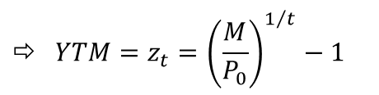


Zero yield curve
Definitions
A zero-coupon bond is a bond that makes no coupon payment and the only cash flow is the price paid and the principal amount received at maturity
$$M$$
1 | 2 | . . . | T
$$P_{0}$$
A zero yield curve is the yield curve which is constructed from yields of zero-coupon bonds
Properties of zero-coupon bonds
Zero-coupon bonds have convenient analytical properties and do not suffer from reinvestment risk
$$P_{0}=\frac{M}{{\left(1+YTM\right)}^{t}}$$
$$⇨ YTM=z_{t}={\left(\frac{M}{P_{0}}\right)}^{1/t}−1$$
$z_{t}…t$-year zero rate
Incomplete structure of zero-coupon bonds needed for the construction of zero yield curve can be solved by bootstrapping or cash flow matching
Ambiguous correspondence between the market returns and extracted zero rate yields: different sets of bonds with the same YTM may generate different zero yield curves

Slide 4








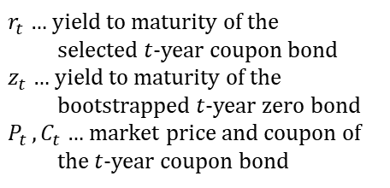


Bootstrapping
Bondstripping (unbundling)
Technique of financial engineering that breaks down a coupon-bearing bond into a set of zero-coupon bonds with the same combined cash flow
Coupon bond
$$C_{1}$$
$$C_{2}$$
• • •
$$C_{T}$$
$$M$$
Zero bonds
$$C_{1}$$
$$C_{2}$$
• • •
$$C_{T}$$
$$M$$
Indifference between the two identical cash flows received at the same point in time
Identical present values for identical cash flows
The process works iteratively from the lowest to the highest maturities
$$P_{1}=\frac{M}{\left(1+r_{1}\right)}=\frac{M}{(1+z_{1})}$$
$r_{t}$ … yield to maturity of the
selected $t$-year coupon bond
$z_{t}$ … yield to maturity of the bootstrapped $t$-year zero bond
$P_{t }, C_{t}$ … market price and coupon of the $t$-year coupon bond
$$P_{2}=\frac{C_{2}}{{\left(1+r_{2}\right)}^{1}}+\frac{C_{2}+M}{{\left(1+r_{2}\right)}^{2}}=\frac{C_{2}}{{\left(1+z_{1}\right)}^{1}}+\frac{C_{2}+M}{{\left(1+z_{2}\right)}^{2}}$$
$$P_{3}=\frac{C_{3}}{{\left(1+r_{3}\right)}^{1}}+\frac{C_{3}}{{\left(1+r_{3}\right)}^{2}}+\frac{C_{3}+M}{{\left(1+r_{3}\right)}^{3}}=\frac{C_{3}}{{\left(1+z_{1}\right)}^{1}}+\frac{C_{3}}{{\left(1+z_{2}\right)}^{2}}+\frac{C_{3}+M}{{\left(1+z_{3}\right)}^{3}}$$

Slide 5
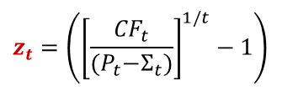
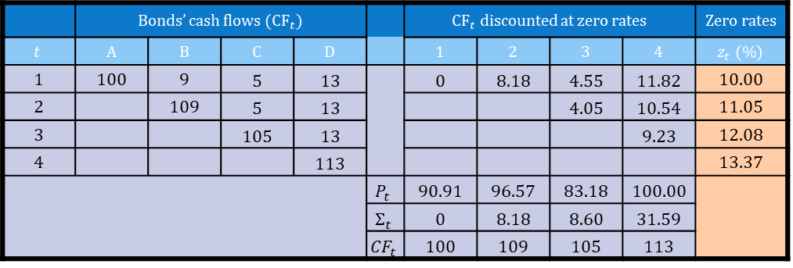
Bootstrapping – example
Set of coupon bonds
$$P_{t}=M×\sum_{τ=1}^{t−1}{\frac{c}{{\left(1+r_{t}\right)}^{τ}}+\frac{cM+M}{{\left(1+r_{t}\right)}^{t}}}$$
Bond | $$Maturity$$ | Face value | Coupon | YTM | Price
 | $$t (\text{years})$$ | $$M (€)$$ | $$c (\%)$$ | $$r_{t} (\%)$$ | $$P_{t} (€)$$
A | 1 | 100 | 0 | 10.00 | 90.91
B | 2 | 100 | 9 | 11.00 | 96.57
C | 3 | 100 | 5 | 12.00 | 83.18
D | 4 | 100 | 13 | 13.00 | 100.00
$$P_{t}=M×\sum_{τ=1}^{t−1}{\frac{c}{{\left(1+z_{τ}\right)}^{τ}}+\frac{{CF}_{t}}{{\left(1+z_{t}\right)}^{t}}}$$
$$=Σ_{t}+\frac{{CF}_{t}}{{\left(1+z_{t}\right)}^{t}}$$
$$z_{t}=\left({\left[\frac{{CF}_{t}}{{(P}_{t}−Σ_{t})}\right]}^{1/t}−1\right)$$
Bootstrapping table
Bootstrapping proceeds from the lowest to the highest maturity
 | Bonds’ cash flows (${\text{CF}}_{t}$) | Face value | Coupon | YTM |  | ${\text{CF}}_{t}$ discounted at zero rates | ${\text{CF}}_{t}$ discounted at zero rates |  |  | Zero rates
$$t$$ | A | B | C | D |  | 1 | 2 | 3 | 4 | $$z_{t} (\%)$$
1 | 100 | 9 | 5 | 13 |  | 0 | 8.18 | 4.55 | 11.82 | 10.00
2 |  | 109 | 5 | 13 |  |  |  | 4.05 | 10.54 | 11.05
3 |  |  | 105 | 13 |  |  |  |  | 9.23 | 12.08
4 |  |  |  | 113 |  |  |  |  |  | 13.37
 |  |  |  |  | $$P_{t}$$ | 90.91 | 96.57 | 83.18 | 100.00
 |  |  |  |  | $$Σ_{t}$$ | 0 | 8.18 | 8.60 | 31.59
 |  |  |  |  | $${CF}_{t}$$ | 100 | 109 | 105 | 113
Analysis of yield curve
5

Slide 6
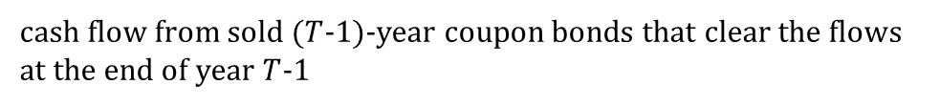


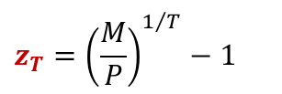

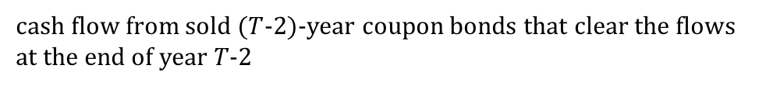
Cash flow matching
Synthetic security
A bundle of securities whose combined cash flow is the same as the cash flow of the imitated security
Synthetic zero bond is a set of coupon bonds whose combined cash flow is identical to the cash flow of the zero-coupon bond
Assembling a zero-coupon bond
$$M$$
$$z_{T}={\left(\frac{M}{P}\right)}^{1/T}−1$$
1 | 2 | 3 |  | T-2 | T-1 | T
$$P$$
cash flow from purchased $T$-year coupon bond
cash flow from sold ($T$-1)-year coupon bonds that clear the flows at the end of year $T$-1
cash flow from sold ($T$-2)-year coupon bonds that clear the flows at the end of year 𝑇-2

Slide 7


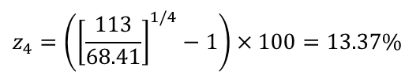
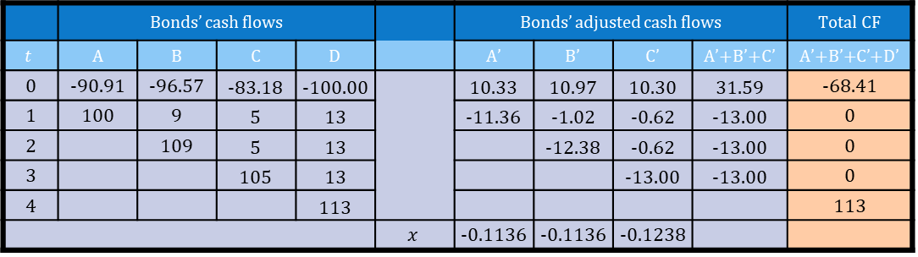
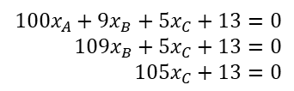
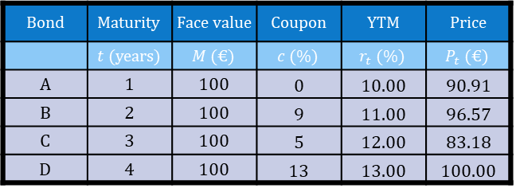
Cash flow matching – example
Set of coupon bonds
Bond | $$Maturity$$ | Face value | Coupon | YTM | Price
 | $$t (\text{years})$$ | $$M (€)$$ | $$c (\%)$$ | $$r_{t} (\%)$$ | $$P_{t} (€)$$
A | 1 | 100 | 0 | 10.00 | 90.91
B | 2 | 100 | 9 | 11.00 | 96.57
C | 3 | 100 | 5 | 12.00 | 83.18
D | 4 | 100 | 13 | 13.00 | 100.00
Calculation of four-year zero rate
$${100x}_{A}+9x_{B}+5x_{C}+13=0$$
$${109x}_{B}+5x_{C}+13=0$$
$$105x_{C}+13=0$$
Math. functions
→ MINVERSE
→ MMULT
$$\left[\begin{matrix}x_{A} & x_{B} & x_{C}\end{matrix}\right]={\left[\begin{matrix}−13 & −13 & −13\end{matrix}\right]\left[\begin{matrix}100 & 0 & 0 \\ 9 & 109 & 0 \\ 5 & 5 & 105\end{matrix}\right]}^{−1}$$
CFM table
 | Bonds’ cash flows | Face value | Coupon | YTM |  | Bonds’ adjusted cash flows | ${\text{CF}}_{t}$ discounted at zero rates |  |  | Total CF
$$t$$ | A | B | C | D |  | A’ | B’ | C’ | A’+B’+C’ | $\text{A}\text{’+}\text{B}\text{’+}\text{C}\text{’}$+D’
0 | -90.91 | -96.57 | -83.18 | -100.00 |  | 10.33 | 10.97 | 10.30 | 31.59 | -68.41
1 | 100 | 9 | 5 | 13 |  | -11.36 | -1.02 | -0.62 | -13.00 | 0
2 |  | 109 | 5 | 13 |  |  | -12.38 | -0.62 | -13.00 | 0
3 |  |  | 105 | 13 |  |  |  | -13.00 | -13.00 | 0
4 |  |  |  | 113 |  |  |  |  |  | 113
 |  |  |  |  | $$x$$ | -0.1136 | -0.1136 | -0.1238
$$z_{4}=\left({\left[\frac{113}{68.41}\right]}^{1/4}−1\right)×100=13.37\%$$
Analysis of yield curve
7

Slide 8









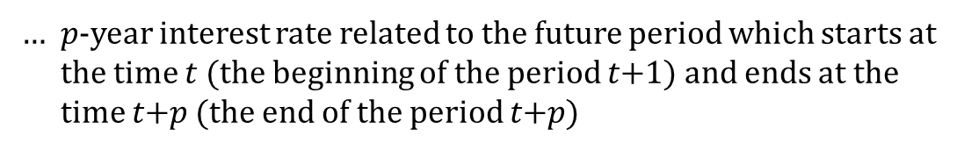





Forward rates
Definitions
A spot interest rate is the rate charged for immediate borrowing and lending
A forward interest rate (forward-forward) is the rate agreed upon now for future borrowing and lending
$$0$$
$$1$$
$$2$$
$$\text{t}$$
$$\text{t}\text{+1}$$
$$\text{t}\text{+}\text{p}$$
$$\text{T}\text{−1}$$
$$\text{T}$$
1 | 2 | . . . | t+1 | . . . | t+p | . . . | T
1 | 2 | . . . | t+1 | . . . | t+p | . . . | T
$${}_{t}^{ }{f_{t+p}}$$
… $p$-year interest rate related to the future period which starts at the time $t$ (the beginning of the period $t\text{+}1$) and ends at the time $t\text{+}p$ (the end of the period $t\text{+}p$)
Do not confuse forward rates with future spot rates
$$z_{p}^{t}$$
… $p$-year zero rate that will exist at the time $t$
Spot rates can be seen as a special case of forward rates
$$z_{p}=z_{p}^{0}={}_{0}^{ }{f_{p}}$$
Forward yield curves
${}_{1}^{ }{f_{2}^{ }}$,${}_{1}^{ }{f_{3}^{ }},{}_{1}^{ }{f_{4}^{ }}$
… forward yield curve expected in one year’s time
${}_{2}^{ }{f_{3}^{ }}$,${}_{2}^{ }{f_{4}^{ }},{}_{2}^{ }{f_{5}^{ }}$
… forward yield curve expected in two years’ time

Slide 9
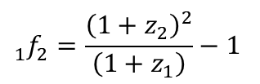

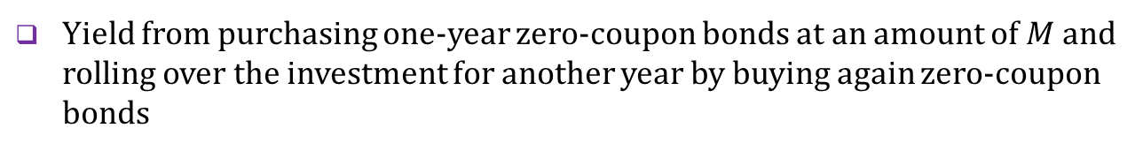
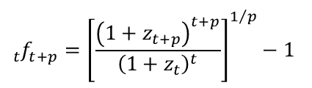

Implied forward rates
Definition
Implied forward zero rates are forward rates that are consistent with the observed spot zero yield curve in efficient financial markets
Derivation
Yield from purchasing two-year zero-coupon bonds at an amount of $M$
${M×\left(1+z_{2}\right)}^{2}$
Yield from purchasing one-year zero-coupon bonds at an amount of $M$ and rolling over the investment for another year by buying again zero-coupon bonds
$M×\left(1+z_{1}\right)×\left(1+{}_{1}^{ }{f_{2}^{ }}\right)$
Consistency condition
$${}_{1}^{ }{f_{2}^{ }=\frac{{\left(1+z_{2}\right)}^{2}}{\left(1+z_{1}\right)}−1}$$
General formula
$${\left(1+z_{t+p}\right)}^{t+p}={\left(1+z_{t}\right)}^{t}×{\left(1+{}_{t}^{ }{f_{t+p}^{ }}\right)}^{p}$$
$${}_{t}^{ }{f_{t+p}^{ }={\left[\frac{{\left(1+z_{t+p}\right)}^{t+p}}{{\left(1+z_{t}\right)}^{t}}\right]}^{1/p}−1}$$

Slide 10






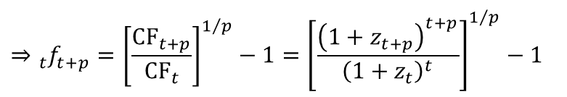







Synthetic forward rates
Definition
A synthetic zero forward rate is a forward rate that is locked in appropriate combinations of borrowing and lending at zero spot rates
issuance of ($t\text{+}p$)-year zero bonds (CF₀)
redemption of $t$-year zero bonds (CF_{t})
1 | 2 | . . . | t | . . . | t+p | . . .
purchase of $t$-year zero bonds (CF₀)
redemption of ($t\text{+}p$)-year zero bonds (CF_{t+p})
Derivation
$t$-year zero bonds
($t\text{+}p$)-year zero bonds
Net cash flows
time 0:
$${\text{CF}}_{0}−{\text{CF}}_{0}=0$$
time $t$:
$${{\text{CF}}_{t}={\text{CF}}_{0}×\left(1+z_{t}\right)}^{t}$$
time $t\text{+}p$:
$${{\text{CF}}_{t+p}={\text{CF}}_{0}×\left(1+z_{t+p}\right)}^{t+p}$$
Locked-in $p$-year forward zero rate
$$⇒{}_{t}^{ }{f_{t+p}^{ }={{\left[\frac{{\text{CF}}_{t+p}}{{\text{CF}}_{t}}\right]}^{1/p}−1=\left[\frac{{\left(1+z_{t+p}\right)}^{t+p}}{{\left(1+z_{t}\right)}^{t}}\right]}^{1/p}−1}$$
$${CF}_{t}×{\left(1+{}_{t}^{ }{f_{t+p}^{ }}\right)}^{p}={CF}_{t+p}$$

Slide 11


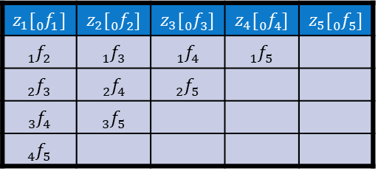
Properties of implied forward rates
Waning property
The more distant the time location of the forward yield curve, the shorter its range of values
$$z_{1}[{}_{0}^{ }{f_{1}^{ }]}$$ | $$z_{2}[{}_{0}^{ }{f_{2}^{ }]}$$ | $$z_{3}[{}_{0}^{ }{f_{3}^{ }]}$$ | $$z_{4}[{}_{0}^{ }{f_{4}^{ }]}$$ | $$z_{5}[{}_{0}^{ }{f_{5}^{ }]}$$
$${}_{1}^{ }{f_{2}^{ }}$$ | $${}_{1}^{ }{f_{3}^{ }}$$ | $${}_{1}^{ }{f_{4}^{ }}$$ | $${}_{1}^{ }{f_{5}^{ }}$$
$${}_{2}^{ }{f_{3}^{ }}$$ | $${}_{2}^{ }{f_{4}^{ }}$$ | $${}_{2}^{ }{f_{5}^{ }}$$
$${}_{3}^{ }{f_{4}^{ }}$$ | $${}_{3}^{ }{f_{5}^{ }}$$
$${}_{4}^{ }{f_{5}^{ }}$$
Position property
Upward sloping zero yield curve is below all forward yield curves
$z_{t}<z_{t+p}$⇨ $z_{p}<{}_{t}^{ }{f_{t+p}^{ }} (\text{for} \text{all} t \text{and} p)$
Downward sloping zero yield curve is above all forward yield curves
$z_{t}>z_{t+p}$⇨ $z_{p}>{}_{t}^{ }{f_{t+p}^{ }} (\text{for} \text{all} t \text{and} p)$
Expectation hypothesis
Implied forward rates are the best indicator of expected future interest rates
Current spot rates may change under the pressure of changing expectations
Analysis of yield curve
11

Slide 12









Pricing of floaters
Definition
A floating rate note (FRN, floater) is a type of bond whose coupon rate is fixed for a given period by reference to some short-term market interest rate and reset periodically on the coupon reset dates
Par property
Fair price of a floater based on the expectation hypothesis
$$P_{FRN}=\frac{z_{1}M}{\left(1+z_{1}\right)}+\frac{{}_{1}^{ }{f_{2}^{ }}M}{{\left(1+z_{2}\right)}^{2}}+\frac{{}_{2}^{ }{f_{3}^{ }}M}{{\left(1+z_{3}\right)}^{3}}+. . . +\frac{{}_{T−1}^{ }{f_{T}^{ }}M}{{\left(1+z_{T}\right)}^{T}}+\frac{M}{{\left(1+z_{T}\right)}^{T}}$$
$$=\frac{z_{1}M}{\left(1+z_{1}\right)}+\frac{M}{{\left(1+z_{2}\right)}^{2}}\left[\frac{{\left(1+z_{2}\right)}^{2}}{\left(1+z_{1}\right)}−1\right]+. . . +\frac{M}{{\left(1+z_{T}\right)}^{T}}\left[\frac{{\left(1+z_{T}\right)}^{T}}{{\left(1+z_{T−1}\right)}^{T−1}}−1\right]+\frac{M}{{\left(1+z_{T}\right)}^{T}}=M$$
Synthetic floater
Cash flow from a floater is equivalent to investing in a short-term money market instrument and reinvesting the principal on a rolling basis
$$M(1+z_{1}^{0})$$
$$M(1+z_{1}^{t−1})$$
$$M(1+z_{1}^{T−1})$$
1 | 2 | . . . | t | . . . | T
$$P_{0}=M$$
$$M$$
$$M$$
$$P_{T−1}=\frac{M(1+z_{1}^{T−1})}{1+z_{1}^{T−1}}=M,$$
$$P_{T−2}=\frac{P_{T−1}+Mz_{1}^{T−2}}{1+z_{1}^{T−2}}=\frac{M(1+z_{1}^{T−2})}{1+z_{1}^{T−2}}=M,$$
$$.. . , P_{0}=\frac{P_{1}+Mz_{1}^{0}}{1+z_{1}^{0}}=M$$

Slide 13
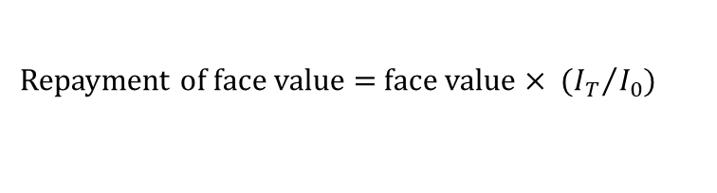
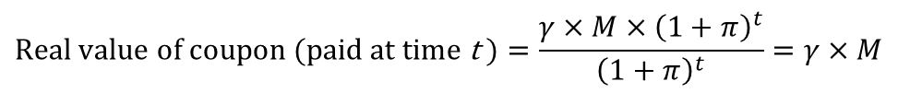
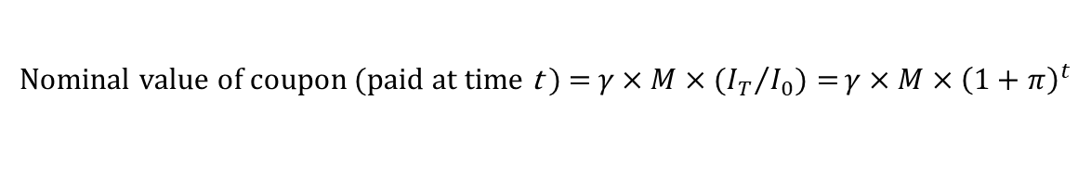
Inflation-linked bond (1)
Definition
Inflation-linked (inflation-indexed) bonds are bonds whose coupons and principal take into account the evolution of a particular price index with the aim to provide protection against inflation
Nominal value of coupon (paid at time t ) = ${{γ×M×(I}_{T}}/{I_{0})=}γ×M×{\left(1+π\right)}^{t}$
$γ$… real coupon rate, $π$… annual rate of inflation, $I_{t}$… price index
$$\text{Real} \text{value} \text{of} \text{coupon}\text{ (}\text{paid} \text{at} \text{time} \text{t}\text{ )}=\frac{γ×M×{\left(1+π\right)}^{t}}{{\left(1+π\right)}^{t}}=γ×M$$
Repayment of face value = face value × ${{ (I}_{T}}/{I_{0})}$
Imperfect protection against inflation
Weighted composition of price index does not coincide with the collection of goods by investors who want to be protected against price changes
Use of outdated price index as a result of:
Statistical data processing (delay up to 2 months)
Fixing the value of the price index at the beginning of the coupon period because of the accrued interest (delay up to 6 months)

Slide 14






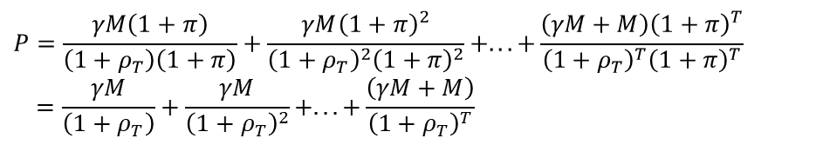

Inflation-linked bond (2)
Nominal and real yield to maturity
Nominal (money) YTM for $T$-year inflation-linked bond
$$P=\frac{γM\left(1+π\right)}{\left(1+r_{T}\right)}+\frac{γM{\left(1+π\right)}^{2}}{{\left(1+r_{T}\right)}^{2}}+. . . +\frac{\left(γM+M\right){\left(1+π\right)}^{T}}{{\left(1+r_{T}\right)}^{T}}$$
$r_{T}$ … $T$-year nominal yield to maturity
Real YTM for $T$-year inflation-linked bond
Fisher equation
$$\left(1+r\right)=\left(1+ρ\right)×\left(1+π\right)$$
$$r\dot{=}ρ+π$$
$${⇨ρ}_{T}=\frac{1+r_{T}}{1+π}$$
$ρ_{T}$ … $T$-year real yield to maturity
$$P=\frac{γM\left(1+π\right)}{\left(1+ρ_{T}\right)\left(1+π\right)}+\frac{γM{\left(1+π\right)}^{2}}{{\left(1+ρ_{T}\right)}^{2}{\left(1+π\right)}^{2}}+. . . +\frac{\left(γM+M\right){\left(1+π\right)}^{T}}{{\left(1+ρ_{T}\right)}^{T}{\left(1+π\right)}^{T}}$$
$$=\frac{γM}{\left(1+ρ_{T}\right)}+\frac{γM}{{\left(1+ρ_{T}\right)}^{2}}+. . . +\frac{\left(γM+M\right)}{{\left(1+ρ_{T}\right)}^{T}}$$
Break-even inflation
Break-even inflation makes the expected yield on an inflation-linked bond equal to the yield on a conventional bond of the same maturity
Break-even inflation can be found using the Fisher equation
$$\left[π_{BE}=\frac{1+r_{T}}{1+ρ_{T}}−1\right]$$
Break-even inflation makes observable expected inflation
expected inflation is higher than BE inflation
⇨ investors prefer IL bonds over conventional ones
⇨ price of IL bonds goes up
⇨ real yield on IL bonds declines
⇨ BE inflation increases
⇨ adjustment process ends when BE inflation equals expected inflation

Slide 15













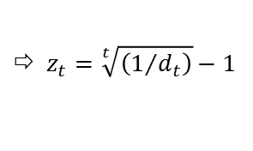
Par yield curve
Definition
Par yield curve is a plot of yields to maturity for bonds priced at par
Par yields are equal to coupon rates for par bonds
$$P_{0}=\frac{r_{T}M}{\left(1+r_{T}\right)}+\frac{r_{T}M}{{\left(1+r_{T}\right)}^{2}}+ …+\frac{r_{T}M+M}{{\left(1+r_{T}\right)}^{T}}=M$$
$r_{T}$ … coupon rate of $T$-year par bond
Par yields are used to determine the required coupon on new bonds that are to be issued at par
Consistency between par yield and zero yield curves
$$M=\frac{r_{T}M}{\left(1+z_{1}\right)}+\frac{r_{T}M}{{\left(1+z_{2}\right)}^{2}}+ …+\frac{r_{T}M+M}{{\left(1+z_{T}\right)}^{T}}$$
$d_{t}$ … $t$-year discount factor
$$d_{t}=\frac{1}{{\left(1+z_{t}\right)}^{t}}$$
$${\text{⇨} z}_{t}=\sqrt[t]{\left(1/{d_{t}}\right)}−1$$
$=r_{T}M×d_{1}+r_{T}M×d_{2}+…+r_{T}M×d_{T}+M×d_{T}$
$$r_{1}=\frac{1−d_{1}}{d_{1}}$$
$${, r}_{2}=\frac{1−d_{2}}{d_{1}+d_{2}}$$
$${, …, r}_{T}=\frac{1−d_{T}}{d_{1}+d_{2}+…+d_{T}}$$
$$d_{1}=\frac{1}{{1+r}_{1}}$$
$$,d_{2}=\frac{1−r_{2}×d_{1}}{{1+r}_{2}}$$
$${,…, d}_{t}=\frac{1−r_{t}×\left(d_{1}+d_{2}+…+d_{t−1}\right)}{{1+r}_{t}}$$
Position property
Upward sloping zero yield curve
$${\text{⇨} r}_{1}=z_{1},{ r}_{t}<z_{t } \text{for} t=2,…,T$$
Downward sloping zero yield curve
$${\text{⇨} r}_{1}=z_{1},{ r}_{t}>z_{t } \text{for} t=2,…,T$$

Slide 16





See you in the next lecture
© O.D. Lecturing Legacy
dedekold@gmail.com
Visit dedeklegacy.cz or TALKING SLIDES for the animated version of this presentation
(with English narrations and English/Czech subtitles)

Slide 17
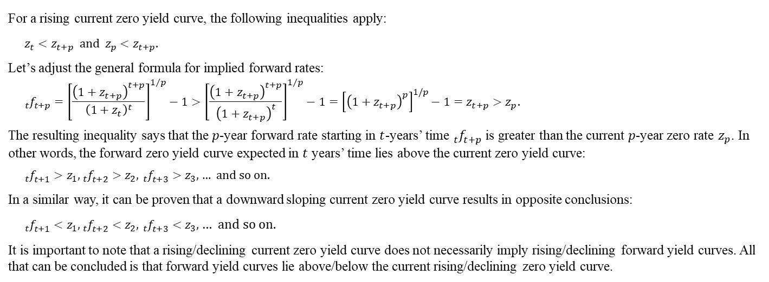
Math note – position property of zero yield curves
For a rising current zero yield curve, the following inequalities apply:
$$z_{t}<z_{t+p} \text{and} z_{p}<z_{t+p}.$$
Let’s adjust the general formula for implied forward rates:
$${}_{t}^{ }{f_{t+p}^{ }={\left[\frac{{\left(1+z_{t+p}\right)}^{t+p}}{{\left(1+z_{t}\right)}^{t}}\right]}^{1/p}−1}>{\left[\frac{{\left(1+z_{t+p}\right)}^{t+p}}{{\left(1+z_{t+p}\right)}^{t}}\right]}^{1/p}−1={\left[{\left(1+z_{t+p}\right)}^{p}\right]}^{1/p}−1=z_{t+p}>z_{p}.$$
The resulting inequality says that the $p$-year forward rate starting in $t$-years’ time ${}_{t}^{ }{f_{t+p}^{ }}$is greater than the current $p$-year zero rate $z_{p}$. In other words, the forward zero yield curve expected in $t$ years’ time lies above the current zero yield curve:
${}_{t}^{ }{f_{t+1}^{ }>z_{1},{}_{t}^{ }{f_{t+2}^{ }>z_{2},}}$ ${}_{t}^{ }{f_{t+3}^{ }>z_{3},}$ … and so on.
In a similar way, it can be proven that a downward sloping current zero yield curve results in opposite conclusions:
${}_{t}^{ }{f_{t+1}^{ }<z_{1},{}_{t}^{ }{f_{t+2}^{ }<z_{2},}}$ ${}_{t}^{ }{f_{t+3}^{ }<z_{3},}$ … and so on.
It is important to note that a rising/declining current zero yield curve does not necessarily imply rising/declining forward yield curves. All that can be concluded is that forward yield curves lie above/below the current rising/declining zero yield curve.

Slide 18
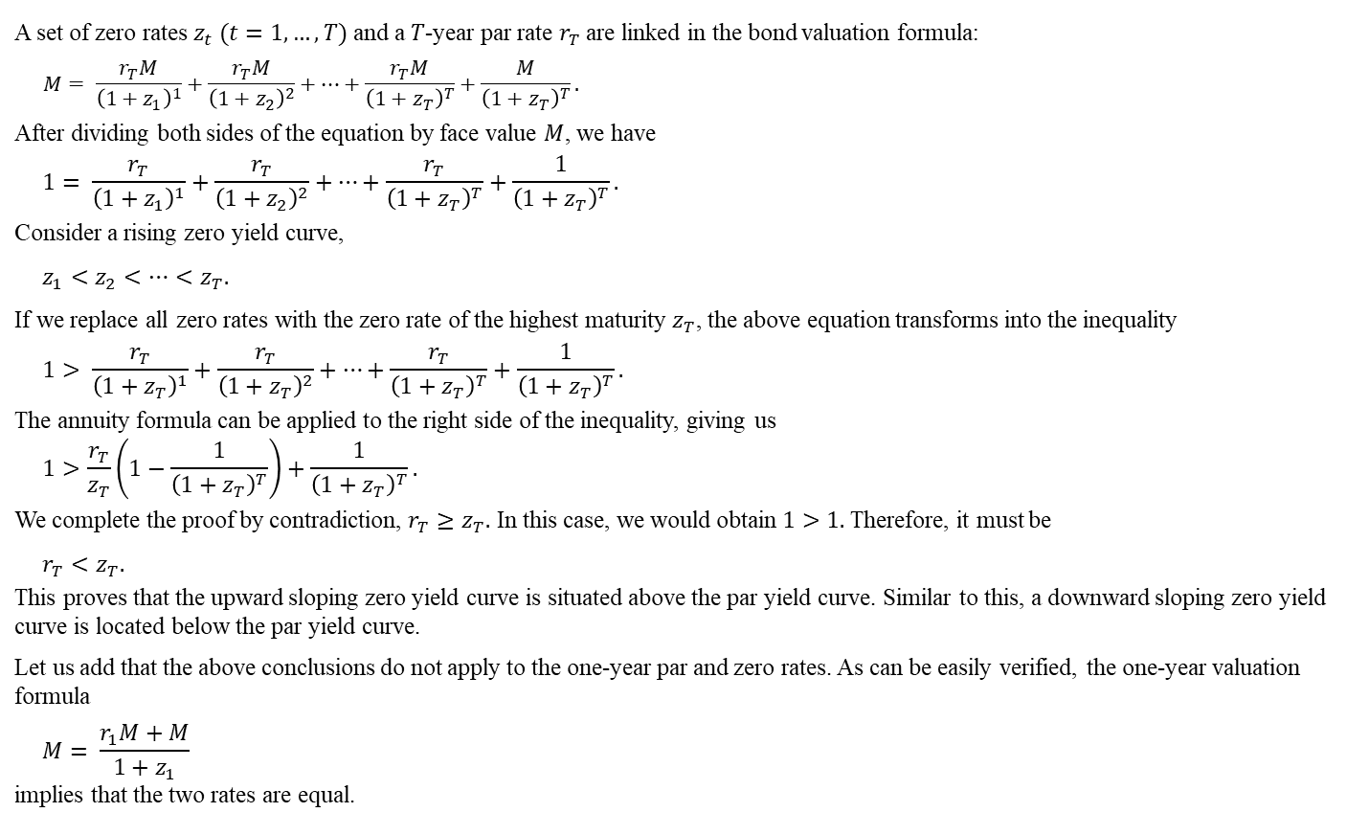
Math note – position property of par yield curve
A set of zero rates $z_{t} (t=1,…,T)$ and a $T$-year par rate $r_{T}$are linked in the bond valuation formula:
$$M= \frac{r_{T}M}{{\left(1+z_{1}\right)}^{1}}+\frac{r_{T}M}{{\left(1+z_{2}\right)}^{2}}+…+\frac{r_{T}M}{{\left(1+z_{T}\right)}^{T}}+\frac{M}{{\left(1+z_{T}\right)}^{T}}.$$
After dividing both sides of the equation by face value $M$, we have
$$1= \frac{r_{T}}{{\left(1+z_{1}\right)}^{1}}+\frac{r_{T}}{{\left(1+z_{2}\right)}^{2}}+…+\frac{r_{T}}{{\left(1+z_{T}\right)}^{T}}+\frac{1}{{\left(1+z_{T}\right)}^{T}}.$$
Consider a rising zero yield curve,
$$z_{1}<z_{2}<…<z_{T}.$$
If we replace all zero rates with the zero rate of the highest maturity$z_{T}$, the above equation transforms into the inequality
$$1> \frac{r_{T}}{{\left(1+z_{T}\right)}^{1}}+\frac{r_{T}}{{\left(1+z_{T}\right)}^{2}}+…+\frac{r_{T}}{{\left(1+z_{T}\right)}^{T}}+\frac{1}{{\left(1+z_{T}\right)}^{T}}.$$
The annuity formula can be applied to the right side of the inequality, giving us
$$1>\frac{r_{T}}{z_{T}}\left(1−\frac{1}{{\left(1+z_{T}\right)}^{T}}\right)+\frac{1}{{\left(1+z_{T}\right)}^{T}}.$$
We complete the proof by contradiction, $r_{T}≥z_{T}.$ In this case, we would obtain $1>1.$ Therefore, it must be
$$r_{T}<z_{T}.$$
This proves that the upward sloping zero yield curve is situated above the par yield curve. Similar to this, a downward sloping zero yield curve is located below the par yield curve.
Let us add that the above conclusions do not apply to the one-year par and zero rates. As can be easily verified, the one-year valuation formula
$$M= \frac{r_{1}M+M}{1+z_{1}}$$
implies that the two rates are equal.

Slide 19

Footnotes
Inverted yield curve – early warning of recession.
The yield curve is inverted when short-term bonds have higher yields than long-term bonds.
Inverted yield curves don't happen often, but when they do, they have been followed by recessions in the United States, not always, but most of the time. They have preceded recessions by several months to a few years, making them a valuable tool for predicting economic downturns.
How it works:
Concerns about a negative near-term economic outlook shift demand from short-term to long-term bonds, as investors seek safety. The rush to long-term bonds drives their prices up and yields down.
The move away from short-term bonds is fueled by expectations of central bank rate cuts in response to a gloomy outlook. Short-term yields are rising.
Negative sentiment leads individuals and businesses to be more cautious about spending and investment, which may further accelerate the onset of a recession. An illustrative example of a self-fulfilling prophecy.

