Slide 1

Measuring market and credit risk
Institute of Economic Studies
Faculty of Social Sciences
Charles University in Prague
Financial markets instruments

Slide 2
Investment risks from holding bonds
Interest rate risk
Interest rate risk (market risk, price risk) is the risk of a change in the bond’s price as a result of a change in the market yields
price
By changing its price the bond adjusts to prevailing yields of competing investment instruments
yield
This risk is not relevant for investors who hold the bond to maturity
Credit risk
Credit risk is the risk of a change in the bond’s price associated with the occurrence of a credit event
Credit events
Default: inability of the issuer of the bond to honour its contractual obligations (payments of coupons and/or principal)
Downgrade: a cut in rating by rating agencies based on deteriorating earning capacity to honour obligations from the bond
Flight to quality: liquidation of bond holdings due to wider economic factors (worsened macroeconomic outlook, danger of political instability, imminent financial turbulence, contagion and others)

Slide 3
Other risks associated with bonds
Reinvestment risk
The risk that coupons of the bond will have to be reinvested at a lower interest rate than the rate that existed when the bond was purchased
Lower reinvestment rates reduce the yield to maturity
The risk is less urgent for floaters and irrelevant for zero-coupon bonds
Inflation risk
The risk that purchasing power of coupons and principal received in the future will be eroded by a higher inflation than initially expected
The risk is less relevant for inflation-linked bonds
Liquidity (marketability) risk
The risk that the ease of trading the bond near the prevailing market price will be impaired
The higher the liquidity risk the wider the bid-ask spread quoted by bond dealers
Call risk
The risk that the issuer will retire the bond before the maturity by exercising the call provision in the callable bond contract

Slide 4
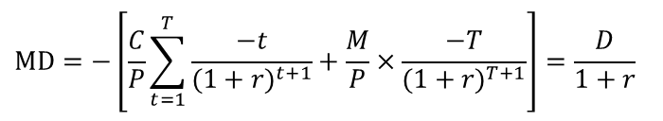
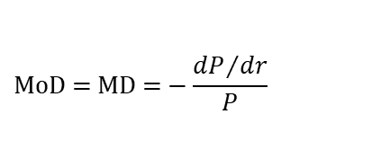

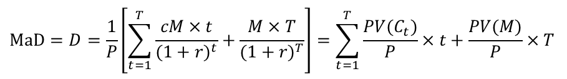

Duration
Macaulay duration (MaD, D)
Weighted average of the times in which the cash flow from the bond is received
$$\text{MaD}=D=\frac{1}{P}\left[\sum_{t=1}^{T}{\frac{cM×t}{{(1+r)}^{t}}}+\frac{M×T}{{(1+r)}^{T}}\right]=\sum_{t=1}^{T}{\frac{PV(C_{t})}{P}}×t+\frac{PV(M)}{P}×T$$
Closed-form formula
$$D=\frac{M}{P}×\left[c×\frac{{(1+r)}^{T+1}−\left(1+r\right)−rT}{r^{2}{(1+r)}^{T}}+\frac{T}{{(1+r)}^{T}}\right]$$
Modified duration (MoD, MD)
Change in the bond price with respect to the change in the yield relative to the bond price
$$\text{MoD}\text{ = }\text{MD}\text{ =}−\frac{{dP}/{dr}}{P}$$
Relationship between D and MD
$$\text{MD}=−\left[\frac{C}{P}\sum_{t=1}^{T}{\frac{−t}{{(1+r)}^{t+1}}}+\frac{M}{P}×\frac{−T}{{(1+r)}^{T+1}}\right]=\frac{D}{1+r}$$
$$D=(1+r)×\text{MD}$$
D and MD are measured using different units (a time interval in D versus percentages in MD)

Slide 5


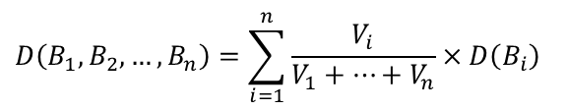

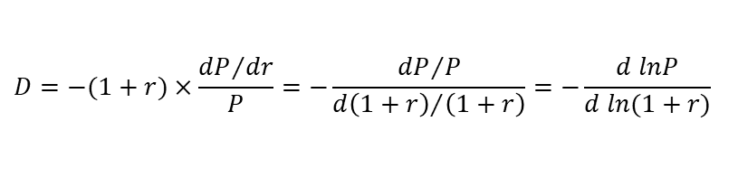


Properties of duration
Measure of interest rate risk
First order approximation of a change in the bond’s price
$$∆P\dot{=}\frac{dP}{dr}∆r=\left(\frac{−P×D}{\left(1+r\right)}\right)×∆r=−P×\frac{D}{\left(1+r\right)}×∆r=−P×MD×∆r$$
ln $P$
Graphical representation of Macaulay duration
$$D=−(1+r)×\frac{{dP}/{dr}}{P}=−\frac{{dP}/P}{{d\left(1+r\right)}/{\left(1+r\right)}}=−\frac{d lnP}{d ln(1+r)}$$
Limiting value
$$[dr=d\left(1+r\right)]$$
D
$$ln⁡(1+r)$$
Duration is always less than (or equal to) maturity
$$D≤T$$
Duration is equal to maturity for zero-coupon bonds
Portfolio duration
Duration of bond portfolio is equal to the weighted average of durations of individual bonds using relative market values of bonds as weights
$$D\left(B_{1},B_{2},…,B_{n}\right)=\sum_{i=1}^{n}{\frac{V_{i}}{V_{1}+…+V_{n}}×D\left(B_{i}\right)}$$
$V_{i} …$ value of bond $B_{i}$

Slide 6







Immunisation (1)
Economic context
 |  | . . . |  | . . . |  | . . .
$$0$$
$$1$$
$$2$$
$$\text{t}$$
$$\text{Sale}$$
$$\text{T}$$
$$\text{Duration}$$
Two effects of an interest rate increase from holding and selling a bond
Reinvestment effect: accumulated value of reinvested coupons will be greater
Price effect: market price of the bond (the sum of discounted values of remaining coupons and principal) will be smaller
Opposite effects when interest rates fall
Immunisation property
Immunisation refers to the offsetting effect between the two risks at a point of time which is equal to the bond’s duration
Interest rate increase ⇨ the gain on bond’s coupons reinvested at a higher interest rate is offset by a lower value of the bond’s selling price
Interest rate decline ⇨ the loss on bond’s coupons reinvested at a lower interest rate is offset by a higher value of the bond’s selling price

Slide 7




Immunisation (2)
Immunisation rule
Construction of a bond portfolio assuring given future value regardless of changes in interest rates
Market value of the bond portfolio is equal to the present value of a hedged liability
Duration of the bond portfolio is equal to the time horizon at the end of which the liability should be met
Limitations of the immunisation strategy
Restrictive assumption about a parallel shift of a horizontal yield curve just immediately after the immunised position was created
Protection only against small interest rate changes (duration is the first order approximation of interest rate changes)
years
$$T=D$$
Time decay: the passage of time reduces duration more slowly relative to the shortening of the hedging horizon
$$T<D$$
decay
end of hedging horizon
$T–$1
$$T$$

Slide 8
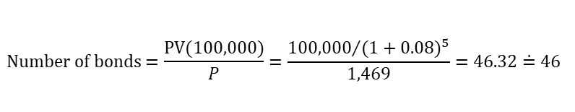









Immunisation – example
Initial information
Immunised liability: size €100,000, maturity 5 years, current yield 8%
Immunisation bond: face value €1,000, coupon 17%, maturity 7 years
Bond’s analysis
Time (t) | 1 | 2 | 3 | 4 | 5 | 6 | 7 | Total
Bond’s cash flow | 170¹⁾ | 170 | 170 | 170 | 170 | 170 | 1,170 | X
Price | 157²⁾ | 146 | 135 | 125 | 116 | 107 | 683 | 1,469
Duration | 0.11³⁾ | 0.20 | 0.28 | 0.34 | 0.39 | 0.44 | 3.25 | 5.01
$$1) 0.17×1,000$$
$$2) 170/{(1+0.08)}^{t}$$
$$3) (170/1,469)×t]/{(1+0.08)}^{t}$$
$$4) 170×46$$
$$5) 7,820×{(1+0.08)}^{(5−t)}$$
$$6) 7,820/{(1+0.08)}^{(7−t)}$$
$$\text{Number} \text{of} \text{bonds}=\frac{PV(100,000)}{P}=\frac{{100,000}/{{(1+0.08)}^{5}}}{1,469}=46.32\dot{=}46$$
Sensitivity analysis
 | Time | 1 | 2 | 3 | 4 | 5 | 6 | 7 | Total
Yield | Bonds’ cash flow | 7,820⁴⁾ | 7,820 | 7,820 | 7,820 | 7,820 | 7,820 | 53,820 | X
8 % | Reinvested coupons | 10,639⁵⁾ | 9,851 | 9,121 | 8,446 | 7,820 |  |  | 45,877
 | Selling price |  |  |  |  |  | 7,241⁶⁾ | 46,142 | 53,383
9 % | Reinvested coupons | 11,039 | 10,127 | 9,291 | 8,542 | 7,820 |  |  | 46,801
 | Selling price |  |  |  |  |  | 7,174 | 45,299 | 52,473
7 % | Reinvested coupons | 10,250 | 9,580 | 8,953 | 8,367 | 7,820 |  |  | 44,970
 | Selling price |  |  |  |  |  | 7,308 | 47,008 | 54,316
$$=€99,260$$
$$=€99,274$$
$$=€99,286$$

Slide 9



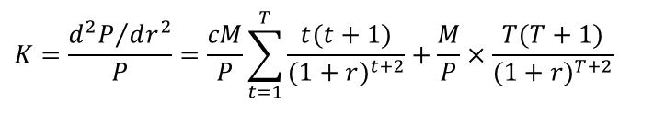

Convexity
Definition
Convexity is the second-order measure of interest rate risk
$$K=\frac{{d^{2}P}/{dr^{2}}}{P}=\frac{cM}{P}\sum_{t=1}^{T}{\frac{t(t+1)}{{(1+r)}^{t+2}}}+\frac{M}{P}×\frac{T(T+1)}{{(1+r)}^{T+2}}$$
Second order approximation of a change in the bond’s price (first two terms in Taylor expansion)
$$∆P\dot{=}\frac{dP}{dr}×∆r+\frac{1}{2}×\frac{d^{2}P}{{dr}^{2}}×∆r^{2}$$
$$\text{ln}P$$
$$∆P\dot{=}−P×\frac{D}{1+r}×∆r+\frac{1}{2}×P×K×∆r^{2}$$
duration term
convexity term
D
Attractiveness of convexity
$$ln⁡(1+r)$$
Between two bonds with equal prices, yields and durations a more convex bond will always perform better if the yield changes
In practice the green more convex bond should have a higher price and a lower yield than the red less convex bond

Slide 10





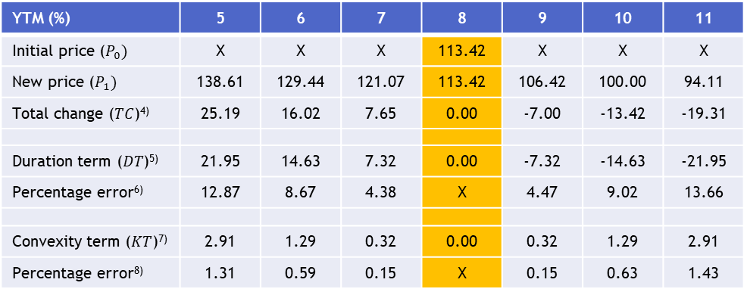

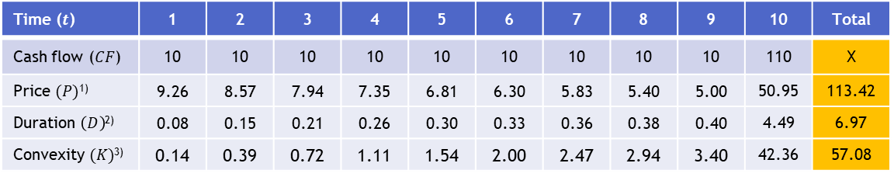


Convexity – example
Initial information
Properties of the bond: nominal value €100, coupon 10%, maturity 10 years, current yield 8%
Time ($t$) | 1 | 2 | 3 | 4 | 5 | 6 | 7 | 8 | 9 | 10 | Total
Cash flow ($CF$) | 10 | 10 | 10 | 10 | 10 | 10 | 10 | 10 | 10 | 110 | X
Price $(P)$¹⁾ | 9.26 | 8.57 | 7.94 | 7.35 | 6.81 | 6.30 | 5.83 | 5.40 | 5.00 | 50.95 | 113.42
Duration $\left(D\right)$²⁾ | 0.08 | 0.15 | 0.21 | 0.26 | 0.30 | 0.33 | 0.36 | 0.38 | 0.40 | 4.49 | 6.97
Convexity $(K)$³⁾ | 0.14 | 0.39 | 0.72 | 1.11 | 1.54 | 2.00 | 2.47 | 2.94 | 3.40 | 42.36 | 57.08
$$1) CF×\frac{1}{{(1+0.08)}^{t}}$$
$$2) \frac{CF}{P}×\frac{t}{{(1+0.08)}^{t}}$$
$$3) \frac{CF}{P}×\frac{t(t+1)}{{(1+0.08)}^{t+2}}$$
Approximation error
YTM (%) | 5 | 6 | 7 | 8 | 9 | 10 | 11
Initial price ($P_{0})$ | X | X | X | 113.42 | X | X | X
New price ($P_{1})$ | 138.61 | 129.44 | 121.07 | 113.42 | 106.42 | 100.00 | 94.11
Total change ($TC$)⁴⁾ | 25.19 | 16.02 | 7.65 | 0.00 | -7.00 | -13.42 | -19.31
Duration term ($DT$)⁵⁾ | 21.95 | 14.63 | 7.32 | 0.00 | -7.32 | -14.63 | -21.95
Percentage error⁶⁾ | 12.87 | 8.67 | 4.38 | X | 4.47 | 9.02 | 13.66
Convexity term ($KT$)⁷⁾ | 2.91 | 1.29 | 0.32 | 0.00 | 0.32 | 1.29 | 2.91
Percentage error⁸⁾ | 1.31 | 0.59 | 0.15 | X | 0.15 | 0.63 | 1.43
$$4) P_{1}−P_{0}$$
$$5) −P_{0}×\frac{D}{(1+0.08)}∆r$$
$$6) \left(1−DT/TC\right)×100$$
$$7) \frac{1}{2}×P_{0}×K×∆r^{2}$$
$$8) \left(1−(DT+KT)/TC\right)×100$$

Slide 11


Credit spread
Credit rating
An evaluation made by a credit rating agency based on the debtor's ability to pay back the debt and the likelihood of default
Rating agencies use their scales whose levels are denoted by special codes
Established rating systems
Moody’s: Aaa, Aa, A, Baa, Ba, B, Caa, Ca, C, Default
Standard & Poor’s: AAA, AA, A, BBB, BB, B, CCC, CC, C, Default
Jargon: investment grade, speculative grade, prime bond, junk bond
Credit spread
Excess of the yield of the risky bond over the yield of the risk-free bond
$z$: yields of zero-coupon risk-free bonds (for given maturities, extracted from risk-free coupon bonds)
$${z_{1}, z}_{2}, …,z_{T}$$
$ξ$: yields of zero-coupon bonds (for given maturities and credit ratings, extracted from risky coupon bonds)
$ξ_{1}^{X},ξ_{2}^{X}….,ξ_{T}^{X}$ X = AA, A, BBB, . . .
$φ$: credit spreads (for given maturities and credit ratings)
${φ_{1}^{X}=ξ}_{1}^{X}−z_{1}, {φ_{2}^{X}=ξ}_{2}^{X}−z_{2},…,{{ φ}_{T}^{X}=ξ}_{T}^{X}−z_{T}$ ($z_{t}=ξ_{t}^{AAA}$)
Measuring market and credit risk
11

Slide 12



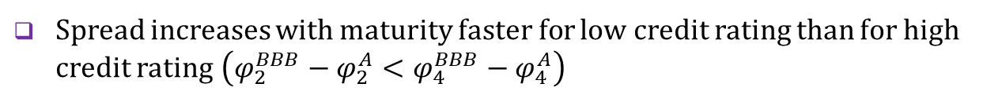
Credit yield curves
Zero yield curves for individual credit ratings
yield
BBB
$$φ_{4}^{BBB}$$
A
$$φ_{2}^{BBB}$$
$$φ_{4}^{A}$$
AA
AAA
1
2
3
4
T
maturity
Empirical patterns
Spread increases as the rating declines $\left(φ_{4}^{A}<φ_{4}^{BBB}\right)$
Spread increases with maturity $\left(φ_{2}^{BBB}<φ_{4}^{BBB}\right)$
Spread increases with maturity faster for low credit rating than for high credit rating $\left(φ_{2}^{BBB}−φ_{2}^{A}<φ_{4}^{BBB}−φ_{4}^{A}\right)$
Factors behind credit spreads
Compensation for possible losses from unfavourable credit events
Other factors may also influence the spread (liquidity, inflation risk, unforeseen bad scenarios etc.)

Slide 13


Risk-neutral probabilities of default (1)
Expected value
Expected value = Σ_{n} (probability of $n$-th outcome) × (value of $n$-th outcome)
Objective certainty: The law of large numbers ensures that the expected value is a sure event to take place if the risky game is repeated many times
Subjective certainty: The expected value of a one-off experiment is subjectively regarded as a sure event that will happen
Risk-neutral environment
Application of no-arbitrage condition to the risky environment: today’s price of the two investments, identical in the size of return and risk, must be the same
$$\frac{E(V) }{I}=1+r_{f}$$
Investments earning just the expected value (sure outcome) should generate risk-free returns
$$\frac{E(V) }{1+r_{f}}=I$$
The expected value of the investment when discounted at a risk-free rate of return should be equal to the current value of the investment
Risk-neutral probabilities are theoretical probabilities consistent with the risk-neutral environment (as opposed to empirical probabilities)

Slide 14
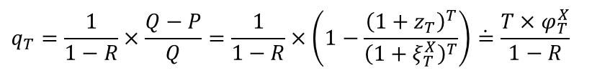
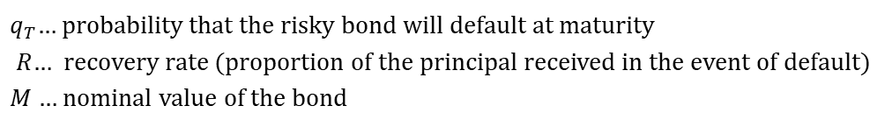





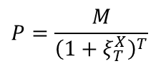
Risk-neutral probabilities of default (2)
Model description
Expected pay-off from the $T$-year zero-coupon bond at maturity
$$EV=q_{T}×R×M+\left(1−q_{T}\right)×M$$
$q_{T}\text{… }$probability that the risky bond will default at maturity
$R$… recovery rate (proportion of the principal received in the event of default)
$M$… nominal value of the bond
No arbitrage condition between two valuations of the bond
$$P=\frac{q_{T}×R×M+\left(1−q_{T}\right)×M}{{\left(1+z_{T}\right)}^{T}}$$
$$P=\frac{M}{{\left(1+ξ_{T}^{X}\right)}^{T}}$$
$P\text{… }$ price of risky bond
$$Q=\frac{M}{{\left(1+z_{T}\right)}^{T}}$$
$Q\text{… }$ price of risk-free bond
Probability that the bond defaults at its maturity
$$q_{T}=\frac{1}{1−R}×\frac{Q−P}{Q}=\frac{1}{1−R}×\left(1−\frac{{\left(1+z_{T}\right)}^{T}}{{\left(1+ξ_{T}^{X}\right)}^{T}}\right)\dot{=}\frac{T×φ_{T}^{X}}{1−R}$$

Slide 15
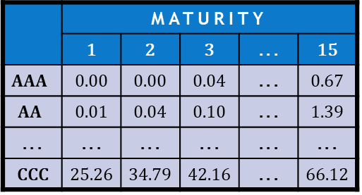
Historical probabilities of default
Empirical evidence
Rich historical data sets about bond defaults throughout their economic life
 | MATURITY
 | 1 | 2 | 3 | . . . | 15
$$AAA$$ | 0.00 | 0.00 | 0.04 | . . . | 0.67
$$AA$$ | 0.01 | 0.04 | 0.10 | . . . | 1.39
. . . | . . . | . . . | . . . | . . . | . . .
CCC | 25.26 | 34.79 | 42.16 | . . . | 66.12
Mortality table
Marginal mortality rate (MMR) is probability that a bond of a rating $X$ at its issuance will default in a given year of its life
MMRs are significantly lower than those derived from observed spreads because only a part of the spread can be associated with the default risk
Other analytical concepts
Survival rate (SR) is the probability that a bond of a rating $X$will not default in a given year of its life ⇨ ${\text{SR}}_{t}^{X}=1−{\text{MMR}}_{t}^{X}$
Cumulative mortality rate (CMR) is the probability that a bond of a rating $X$will default over a given period ⇨ ${\text{CMR}}_{t}^{X}={1−\text{SR}}_{1}^{X}×…×{\text{SR}}_{t}^{X}$

Slide 16

See you in the next lecture
© O.D. Lecturing Legacy
dedekold@gmail.com
Visit dedeklegacy.cz or TALKING SLIDES for the animated version of this presentation
(with English narrations and English/Czech subtitles)

Slide 17
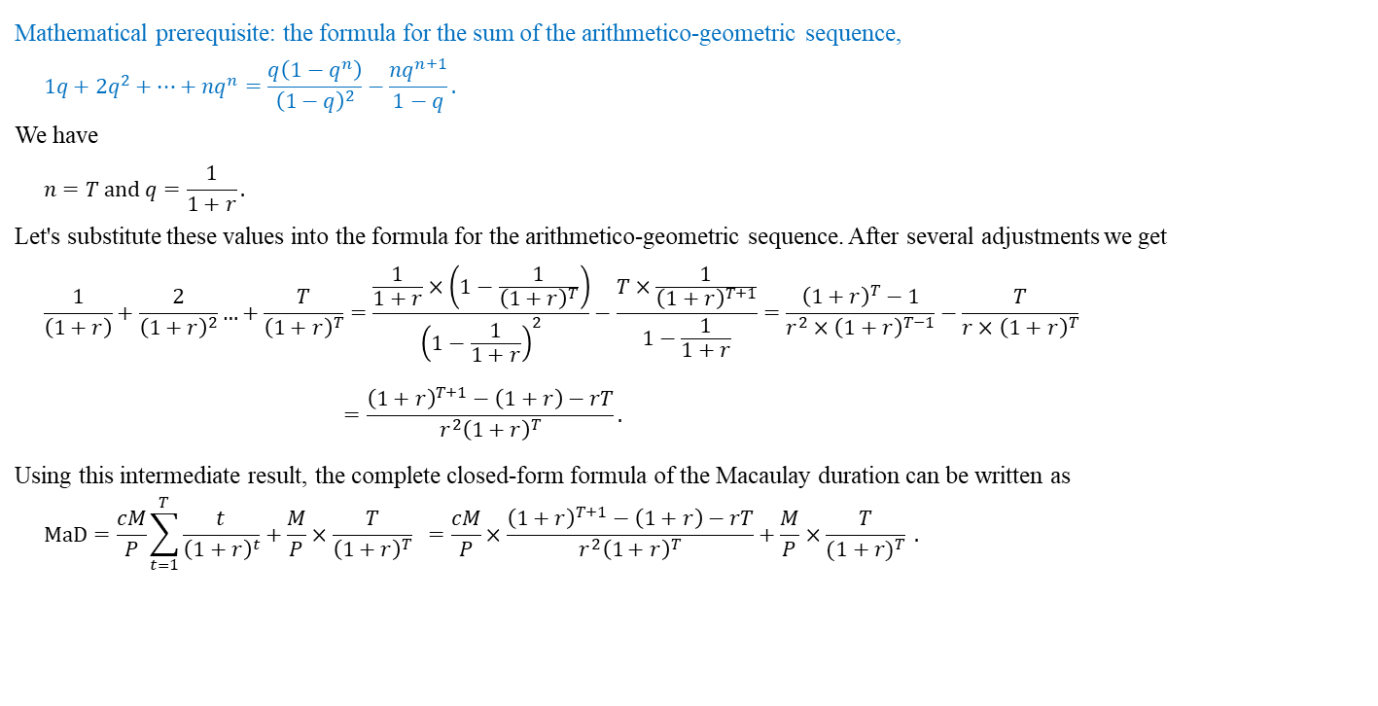
Math note – closed-form formula of the Macaulay duration
Mathematical prerequisite: the formula for the sum of the arithmetico-geometric sequence,
$$1q+2q^{2}+…+nq^{n}=\frac{q\left(1−q^{n}\right)}{{\left(1−q\right)}^{2}}−\frac{nq^{n+1}}{1−q}.$$
We have
$$n=T \text{and} q=\frac{1}{1+r}.$$
Let's substitute these values into the formula for the arithmetico-geometric sequence. After several adjustments we get
$$\frac{1}{\left(1+r\right)}+\frac{2}{{\left(1+r\right)}^{2}}…+\frac{T}{{\left(1+r\right)}^{T}}=\frac{\frac{1}{1+r}×\left(1−\frac{1}{{\left(1+r\right)}^{T}}\right)}{{\left(1−\frac{1}{1+r}\right)}^{2}}−\frac{T×\frac{1}{{\left(1+r\right)}^{T+1}}}{1−\frac{1}{1+r}}=\frac{{\left(1+r\right)}^{T}−1}{r^{2}×{\left(1+r\right)}^{T−1}}−\frac{T}{r×{\left(1+r\right)}^{T}}$$
$$=\frac{{\left(1+r\right)}^{T+1}−\left(1+r\right)−rT}{r^{2}{\left(1+r\right)}^{T}}.$$
Using this intermediate result, the complete closed-form formula of the Macaulay duration can be written as
$$\text{MaD}=\frac{cM}{P}\sum_{t=1}^{T}{\frac{t}{{\left(1+r\right)}^{t}}}+\frac{M}{P}×\frac{T}{{\left(1+r\right)}^{T}} =\frac{cM}{P}×\frac{{\left(1+r\right)}^{T+1}−\left(1+r\right)−rT}{r^{2}{\left(1+r\right)}^{T}}+\frac{M}{P}×\frac{T}{{(1+r)}^{T}} .$$

Slide 18
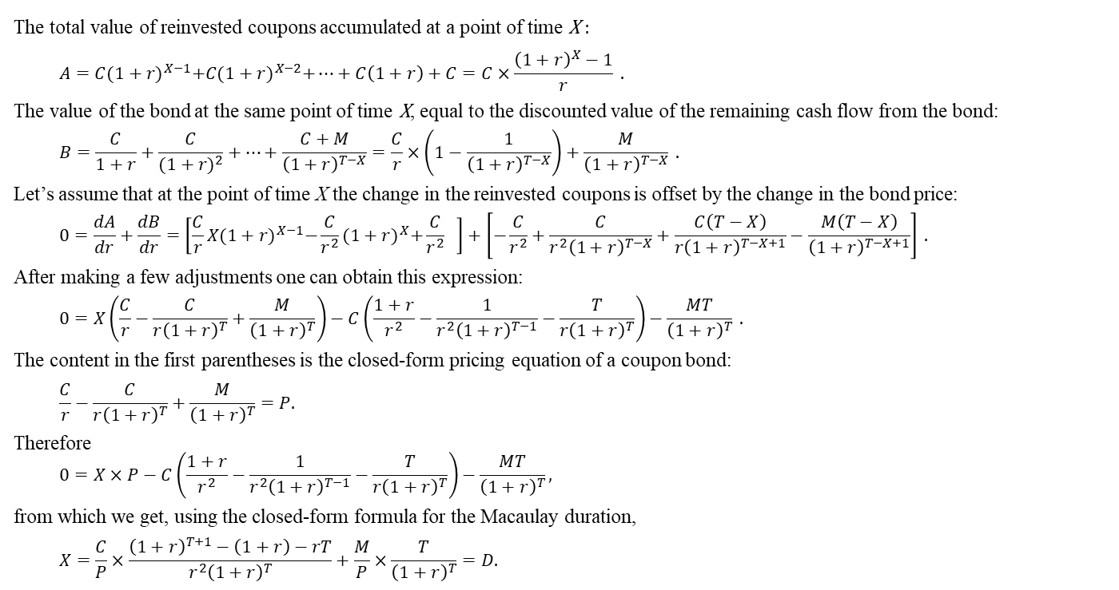
Math note – immunisation rule
The total value of reinvested coupons accumulated at a point of time X :
$$A=C{(1+r)}^{X−1}+C{(1+r)}^{X−2}+…+C\left(1+r\right)+C=C×\frac{{\left(1+r\right)}^{X}−1}{r} .$$
The value of the bond at the same point of time X, equal to the discounted value of the remaining cash flow from the bond:
$$B=\frac{C}{1+r}+\frac{C}{{(1+r)}^{2}}+…+\frac{C+M}{{\left(1+r\right)}^{T−X}}=\frac{C}{r}×\left(1−\frac{1}{{\left(1+r\right)}^{T−X}}\right)+\frac{M}{{\left(1+r\right)}^{T−X}} .$$
Let’s assume that at the point of time X the change in the reinvested coupons is offset by the change in the bond price:
$$0=\frac{dA}{dr}+\frac{dB}{dr}=\left[\frac{C}{r}X{(1+r)}^{X−1}−\frac{C}{r^{2}}{(1+r)}^{X}+\frac{C}{r^{2}} \right]+\left[−\frac{C}{r^{2}}+\frac{C}{r^{2}{\left(1+r\right)}^{T−X}}+\frac{C\left(T−X\right)}{{r\left(1+r\right)}^{T−X+1}}−\frac{M\left(T−X\right)}{{\left(1+r\right)}^{T−X+1}}\right] .$$
After making a few adjustments one can obtain this expression:
$$0=X\left(\frac{C}{r}−\frac{C}{{r\left(1+r\right)}^{T}}+\frac{M}{{\left(1+r\right)}^{T}}\right)−C\left(\frac{1+r}{r^{2}}−\frac{1}{r^{2}{\left(1+r\right)}^{T−1}}−\frac{T}{{r\left(1+r\right)}^{T}}\right)−\frac{MT}{{\left(1+r\right)}^{T}} .$$
The content in the first parentheses is the closed-form pricing equation of a coupon bond:
$$\frac{C}{r}−\frac{C}{{r\left(1+r\right)}^{T}}+\frac{M}{{\left(1+r\right)}^{T}}=P.$$
Therefore
$$0=X×P−C\left(\frac{1+r}{r^{2}}−\frac{1}{r^{2}{\left(1+r\right)}^{T−1}}−\frac{T}{r{\left(1+r\right)}^{T}}\right)−\frac{MT}{{\left(1+r\right)}^{T}},$$
from which we get, using the closed-form formula for the Macaulay duration,
$$X=\frac{C}{P}×\frac{{\left(1+r\right)}^{T+1}−\left(1+r\right)−rT}{r^{2}{\left(1+r\right)}^{T}}+\frac{M}{P}×\frac{T}{{\left(1+r\right)}^{T}}=D.$$

