Slide 1



Mortgages
Institute of Economic Studies
Faculty of Social Sciences
Charles University in Prague
Financial markets instruments

Slide 2








Level-payment mortgage
Terminology
Mortgages are various types of long-term financial instruments that intermediate housing financing
Balloon mortgage is characterized by instalments that cover only interest payments and the original balance is repaid at maturity of the mortgage
Potential problem with repayment of the entire balance at maturity (disastrous consequences during the Great Depression)
Level-payment (traditional, annuity) mortgage is characterized by equal instalments that are made up of an interest payment and a repayment of part of the original mortgage balance
$$A$$
$$A$$
$$A$$
$$A$$
1 | 2 | 3 |  | T-1 | T
$$H_{0}$$
$T$ … term of the mortgage
$H_{0}$ … original mortgage balance
$A$ … regular instalment (made up of interest payment and principal repayment)

Slide 3


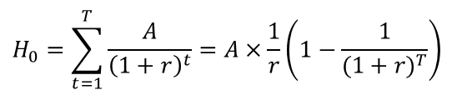





Math of level-payment mortgage
Annuity formula
Fair value principle requires the equality between the mortgage loan and the present value of all instalments discounted at a given mortgage rate
$$H_{0}=\sum_{t=1}^{T}{\frac{A}{{\left(1+r\right)}^{t}}=A×\frac{1}{r}\left(1−\frac{1}{{(1+r)}^{T}}\right)}$$
$$⇨ A=H_{0}×\frac{r{(1+r)}^{T}}{{(1+r)}^{T}−1}=H_{0}×a_{T}(r)$$
$a_{T}$ … annuity factor for the period $T$
Decomposition of the regular instalment
In each period a fixed mortgage payment consists of interest paid on an outstanding mortgage balance and repayment of a portion of the outstanding mortgage balance
$H_{t}$ … mortgage balance at the end
of the period $t$
$$A={r×H}_{t−1}+\left(H_{t−1}−H_{t}\right)$$
Formula for the remaining mortgage balance (at the end of period $t$)
$$H_{t}=H_{0}×\frac{{(1+r)}^{T}−{(1+r)}^{t}}{{(1+r)}^{T}−1}$$
Formulas for the interest payment and the principal repayment (in period $t$)
$${rH}_{t−1}=H_{0}×\frac{r×\left[{(1+r)}^{T}−{(1+r)}^{t−1}\right]}{{(1+r)}^{T}−1}$$
$$H_{t−1}−H_{t}=H_{0}×\frac{r×{(1+r)}^{t−1}}{{(1+r)}^{T}−1}$$

Slide 4
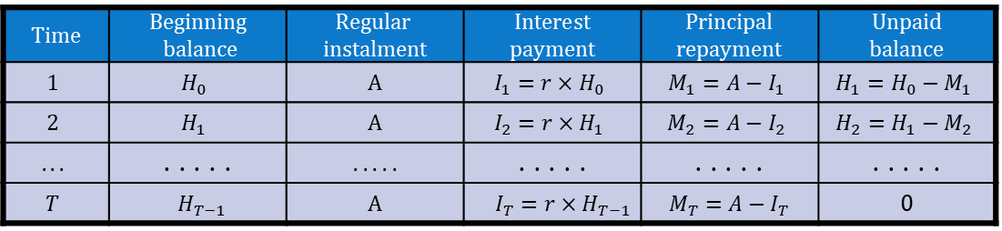
Annuity payment calendar
Structure of payment calendar
$$Time$$ | Beginning balance | $$Regular$$ $$instalment$$ | $$Interest$$ payment | $$Principal$$ repayment | Unpaid balance
$$1$$ | $$H_{0}$$ | A | $$I_{1}=r×H_{0}$$ | $$M_{1}=A−I_{1}$$ | $$H_{1}=H_{0}−M_{1}$$
$$2$$ | $$H_{1}$$ | A | $$I_{2}=r×H_{1}$$ | $$M_{2}=A−I_{2}$$ | $$H_{2}=H_{1}−M_{2}$$
$$. . .$$ | . . . . . | . . . . . | . . . . . | . . . . . | . . . . .
$$T$$ | $${ H}_{T−1}$$ | A | $I_{T}=r×H_{T−1}$ | $$M_{T}=A−I_{T}$$ | 0
Compilation of payment calendar
Calculation of fixed regular instalment using the annuity formula
Calculation of interest payment as a product of the beginning balance and the mortgage rate
Calculation of principal repayment by deducting the interest payment from the regular instalment
Calculation of unpaid balance by deducting the principal repayment from the beginning balance; it becomes the beginning balance in the next period
Consistency check: The portion of the interest payment gradually decreases and the portion of the principal repayment gradually increases
Consistency check: The last mortgage balance must be zero and the sum of all principal repayments must be equal to the mortgage loan

Slide 5












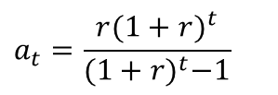
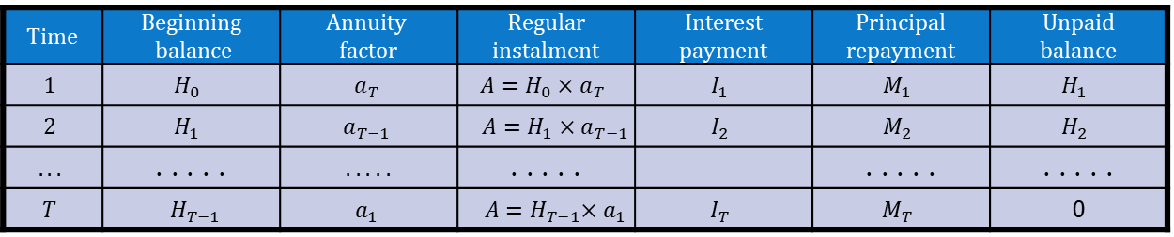


Refinancing payment calendar
Sequence of prepaid mortgages
$$H_{1}$$
$$H_{2}$$
$$A$$
$$A$$
$$H_{T−1}$$
$$A$$
$$A$$
1 | 2 | 3 |  | T-1 | T
$$H_{T−1}$$
$$a_{t}=\frac{r{(1+r)}^{t}}{{(1+r)}^{t}−1}$$
$$H_{0}$$
$$H_{1}$$
$$H_{2}$$
$$A=H_{0}×a_{T}$$
$$=H_{1}×a_{T−1}$$
$$= {. . . =H}_{T−1}×a_{1}$$
Compilation of payment calendar
$Time$ | Beginning balance | $$Annuity$$ $$factor$$ | $$Regular$$ instalment | Interest payment | $$Principal$$ repayment | Unpaid balance
$$1$$ | $$H_{0}$$ | $$a_{T}$$ | $${A=H}_{0}×a_{T}$$ | $$I_{1}$$ | $$M_{1}$$ | $$H_{1}$$
$$2$$ | $$H_{1}$$ | $$a_{T−1}$$ | $${A=H}_{1}×a_{T−1}$$ | $$I_{2}$$ | $$M_{2}$$ | $$H_{2}$$
$$. . .$$ | . . . . . | . . . . . | . . . . . |  | . . . . . | . . . . .
$$T$$ | $${ H}_{T−1}$$ | $$a_{1}$$ | $${ A=H}_{T−1}×a_{1}$$ | $$I_{T}$$ | $$M_{T}$$ | 0
Calculation of annuity factor
Calculation of regular instalment as a product of the beginning balance and the annuity factor
Decomposition of the instalment into interest and principal repayments
Unpaid balance becomes the beginning balance in the next period
Consistency checks: $H_{T}=0,\sum_{t}{M_{t}=H_{0}}$

Slide 6



Prepayments (1)
Three components of mortgage cash flow
Interest payment
Scheduled principal repayment
Prepayments – payments in excess of regularly scheduled repayments
$Π_{t}$ … prepayments in the period $t$
$$Π_{t}=p_{t}×\left(H_{t−1}−M_{t}\right)$$
$p_{t}$ … prepayment rate in the period $t$
$H_{t−1}$ mortgage balance at the beginning of the period $t$
$M_{t}$ … scheduled principal repayment in the period $t$
Reasons for exercising the prepayment option
Economic: taking out a cheaper mortgage to repay the more expensive mortgage (a strong incentive especially in case of a significant drop in mortgage rates)
Default on meeting mortgage obligations: the property is repossessed, sold and the proceeds are used to pay off the mortgage
Social: change of employment, moving to another location, divorce, insured natural disaster, purchasing a new house, etc.

Slide 7
Prepayments (2)
Prepayment risks
Loss of interest income: mortgage providers are losing the interest income they previously counted on and must pay interest on funds borrowed to extend mortgages
Contraction risk: declining mortgage rates speed up prepayments, so investors are forced to reinvest unplanned cash inflow at lower market rates
Extension risk: rising mortgage rates slow down prepayments, so investors are deprived of cash inflow that could be invested at higher market rates
Open and closed mortgages
The prepayment right is an example of an embedded option for which mortgage providers may require payment of the option premium
An open mortgage allows prepayment of all or part of the mortgage at any time during the term without paying a prepayment charge; the interest rate is often higher than that on a closed mortgage
A closed mortgage cannot be prepaid, renegotiated or refinanced before the end of the term without paying a prepayment penalty; it usually offers a lower interest rate than an open mortgage

Slide 8






Annuity mortgage and inflation
Erosion effect hurts creditors
High inflation progressively reduces the purchasing power of repayments
$$RPP=\frac{1}{{(1+π)}^{t}}$$
$$π=10\%$$
The remedy can consist in including the expected inflation in the mortgage rate
$$r=\left(1+ρ\right)×\left(1+π\right)−1$$
$$\dot{=}ρ+π$$
$ρ$… real mortgage rate
$π$ … rate of inflation
Tilt effect hurts debtors
$RPP$ … real purchasing power
Inflation shifts or tilts the real value of mortgage repayments towards the early years of the mortgage life, causing reduced affordability of mortgages
Annuity mortgage exacerbates the tilt: higher mortgage rate after including inflation ⇨ higher size of the regular instalment ⇨ higher real burden of the instalment in the initial phase of the mortgage loan
Term of the mortgage: 20 years
Real mortgage rate: 4 %
Nominal mortgage rate =
real rate + inflation rate

Slide 9

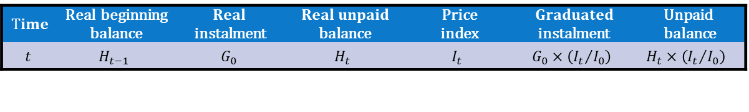
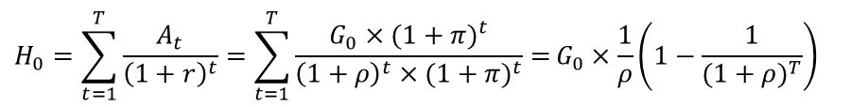
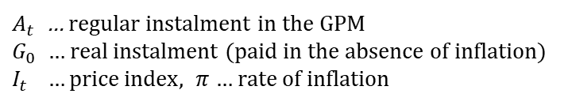
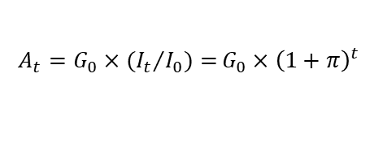
Graduated-payment mortgage
Description
Graduated-payment mortgage increases the stream of instalments at the rate of inflation that leaves the real value of instalments unchanged
$$A_{t}={G_{0}×{{(I}_{t}}/{I_{0})=}G}_{0}×{\left(1+π\right)}^{t}$$
$A_{t}$ … regular instalment in the GPM
$G_{0}$ … real instalment (paid in the absence of inflation)
$I_{t} …\text{price} \text{index}, π$ … rate of inflation
Pricing equation
$$H_{0}=\sum_{t=1}^{T}{\frac{A_{t}}{{\left(1+r\right)}^{t}}=\sum_{t=1}^{T}{\frac{G_{0}×{(1+π)}^{t}}{{\left(1+ρ\right)}^{t}×{(1+π)}^{t}}=}G_{0}×\frac{1}{ρ}\left(1−\frac{1}{{(1+ρ)}^{T}}\right)}$$
$$⇨ G_{0}=H_{0}×a_{T}(ρ)$$
Compilation of payment calendar
$$Time$$ | Real beginning balance | $$Real$$ instalment | $Real unpaid$ balance | Price index | $$Graduated$$ instalment | Unpaid balance
$$t$$ | $$H_{t−1}$$ | $$G_{0}$$ | $$H_{t}$$ | $$I_{t}$$ | $$G_{0}×\left({I_{t}}/{I_{0}}\right)$$ | $$H_{t}×\left({I_{t}}/{I_{0}}\right)$$
Potential drawbacks of the GPM
Small instalments at the beginning but high instalments at the end of the mortgage life ⇨ potential problem for households whose income cannot keep pace with inflation
Negative amortization means that instalments are insufficient to cover interest, so the unpaid interest increases the outstanding mortgage

Slide 10
Foreign currency mortgage
Description
The mortgage is provided and repaid in a currency which is different from the currency of the country in which the borrower is resident
The mortgage payments may be made in domestic currency but their size changes in line with changes in the exchange rate of foreign currency
The charged interest rate is based on foreign interest rates relevant to the currency in which the mortgage is denominated
Economic incentives
Significantly lower interest rates on foreign currency then interest rates on domestic currency
Prospects for strengthening of domestic currency against foreign currency (borrower’s cost of repaying the mortgage is less in terms of domestic currency)
Risks of open currency position
An open currency position (currency mismatch) means that revenues in one currency are used for paying expenditures in another currency
The mortgage borrower is exposed to the risk of the weakening of domestic currency which causes a capital loss
Mortgages
10

Slide 11
Some other types of mortgages
Adjustable-rate (variable-rate) mortgage
The interest is fixed for an initial term, after which it can change periodically based on prevailing interest rates, subject to some limits on its increase
The initial interest rate is often below market, which can make the mortgage more affordable, but possibly less affordable in the long run if the rate rises substantially
Reverse mortgage
Senior homeowners can borrow against the value of their home and receive the money as a lump sum or fixed monthly payment, generally for living expenses
The entire loan becomes due when the borrower dies, moves away permanently or sells the home; it is settled from the proceeds of the sale of the property
Offset mortgage
The mortgage is linked to a normally non-interest-bearing savings account whose balance reduces the basis from which the mortgage’s interest payment is calculated
Cashback mortgage
The mortgage borrower receives some cash when they take out the mortgage, which can help cover costs like furniture and repairs of their new home
Hybrid mortgage
A single mortgage application can include more than one type of mortgage financing (a fixed-rate portion, a variable-rate portion, a line-of-credit portion, etc.)
Mortgages
11

Slide 12

See you in the next lecture
© O.D. Lecturing Legacy
dedekold@gmail.com
Visit dedeklegacy.cz or TALKING SLIDES for the animated version of this presentation
(with English narrations and English/Czech subtitles)

Slide 13
Excel table – annuity payment calendar
Explore the table in Excel
(available only in the still version of the slideshow)
Right-click the table
In the pop-up menu go to Object - Worksheet
Click Open

Slide 14
Excel table – refinancing payment calendar
Explore the table in Excel
(available only in the still version of the slideshow)
Right-click the table
In the pop-up menu go to Object - Worksheet
Click Open

Slide 15
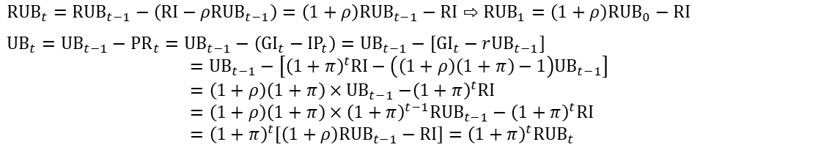
Excel table – graduated payment calendar
Explore the table in Excel
(available only in the still version of the slideshow)
Right-click the table
In the pop-up menu go to Object - Worksheet
Click Open
$${RUB}_{t}={RUB}_{t−1}−\left(RI−ρ{RUB}_{t−1}\right)=\left(1+ρ\right){RUB}_{t−1}−RI⇨{RUB}_{1}=\left(1+ρ\right){RUB}_{0}−RI$$
$${UB}_{t}={UB}_{t−1}−{PR}_{t}={UB}_{t−1}−\left({GI}_{t}−{IP}_{t}\right)={UB}_{t−1}−\left[{GI}_{t}−r{UB}_{t−1}\right]$$
$$={UB}_{t−1}−\left[{\left(1+π\right)}^{t}RI−\left(\left(1+ρ\right)\left(1+π\right)−1\right){UB}_{t−1}\right]$$
$$=\left(1+ρ\right)\left(1+π\right){×UB}_{t−1}−{\left(1+π\right)}^{t}RI$$
$$=\left(1+ρ\right)\left(1+π\right)×{\left(1+π\right)}^{t−1}{RUB}_{t−1}−{\left(1+π\right)}^{t}RI$$
$$={\left(1+π\right)}^{t}\left[\left(1+ρ\right){RUB}_{t−1}−RI\right]={\left(1+π\right)}^{t}{RUB}_{t}$$
$${⇨UB}_{1}=\left(1+π\right)\left[\left(1+ρ\right){UB}_{0}−RI\right]$$
$${UB}_{1}=\left(1+π\right)\left[\left(1+ρ\right){UB}_{0}−RI\right]=\left(1+π\right)\left[\left(1+ρ\right){RUB}_{0}−RI\right]=\left(1+π\right){RUB}_{1}$$
$${UB}_{t−1}={\left(1+π\right)}^{t−1}{RUB}_{t−1}$$
application of
mathematical induction

Slide 16
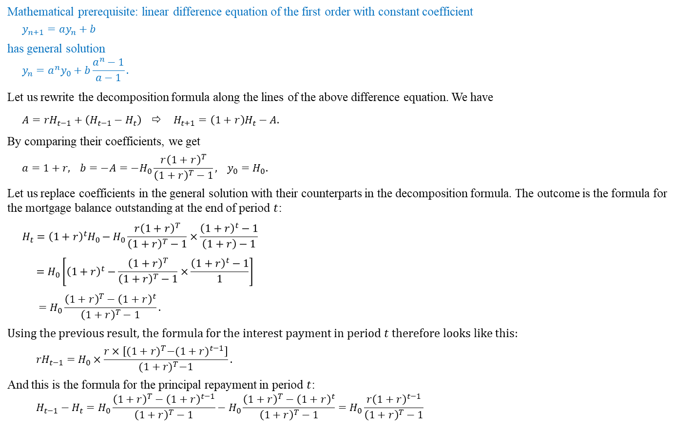
Math note – decomposition of regular instalment
Mathematical prerequisite: linear difference equation of the first order with constant coefficient
$$y_{n+1}=ay_{n}+b$$
has general solution
$$y_{n}=a^{n}y_{0}+b\frac{a^{n}−1}{a−1}.$$
Let us rewrite the decomposition formula along the lines of the above difference equation. We have
$${A=rH}_{t−1}+\left(H_{t−1}−H_{t}\right) ⇨ H_{t+1}=\left(1+r\right)H_{t}−A.$$
By comparing their coefficients, we get
$$a=1+r\text{,} b=−A=−H_{0}\frac{r{\left(1+r\right)}^{T}}{{\left(1+r\right)}^{T}−1}\text{,} y_{0}=H_{0}.$$
Let us replace coefficients in the general solution with their counterparts in the decomposition formula. The outcome is the formula for the mortgage balance outstanding at the end of period $t$:
$$H_{t}={\left(1+r\right)}^{t}H_{0}−H_{0}\frac{r{\left(1+r\right)}^{T}}{{\left(1+r\right)}^{T}−1}×\frac{{\left(1+r\right)}^{t}−1}{\left(1+r\right)−1}$$
$$=H_{0}\left[{\left(1+r\right)}^{t}−\frac{{\left(1+r\right)}^{T}}{{\left(1+r\right)}^{T}−1}×\frac{{\left(1+r\right)}^{t}−1}{1}\right]$$
$$=H_{0}\frac{{\left(1+r\right)}^{T}−{\left(1+r\right)}^{t}}{{\left(1+r\right)}^{T}−1}.$$
Using the previous result, the formula for the interest payment in period $t$ therefore looks like this:
$${rH}_{t−1}=H_{0}×\frac{r×\left[{(1+r)}^{T}−{(1+r)}^{t−1}\right]}{{(1+r)}^{T}−1}.$$
And this is the formula for the principal repayment in period $t$:
$$H_{t−1}−H_{t}={H_{0}\frac{{\left(1+r\right)}^{T}−{\left(1+r\right)}^{t−1}}{{\left(1+r\right)}^{T}−1}−H}_{0}\frac{{\left(1+r\right)}^{T}−{\left(1+r\right)}^{t}}{{\left(1+r\right)}^{T}−1}=H_{0}\frac{{r\left(1+r\right)}^{t−1}}{{\left(1+r\right)}^{T}−1}$$

Slide 17
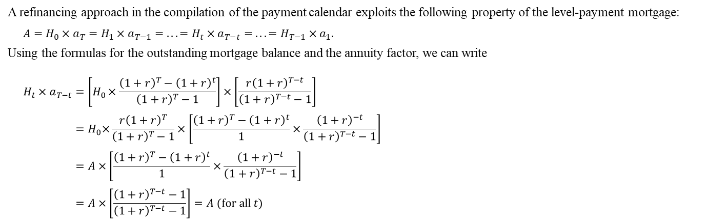
Math note – annuity refinancing property
A refinancing approach in the compilation of the payment calendar exploits the following property of the level-payment mortgage:
$$A=H_{0}×a_{T}=H_{1}×a_{T−1}= . . . ={H_{t}×a_{T−t}= . . . =H}_{T−1}×a_{1}.$$
Using the formulas for the outstanding mortgage balance and the annuity factor, we can write
$$H_{t}×a_{T−t}=\left[H_{0}×\frac{{\left(1+r\right)}^{T}−{\left(1+r\right)}^{t}}{{\left(1+r\right)}^{T}−1}\right]×\left[\frac{r{\left(1+r\right)}^{T−t}}{{\left(1+r\right)}^{T−t}−1}\right]$$
$${=H}_{0}×\frac{{r\left(1+r\right)}^{T}}{{\left(1+r\right)}^{T}−1}×\left[\frac{{\left(1+r\right)}^{T}−{\left(1+r\right)}^{t}}{1}×\frac{{\left(1+r\right)}^{−t}}{{\left(1+r\right)}^{T−t}−1}\right]$$
$$=A×\left[\frac{{\left(1+r\right)}^{T}−{\left(1+r\right)}^{t}}{1}×\frac{{\left(1+r\right)}^{−t}}{{\left(1+r\right)}^{T−t}−1}\right]$$
$$=A×\left[\frac{{\left(1+r\right)}^{T−t}−1}{{\left(1+r\right)}^{T−t}−1}\right]=A (for all t)$$

Slide 18
Footnotes
LTV, DSTI and DTI ratios.
Mortgage ratios are crucial indicators to ensure responsible lending. Regulators use them to help prevent boom-bust cycles in the mortgage market, which in the past have caused significant damage to households and threatened the stability of the banking sector.
LTV (loan-to-value) is the ratio of the loan amount to the value of the mortgaged property. It shows the proportion of the property value that the bank will lend to the borrower and the amount the borrower must contribute from their own funds. Lenders view lower LTV ratios as less risky because they provide a larger cushion against declines in property prices, thereby reducing the likelihood that the mortgage balance exceeds the home’s market value.
DSTI (debt service-to-income) shows the percentage of net monthly income required to service all debt payments (mortgage, loans, etc.). Its purpose is to assess whether a mortgage applicant can comfortably afford monthly mortgage payments, even with higher interest rates and living expenses.
DTI (debt-to-income) indicates how many times an applicant’s total debt is higher than their net annual income. It helps banks assess the debtor’s ability to repay and whether they can afford to take on additional debt, such as a mortgage.

