Slide 1



Interest rate swap
Institute of Economic Studies
Faculty of Social Sciences
Charles University in Prague
Financial markets instruments

Slide 2
Coupon swap
Basic notions
Interest rate swap is a contract which commits two parties to exchange, over an agreed period, two streams of interest payments, each calculated using a different interest rate
Coupon swap (fixed-for-float) exchanges two interest streams:
A stream based on a fixed rate (unchanged over the life of the swap)
A stream based on a floating rate (periodically reset for each interest period)
Fixed rate
Swap buyer
Netting
Swap seller
Floating rate
The buyer of the coupon swap is the party that pays fixed interest and the seller of the coupon swap is the party that pays floating interest
Interest payments are applied to a common notional principal, which is used only to calculate the interest amounts (no physical exchange of principals takes place)
An interest rate swap is a derivative instrument because its payments are derived from other instruments (fixed and floating interest rate securities) without the need to own them

Slide 3

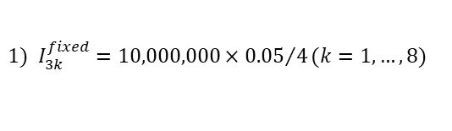
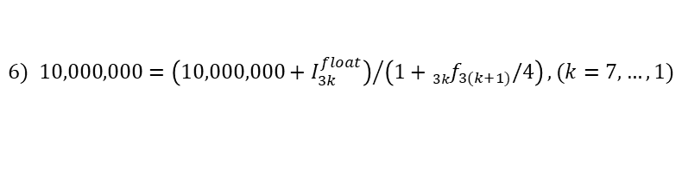
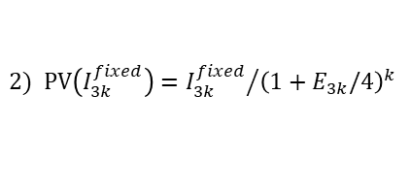
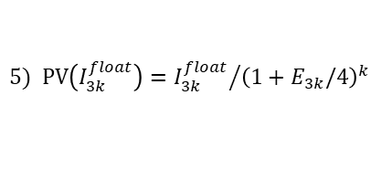
Coupon swap – example
Data
Notional principal €10 mil., maturity 2 years, quarterly payment frequency, day/year convention 30/360
Fixed leg (paid): annual rate 5%; floating leg (received): Euribor yield curve
Payment calendar
Swap’s value = EUR -53,984
 |  |  | Fixed leg |  |  |  | Floating leg
Interest period | Euribor |  | Interest fixed¹⁾ | Present value |  | Stream | Forward rate³⁾ | Interest float⁴⁾ | Present value |  | Stream⁶⁾ | Netting⁷⁾
 | Maturity | Size |  | Interest²⁾ | Notional |  |  |  | Interest⁵⁾ | Notional
[0,3] | 3M | 4.8 | 125,000 | 123,518 |  | 10,053,984 | 4.8 | 120,000 | 118,577 |  | 10,000,000 | -5,000
[3,6] | 6M | 4.9 | 125,000 | 121,993 |  |  | 5.0 | 125,001 | 121,993 |  | 10,000,000 | 1
[6,9] | 9M | 5.0 | 125,000 | 120,427 |  |  | 5.2 | 130,002 | 125,246 |  | 10,000,000 | 5,002
[9,12] | 12M | 5.2 | 125,000 | 118,706 |  |  | 5.8 | 145,015 | 137,713 |  | 10,000,000 | 20,015
[12,15] | 15M | 5.3 | 125,000 | 117,038 |  |  | 5.7 | 142,506 | 133 ,429 |  | 10,000,000 | 17,506
[15,18] | 18M | 5.1 | 125,000 | 115,850 |  |  | 4.1 | 102,537 | 95,031 |  | 10,000,000 | -22,463
[18,21] | 21M | 4.9 | 125,000 | 114,788 |  |  | 3.7 | 92,552 | 84,991 |  | 10,000,000 | -32,448
[21,24] | 24M | 4.7 | 125,000 | 113,848 | 9,107,817 |  | 3.3 | 82,569 | 75,202 | 9,107,817 | 10,000,000 | -42,431
$$1) I_{3k}^{fixed}=10,000,000×{0.05}/4(k=1,…,8)$$
$3) {\left(1+E_{3k}/4\right)}^{k}×\left(1+{}_{3k}^{ }{f_{3(k+1)}/4}\right)={\left(1+E_{3(k+1)}/4\right)}^{k+1}(k=0,1,…,7$)
$$2) \text{PV}\left(I_{3k}^{fixed}\right)={I_{3k}^{fixed}}/{{\left(1+E_{3k}/4\right)}^{k}}$$
$4) I_{3k}^{float}=10,000,000×{}_{3(k−1)}^{ }{f_{3k}/4(}k=1,…,8$)
$$5) \text{PV}\left(I_{3k}^{float}\right)={I_{3k}^{float}}/{{\left(1+E_{3k}/4\right)}^{k}}$$
$6) 10,000,000={\left(10,000,000+I_{3k}^{float}\right)}/{\left(1+{}_{3k}^{ }{f_{3(k+1)}/4}\right)},(k=7,…,1$)
$7) I_{3k}^{float}−$ $I_{3k}^{fixed}$

Slide 4


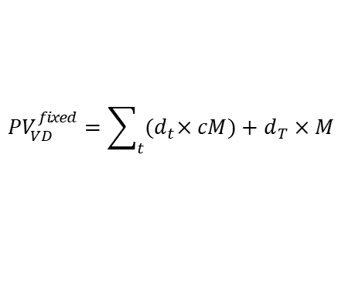



Valuation of coupon swaps
General rules
The value of a coupon swap is equal to the net worth of the two streams of interests exchanged through this instrument
Value for the swap buyer = PV(floating stream) $−$ PV(fixed stream)
Value for the swap seller = PV(fixed stream) $−$ PV(floating stream)
Formulas
interest period
. . . |  | . . .
swap
starts
last netting
(LN)
valuation date
(VD)
nearest netting
(NN)
swap
ends
Swap legs are valued using bond pricing formulas
Floating leg (on the nearest netting date, the sum of present values of floating interests and notional principal is equal to the notional principal)
$${PV}_{NN}^{float}=M$$
$${ PV}_{VD}^{float}=d_{NN}×M$$
$d_{t}…$discount factors based on money market rates
Fixed leg (the sum of present values of fixed interests and notional principal)
Short-term swaps:
$${PV}_{VD}^{fixed}=\sum_{t}{{(d}_{t}×cM)+d_{T}×M}$$
$r_{T}…T$-year yield to maturity
Long-term swaps:
$${PV}_{NN}^{fixed}=cM+M×\left[\frac{c}{r_{T}}×\left(1−\frac{1}{{\left(1+r_{T}\right)}^{T}}\right)+\frac{1}{{\left(1+r_{T}\right)}^{T}}\right]$$
$${ PV}_{VD}^{fixed}=d_{NN}×{PV}_{NN}^{fixed}$$
Including notional principal in the valuation of both legs removes its impact on the swap’s value

Slide 5

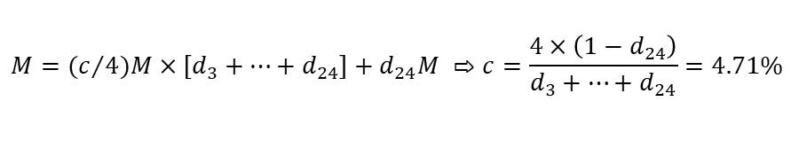
Swap rates
Description
Swap rates are fixed interest rates applied by swap dealers to fixed streams; they are calculated as the average of bid and ask fixed rates
Swap rates should be fair, securing zero NPV of newly agreed upon swaps (nobody would want to conclude a contract with a negative NPV)
PV(fixed stream) = PV(floating stream)
Swap rates for different maturities form a swap yield curve
Swap rates and coupon rates of par bonds
$$P=\text{PV}\left(\text{fixed} \text{stream}\right)+\text{PV}\left(M\right)=\text{PV}\left(\text{floating} \text{stream}\right)+\text{PV}\left(M\right)=M$$
$P…$ price of a $T$-year bond whose coupon is equal to the $T$-year swap rate
A bond whose coupon is equal to the swap rate is a par bond
The swap rate is equal to the bond’s YTM because of the par property
Swap rate in the previous example
Interest period | [0,3] | [3,6] | [6.9] | [9,12] | [12,15] | [15,18] | [18,21] | [21,24] | Total
Discount factors | 0.98814 | 0.7594 | 0.96342 | 0.94965 | 0.93630 | 0.92680 | 0.91830 | 0.91078 | 7.56934
$$M=(c/{4)M}×\left[d_{3}+…+d_{24}\right]+d_{24}M ⇨c=\frac{4×\left(1−d_{24}\right)}{d_{3}+…+d_{24}}=4.71\%$$
$$d_{3k}=\frac{1}{{\left(1+E_{3k}/4\right)}^{k}} (k=1,…,8)$$

Slide 6
Speculative trades
Risk taking strategies
The buyer of a coupon swap (payer of fixed rate and receiver of floating rate) expects that the floating rate will rise above the fixed rate
The speculating swap seller has opposite expectations about rate changes
Cheaper analogy of asset-liability mismatching (gapping)
Long-term
bond
Speculator
Short-term
deposit
Fixed
coupon
Short-term
interest
Risk transforming strategies
Liability swap: transformation of fixed-rate liability to floating-rate liability
Fixed rate
A speculator issued a fixed-income bond and wishes to benefit from an expected fall in interest rates
Speculator
Swap dealer
Fixed
coupon
Floating rate
Asset swap: transformation of floating-rate asset to fixed-rate asset
Fixed rate
A speculator invested in a floating-rate note and wishes to benefit from an expected fall in interest rates
Speculator
Swap dealer
Short-term
interest
Floating rate

Slide 7
Arbitrage trades
Liability arbitrage swap
A swap can reduce the cost of a preferred form of funding if a swap’s user has access to a cheaper but non-preferred form of funding
3Y at 9.0%
An advantage of 50bp in the fixed borrowing rate can be used for subsidising the floating borrowing rate
Borrower
6M Euribor – 50 bp
Swap dealer
3Y at 8.5%
6M Euribor
Sources of arbitrage opportunities: better than average creditworthiness, access to subsidized financing, short-term price anomalies
Asset arbitrage swap
A swap enhances the return on a preferred form of investment if a swap’s user can access an asset with a higher than prevailing market rate of return
3Y at 9.0%
An advantage of 20bp in the floating rate can be used to supplement the fixed interest received in the swap
Borrower
3Y + 20 bp
Swap dealer
6M Euribor+20bp
6M Euribor
Sources of arbitrage opportunities: lower liquidity of the asset compensated by a higher return, short-term price anomalies, different speeds at which individual market segments react to the same information

Slide 8
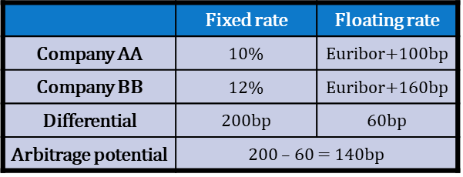
New-issues arbitrage (1)
Key insight
Issuers with different credit standing can benefit from a swap if they exploit their comparative advantage at borrowing interest rates
Analogy with David Ricardo’s theory of comparative advantage in international trade
Terminology
 | Fixed rate | Floating rate
Company AA | 10% | Euribor+100bp
Company $BB$ | 12% | Euribor+160bp
Differential | 200bp | 60bp
Arbitrage potential | 200 – 60 = 140bp
AA has absolute advantage at both interest rates (it can borrow more cheaply on both markets) and BB has absolute disadvantage at both interest rates (it can borrow more expensively on both markets)
AA has comparative advantage at the fixed rate (it can borrow “more more cheaply” at the fixed rate) and BB has comparative advantage at the floating rate (it can borrow “less more expensively” at the floating rate)
Arbitrage potential is the difference between comparative advantages

Slide 9
New-issues arbitrage (2)
Possible design of new-issues arbitrage (among many others)
10.2%
AA
BB
10%
Euribor+160bp
Euribor
Both firms borrow at a rate at which they have a comparative advantage, but their preferred rates are the rates with comparative disadvantages
An appropriate swap ensures cheaper funding at a preferred rate relative to the direct borrowing at this interest rate
AA net borrowing cost = $10\%−10.2\%+\text{Eur}\text{ibor}=\text{Eur}\text{ibor}−0.2\%$
$$⇨\text{net} \text{gain}=\left(Eur\text{ibor}+100\text{bp}\right)−\left(Eur\text{i}\text{bor}−20\text{bp}\right)=120\text{bp}$$
BB net borrowing cost = ($Euribor+1.6\%)−Euribor+10.2\%=\text{11.8\%}$
$$⇨\text{net} \text{gain}=12\%−11.8\%=20\text{bp}$$
total gain = $120bp+20bp=140bp=arbitrage potential$
Concluding remarks
A part of the arbitrage gain is taken by a bank which acts as a swap dealer
Similar credit spreads at both rates reduce arbitrage opportunities
Benefits of a deal are based on unchanged credit rating during the swap
BB is downgraded and the spread over Libor widens to 200bp ⇨ BB funding cost at fixed rate increases by 20bp above direct cost of fixed borrowing
$$\text{net} \text{gain}=12\%−\left[Euribor+2\%−Euribor+10.2\%\right]=12\%−12.2\%=−20bp$$

Slide 10
Hedging trades
Hedging maturity mismatch between assets and liabilities
Funding long-term fixed rate mortgages with short-term deposits ⇨ bank is vulnerable to interest rate increase
Mortgage
bank
Long-term
mortgage rate
Short-term
deposit rate
Fixed rate
Floating rate
Swap
dealer
Funding floating rate mortgages with long-term bonds or certificates of deposit ⇨ bank is vulnerable to interest rate fall
Mortgage
bank
Floating
mortgage rate
Fixed coupon
Floating rate
Fixed rate
Swap
dealer
Hedged positions result in losses if market conditions develop in the opposite direction to what the hedging was meant to protect

Slide 11
Warehousing coupon swaps
Hedged position of swap dealer
5Y interest
+ spread
5Y interest
Customer A
Swap
dealer
Customer B
Floating rate
Floating rate
Dealer is the payer of the fixed rate in the earlier swap ⇨ an interest rate fall may result in a higher fixed rate paid than the fixed rate received
9%
10%
Later
customer
Swap
dealer
Earlier customer
Floating rate
Floating rate
Dealer is the recipient of the fixed rate in the earlier swap ⇨ an interest rate rise may result in a higher fixed rate paid than the fixed rate received
10%
11%
Earlier
customer
Swap
dealer
Later
customer
Floating rate
Floating rate
What is warehousing?
Warehousing comprises various techniques of using financial instruments that offset the permanent loss caused by unfavourable long-term interest rates during the life of later-established swap pairs

Slide 12
Warehousing with bonds
Dealer is the payer of the fixed rate in earlier swap
5Y bonds
5Y interest
Bond market
Capital gain
Swap dealer
Earlier customer
Cash
6M interest
Cash
Overnight rate
Money market
Dealer arranges overnight borrowing; proceeds are used to buy bonds
If interest rates fall, a higher selling price of bonds offsets a permanent loss on the fixed legs of the matching swaps
Dealer is the recipient of the fixed rate in earlier swap
Bond lender
Short sale
5Y bonds
5Y interest
Bond market
Capital gain
Swap dealer
Earlier customer
Cash
Deposit
6M interest
Overnight rate
Money market
Dealer establishes short position on the bond market whose proceeds are deposited on the money market
If interest rates rise, a cheaper purchasing price of bonds offsets a permanent loss on the fixed legs of the matching swaps

Slide 13
Warehousing with par bonds – example
Problem description
A swap dealer arranged a five-year coupon swap with a notional amount of €100,000, paying a fixed rate of 8%. To hedge against falling interest rates, the dealer warehoused the swap by purchasing par bonds with a face value of €1,000 each. Right after concluding the swap, the five-year rate dropped to 7%. Compile the cash flow of the warehousing strategy.
Swap part of the warehousing strategy
 |  |  | 1 | 2 | 3 | 4 | 5 | Total
Notional amount | €100,000 | Fixed interest paid | 8,000 | 8,000 | 8,000 | 8,000 | 8,000
Term | 5 years | Fixed interest received | 7,000 | 7,000 | 7,000 | 7,000 | 7,000
Old fixed rate | 8.0% | Net interest loss | -1,000 | -1,000 | -1,000 | -1,000 | -1,000
New fixed rate | 7.0% | PV of interest loss (new rate) | -934.58 | -873.44 | -816.30 | -762.90 | -712.99 | -4,100.20
Bond part of the warehousing strategy
 |  |  | 1 | 2 | 3 | 4 | 5 | Total
Nominal value | €1,000 | Bond’s cash flow | 80.00 | 80.00 | 80.00 | 80.00 | 1,080.00
Time to maturity | 5 years | PV of cash flow (old rate) | 74.07 | 68.59 | 63.51 | 58.80 | 735.03 | 1,000.000
Yield to maturity | 8.0% | PV of cash flow (new rate) | 74.77 | 69.88 | 65.30 | 61.03 | 770.03 | 1,041.002
Coupon rate | 8.0% | Capital gain |  |  |  |  |  | 4,100.20
Purchase price | €1,000.000
Number of bonds | 100
Sale price | €1,041.002

Slide 14

Warehousing with futures
Reminder of some essentials
Interest rate futures are standardized agreements about the future delivery of an interest-bearing asset (long-term bond, short-term CD)
Long position (buying futures) profits from rising futures prices; prices of interest rate futures rise when interest rates fall
MEMO
Quotation convention
$$F=100−r$$
Short position (selling futures) profits from falling futures prices; prices of interest rate futures fall when interest rates are rise
Dealer is payer of fixed rate in earlier swap
Long position
5Y interest
Long-term futures
Swap dealer
Earlier customer
Short position
6M interest
Short-term futures
Long position in long-term futures and short position in short-term futures offset losses caused by unfavourable interest rate changes
Advantages of futures: high liquidity, small initial payments required by initial margins
Disadvantages of futures: lower accuracy of hedging due to significantly different maturities of swaps and underlying bonds in futures contracts

Slide 15
Basis swap
Description
Basis swap is a floating-against-floating swap that involves a variety of combinations of floating interest rates
Floating rate
3M Euribor
3M Euribor
3M Euribor
Swap party 2
Swap party 1
6M Treasury
6M Euribor + 30 bp
6M Euribor
Floating rate
Types of combinations of floating payments
Different maturities within a given interest class (3M Euribor versus 6M Euribor)
Same maturities within a given interest class carrying a margin (3M Euribor versus 3M Euribor plus 30 basis points)
Same or different maturities between different interest classes (3M Euribor versus 6M Treasury)
Unhelpful conventions of calling the parties of the basis swap the buyer and the seller; reference should instead be made to the interest received or paid
Basis swaps can be used in speculative, hedging and arbitrage trades in a similar way as coupon swaps are used

Slide 16
Esoteric interest rate swaps
Standard versus esoteric swaps
Standard (generic, plain vanilla) swaps refer to the simplest construction of a swap contract: constant notional amount, immediate start, regular interest payments, unchanged fixed rate, floating rate with no margins
Esoteric (non-standard, exotic, bizarre) swaps have more complicated constructions that modify particular features of standard swaps
Examples of esoteric swaps
Compounding swap accumulates fixed-rate and floating-rate payments on a compound basis that are paid on the maturity date
Tailored swap adjusts the principal amount to suit the requirement of the counterparty: amortising or step-down swap (principal declines over time), accreting or step-up swap (principal increases over time), rollercoaster swap (principal may vary up and down)
Forward swap is agreed upon today but starts on a future date
In-arrears swap uses the floating rate prevailing at the time of paying the floating interest (not the rate from the beginning of the interest period)
Cancellable swap gives one party the option to terminate the deal on one or more payment dates

Slide 17




See you in the next lecture
© O.D. Lecturing Legacy
dedekold@gmail.com
Visit dedeklegacy.cz or TALKING SLIDES for the animated version of this presentation
(with English narrations and English/Czech subtitles)

Slide 18
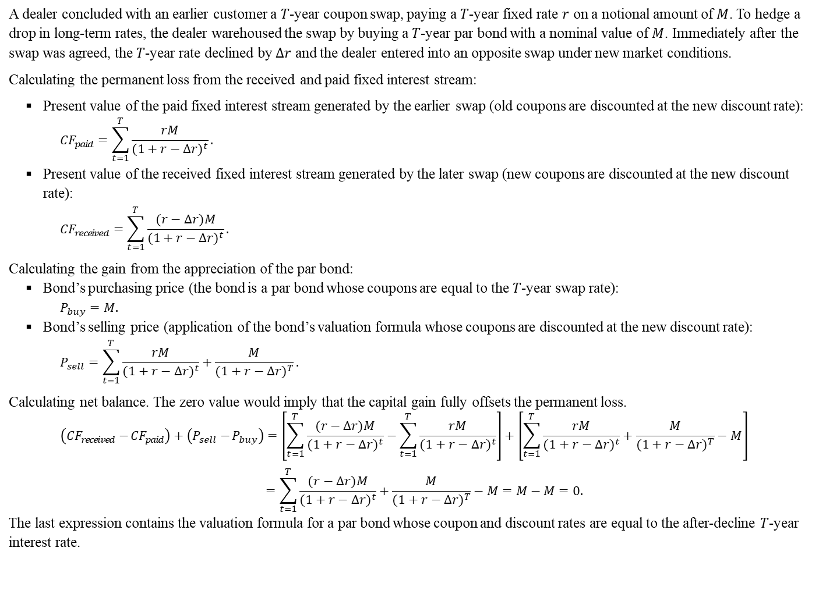
Math note – warehousing with par bonds
A dealer concluded with an earlier customer a $T$-year coupon swap, paying a $T$-year fixed rate $r$ on a notional amount of $M$. To hedge a drop in long-term rates, the dealer warehoused the swap by buying a $T$-year par bond with a nominal value of $M$. Immediately after the swap was agreed, the $T$-year rate declined by $∆r$ and the dealer entered into an opposite swap under new market conditions.
Calculating the permanent loss from the received and paid fixed interest stream:
Present value of the paid fixed interest stream generated by the earlier swap (old coupons are discounted at the new discount rate):
$${CF}_{paid}=\sum_{t=1}^{T}{\frac{rM}{{(1+r−∆r)}^{t}}}.$$
Present value of the received fixed interest stream generated by the later swap (new coupons are discounted at the new discount rate):
$${CF}_{received}=\sum_{t=1}^{T}{\frac{(r−∆r)M}{{(1+r−∆r)}^{t}}}.$$
Calculating the gain from the appreciation of the par bond:
Bond’s purchasing price (the bond is a par bond whose coupons are equal to the $T$-year swap rate):
$$P_{buy}=M.$$
Bond’s selling price (application of the bond’s valuation formula whose coupons are discounted at the new discount rate):
$$P_{sell}=\sum_{t=1}^{T}{\frac{rM}{{(1+r−∆r)}^{t}}}+\frac{M}{{(1+r−∆r)}^{T}}.$$
Calculating net balance. The zero value would imply that the capital gain fully offsets the permanent loss.
$$\left({CF}_{received}−{CF}_{paid}\right)+\left(P_{sell}−P_{buy}\right)=\left[\sum_{t=1}^{T}{\frac{(r−∆r)M}{{(1+r−∆r)}^{t}}−\sum_{t=1}^{T}{\frac{rM}{{(1+r−∆r)}^{t}}}}\right]+\left[\sum_{t=1}^{T}{\frac{rM}{{(1+r−∆r)}^{t}}}+\frac{M}{{(1+r−∆r)}^{T}}−M\right]$$
$$=\sum_{t=1}^{T}{\frac{(r−∆r)M}{{(1+r−∆r)}^{t}}}+\frac{M}{{(1+r−∆r)}^{T}}−M=M−M=0.$$
The last expression contains the valuation formula for a par bond whose coupon and discount rates are equal to the after-decline $T$-year interest rate.

Slide 19
Footnotes
Savings and Loan crisis
In the United States, Savings and Loan associations were community-focused financial institutions historically specialised in fixed-rate mortgage lending. Regulatory requirements placed at their creation included caps on interest rates on deposits and loans. This restriction greatly limited S&L’s ability to compete with other lenders when inflation took hold and the Federal Reserve responded with interest rate hikes, as was the case from 1979 through the early 1980s. Attempts to attract more deposits by offering higher interest rates led to liabilities that could not be serviced by the lower interest rates at which S&Ls provided mortgages. The result was that about one-third of these institutions became insolvent, causing a first wave of failures in 1981–83.
In response to the poor prospects for S&Ls under current economic conditions, President Ronald Reagan signed an act that eliminated interest rate caps for S&Ls and permitted them to engage in new lending activities, such as adjustable-rate mortgages and commercial real estate lending. Lower capital requirements and permissive accounting standards also allowed weaker thrifts to continue operating. These changes enabled substantial risk-taking and spurred the growth of the thrift industry along with ballooning speculative risks. The regional concentration of thrift investments, along with inexperience with new types of lending, proved highly fragile. When property prices dropped in 1986, a second and larger wave of failures began.
The S&L crisis was likely the worst banking collapse since the Great Depression. By 1989, more than 1,000 S&Ls had failed, holding more than $500 billion in assets. The total cost to taxpayers by the end of 1999 was $123.8 billion, with an additional $29.1 billion of losses imposed on the thrift industry.
Source: Wikipedia, the free encyclopedia.

