Slide 1

Forward rate agreement
Institute of Economic Studies
Faculty of Social Sciences
Charles University in Prague
Financial markets instruments
Notes:
Ztlumené efekty: 2,3,4
Odstranit srážku kamionu: snímek 8, 1:33 – 1:45

Slide 2
FRA contract
Main features of an FRA contract
Forward rate agreement (FRA) is an agreement to pay or receive the difference between a predetermined interest rate (FRA rate) and the interest rate prevailing at a specific future date (reference rate)
Interest payments are based on an agreed upon notional principal amount
Settlement cash flow is paid net at the beginning of the FRA period
FRA is referred to by the beginning and end dates of the FRA period, which are expressed as a number of months from now (3v8 denotes an FRA which starts in 3 months’ time and ends in 8 months’ time from now)
3v8 FRA is agreed
3v8 FRA begins
3v8 FRA ends
1 | 2 | 3 | 4 | 5 | 6 | 7 | 8 | 9 | 10 | . . .
FRA period
An FRA buyer is a party which pays the FRA rate and receives the reference rate while an FRA seller is the other party which pays the reference rate and receives the FRA rate
FRA rate
FRA buyer
FRA seller
Reference rate
A predetermined FRA rate is called the price of the FRA contract

Slide 3


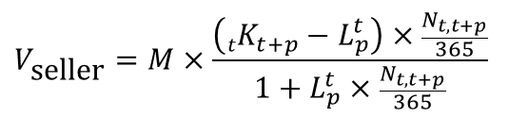
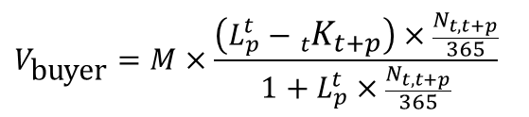
FRA formula
Value of cash flow for the FRA buyer
FRA buyer is the payer of the FRA rate and the receiver of the reference rate
$L_{p}^{t}$ … p -month reference rate which will exist at time t when the FRA period starts
$$V_{\text{buyer}}=M×\frac{\left(L_{p}^{t}−{}_{t}^{ }{K_{t+p}}\right)×\frac{N_{t,t+p}}{365}}{1+L_{p}^{t}×\frac{N_{t,t+p}}{365}}$$
${}_{t}^{ }{K_{t+p}}$ … p -month FRA rate agreed now for the FRA period starting in t-months’ time
$N_{t,t+p}$ … number of days in the FRA period
$M$ … notional principal amount of the FRA contract
Interests are calculated in conformity with money market conventions
Interest payment is discounted to the beginning of the FRA period when the settlement takes place
Value of cash flow for the FRA seller
FRA seller is the payer of the reference rate and the receiver of the FRA rate
$$V_{\text{seller}}=M×\frac{\left({}_{t}^{ }{K_{t+p}}−L_{p}^{t}\right)×\frac{N_{t,t+p}}{365}}{1+L_{p}^{t}×\frac{N_{t,t+p}}{365}}$$
Summary of differences between a coupon swap and an FRA
Swap | FRA
Periodic exchange of interest payments | One-off exchange of interest payments
Immediate start | Delayed start
Settled at the end of interest period | Settled at the beginning of interest period

Slide 4
Applications of FRA
Speculative trades
An FRA can be used to speculate whether the reference rate will be higher or lower than the FRA rate at the beginning of the FRA period
When money market interest rates are expected to rise/fall, speculators want to buy/sell FRA contracts
Speculative gain can be achieved without upfront investment because the FRA’s principal amount is notional
Hedging trades
Locking in short-term borrowing interest rates
FRA rate
Money market
Company
FRA dealer
Libor + spread
Libor
A company which needs to take a three-month loan in two months’ time can fix its borrowing cost by buying a 2v5 FRA
Locking in short-term deposit interest rate
FRA rate
Money market
Company
FRA dealer
Libor + spread
Libor
A company which expects to make a six-month deposit in two weeks’ time can fix its lending return by selling a 0.5v6.5 FRA

Slide 5
FRA strip
Definition
FRA strip is an FRA created synthetically from a series of consecutive FRAs
FRA contracts 3v5, 5v8, 8v9 make up a synthetic 3v9 FRA strip
1 | 2 | 3 | 4 | 5 | 6 | 7 | 8 | 9 | 10 | 11 | . . .
3v5
5v8
8v9
synthetic 3v9 FRA
3M loan and 3v5, 5v8, 8v9 FRAs make up a synthetic 9M loan
1 | 2 | 3 | 4 | 5 | 6 | 7 | 8 | 9 | 10 | 11 | . . .
L3 = 0v3 FRA
3v5
5v8
8v9
synthetic L9 (0v9 FRA)
Strip construction
Rules for the size of notional principals
$\text{NP}\text{(3}\text{v}\text{5) = }M,$ $NP(\text{5}\text{v}\text{8) = }M×\left(1+\frac{N_{3,5}}{365}{}_{3}^{ }{K_{5}}\right),$ $NP(\text{8}\text{v}\text{9) = }M×\left(1+\frac{N_{3,5}}{365}{}_{3}^{ }{K_{5}}\right)$ $×\left(1+\frac{N_{5,8}}{365}{}_{5}^{ }{K_{8}}\right)$
Combination of FRA settlements and refinancing the balance at reference rates can result in a cash flow identical to that of the FRA strip
No arbitrage between synthetic and normal FRAs is reflected in the interest rate parity condition
$$1+\frac{N_{3,9}}{365}{}_{3}^{ }{K_{9}=}\left(1+\frac{N_{3,5}}{365}{}_{3}^{ }{K_{5}}\right)×\left(1+\frac{N_{5,8}}{365}{}_{5}^{ }{K_{8}}\right)×\left(1+\frac{N_{8,9}}{365}{}_{8}^{ }{K_{9}}\right)$$
$$1+\frac{N_{0,9}}{365}L_{9}=\left(1+\frac{N_{0,3}}{365}L_{3}\right)×\left(1+\frac{N_{3,5}}{365}{}_{3}^{ }{K_{5}}\right)×\left(1+\frac{N_{5,8}}{365}{}_{5}^{ }{K_{8}}\right)×\left(1+\frac{N_{8,9}}{365}{}_{8}^{ }{K_{9}}\right)$$

Slide 6
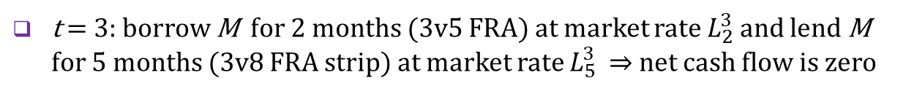
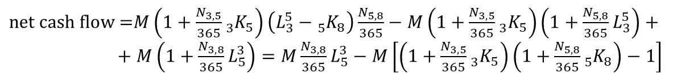
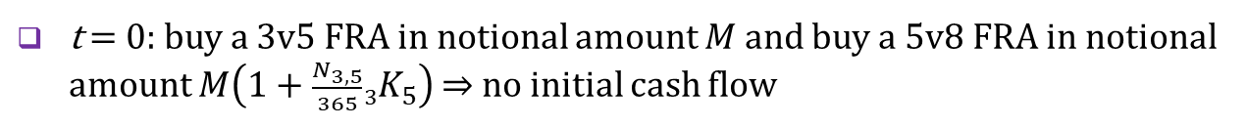

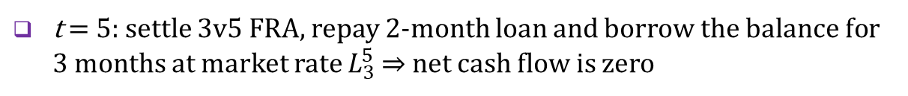

Assembling a 3v8 FRA strip
Assumptions
A 3v8 FRA strip is made up of 3v5 and 5v8 FRA contracts
FRAs are settled at the end of the FRA period (discounted settlements can simply be invested at the market rate for the FRA period)
Construction
t = 0: buy a 3v5 FRA in notional amount $M$ and buy a 5v8 FRA in notional amount $M\left(1+\frac{N_{3,5}}{365}{}_{3}^{ }{K_{5}}\right)$ ⇒ no initial cash flow
1
2
3
4
5
6
7
8
9
10
t = 3: borrow M for 2 months (3v5 FRA) at market rate $L_{2}^{3}$ and lend M for 5 months (3v8 FRA strip) at market rate $L_{5}^{3}$ ⇒ net cash flow is zero
3v5
t = 5: settle 3v5 FRA, repay 2-month loan and borrow the balance for 3 months at market rate $L_{3}^{5}$ ⇒ net cash flow is zero
3v8
$\text{borrowed} \text{amount}\text{ =}−M\left(L_{2}^{3}−{}_{3}^{ }{K_{5}}\right)\frac{N_{3,5}}{365}+M\left(1+\frac{N_{3,5}}{365}L_{2}^{3}\right)=M\left(1+\frac{N_{3,5}}{365}{}_{3}^{ }{K_{5}}\right)$
5v8
t = 8: settle 5v8 FRA, repay 3-month loan and terminate 5-month lending
$\text{net} \text{cash} \text{flow}\text{ =}M\left(1+\frac{N_{3,5}}{365}{}_{3}^{ }{K_{5}}\right)\left(L_{3}^{5}−{}_{5}^{ }{K_{8}}\right)\frac{N_{5,8}}{365}−M\left(1+\frac{N_{3,5}}{365}{}_{3}^{ }{K_{5}}\right)\left(1+\frac{N_{5,8}}{365}L_{3}^{5}\right)++M\left(1+\frac{N_{3,8}}{365}L_{5}^{3}\right)=M\frac{N_{3,8}}{365}L_{5}^{3}−M\left[\left(1+\frac{N_{3,5}}{365}{}_{3}^{ }{K_{5}}\right)\left(1+\frac{N_{5,8}}{365}{}_{5}^{ }{K_{8}}\right)−1\right]$
No arbitrage between synthetic and normal 3v8 FRAs
$\left(1+\frac{N_{3,5}}{365}{}_{3}^{ }{K_{5}}\right)$ $\left(1+\frac{N_{5,8}}{365}{}_{5}^{ }{K_{8}}\right)=1+\frac{N_{3,8}}{365}{}_{3}^{ }{K_{8}}$
$$\left(\frac{N_{3,8}}{365} {}_{3}^{ }{K_{8}}\right)$$

Slide 7











Price links with coupon swaps
Similarity between an FRA strip and a coupon swap
Both products can fix borrowing cost over a given period in advance
$${M\text{+}L}_{12}^{0}M$$
FRA strip (composed of 3M interest rate, 3v6 FRA, 6v9 FRA and 9v12 FRA) fixes 12M interest rate
1 | 2 | 3 | 4 | 5 | 6 | 7 | 8 | 9 | 10 | 11 | 12 | . . .
M
3M rate (0v3 FRA)
3v6 FRA
6v9 FRA
9v12 FRA
synthetic 12M rate (0v12 FRA)
1Y coupon swap with 3M floating leg fixes 12M interest rate
$$M\text{+}r_{12}M$$
$${M\text{+}L}_{3}^{0}M$$
$$M\text{+}L_{3}^{3}M$$
$${M\text{+}L}_{3}^{6}M$$
$$r_{12}^{0}M$$
$${M\text{+}L}_{3}^{9}M$$
1 | 2 | 3 | 4 | 5 | 6 | 7 | 8 | 9 | 10 | 11 | 12 | . . .
M
M
$L_{3}^{0}$M
M
$$L_{3}^{3}M$$
M
$L_{3}^{6}$M
$$L_{3}^{9}M$$
swap’s 12-month fixed payment
swap’s 3-month floating payments
initial principal amount
accumulated values of principal amount
No arbitrage condition
Swap price should be equal to the money market rate (FRA rate of the strip) whose maturity coincides with the duration of the swap
$1+r_{12}=\left(1+L_{12}\right)=\left(1+\frac{N_{0,3}}{365}L_{3}\right)$ $\left(1+\frac{N_{3,6}}{365}{}_{3}^{ }{K_{6}}\right)\left(1+\frac{N_{6,9}}{365}{}_{6}^{ }{K_{9}}\right)\left(1+\frac{N_{9,12}}{365}{}_{9}^{ }{K_{12}}\right)$
Imperfections may exist due to different conventions in money markets (applied to FRA contracts) and capital markets (applied to swaps)

Slide 8
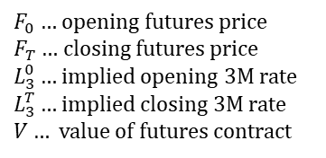

Price links with interest rate futures
Similarities and differences
FRA is a negotiable equivalent to highly standardized short-term interest rate futures contract
In both cases the financial settlement is based on the difference between a predetermined and a future market rate
Buyer (long) of a three-month interest rate futures
$F_{0}…$opening futures price
$F_{T}…$closing futures price
$L_{3}^{0}…$ implied opening 3M rate
$L_{3}^{T}…$ implied closing 3M rate
$V…$value of futures contract
$${(F}_{T}−F_{0})×\text{tick} \text{value}=\left[\left(100−L_{3}^{T}\right)−\left(100−L_{3}^{0}\right)\right]×\frac{3}{12}×V/100$$
$=\left(L_{3}^{0}−L_{3}^{T}\right)×\frac{3}{12}×V/100$
Both FRA and futures contracts are settled at the beginning of some future interest rate period (FRA period versus delivery date)
FRA’s settlement amount is based on discounted values while the futures settlement amount is based on undiscounted values
Opposite meaning of long and short positions
A long position in interest rate futures means paying the floating rate and receiving the fixed rate; it has the opposite meaning in FRAs
A short position in interest rate futures means receiving the floating rate and paying the fixed rate; it has the opposite meaning in FRAs

Slide 9
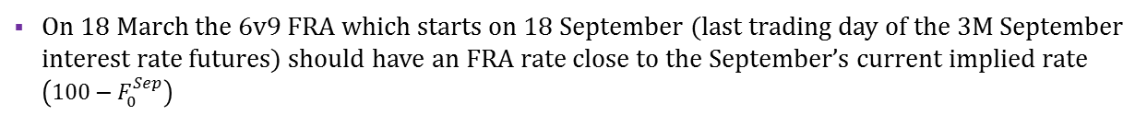


Futures-linked FRA contracts
Futures-linked FRA contract
Equality between the FRA rate and the implied futures interest rate
$$\text{futures} \text{payoff}=\left(L_{3}^{0}−L_{3}^{T}\right)×\frac{3}{12}V=\frac{\left({}_{T}^{ }{K_{T+3}}−L_{3}^{T}\right)×\frac{N_{T,T+3}}{365}V}{1+L_{3}^{T}×\frac{N_{T,T+3}}{365}V}=\text{FRA} \text{payoff}$$
FRA period and the period of the futures’ underlying deposit start at the same time $T$ and have the same length ($N_{T,T+3}\text{/365} \dot{=}3/12$)
Notional amount of FRA is equal to the size of the futures contract $V,$ and both contacts use the same floating rate (3M Libor prevailing at time $T$)
${}_{T}^{ }{K_{T+3}}\dot{=}L_{3}^{0}$
Quantitative effect of discounting must be ignored
Examples
On 18 March the 3v6 FRA which starts on 18 June (last trading day of the 3M June interest rate futures) should have an FRA rate close to the June’s current implied rate $\left(100−F_{0}^{Jun}\right)$
On 18 March the 6v9 FRA which starts on 18 September (last trading day of the 3M September interest rate futures) should have an FRA rate close to the September’s current implied rate $\left(100−F_{0}^{Sep}\right)$
Futures-linked FRA strip
Futures-linked FRA strip is built up from consecutive futures-linked FRAs
Example
On 18 March the 3v9 FRA rate must be compatible with futures-linked 3v6 and 6v9 FRA rates
On 18 March the implied rates of the June, September and December futures currently being traded determine FRA rates of the following FRA contracts: 3v6, 6v9, 9v12, 3v9, 3v12, 6v12

Slide 10


















Interpolated FRA rates
Matrix of futures-linked FRAs
18 March
 | 6 | 7 | 8 | 9 | 10 | 11 | 12
3
4
5
6
7
8
9
More liquid futures market influence FRA rates via no arbitrage condition
 | 6 | 7 | 8 | 9 | 10 | 11 | 12
3 | ⬇ | → | → | ○ | → | → | ○
4 |  | ↘ | ↘ | ↘ | ↘
5 |  |  | ↘ | ↘ | ↘ | ↘
6 |  |  |  | ⬇ | → | → | ○
7 |  |  |  |  | ↘
8 |  |  |  |  |  | ↘
9 |  |  |  |  |  |  | ⬇
Jun
⬇ futures-linked FRA
Sep
○ futures-linked FRA strip
→ same start, different length
↘ same length, different start
Dec
Linear interpolation ― the same start and different length
$${}_{3}^{ }{K_{9}}$$
$$\frac{{}_{3}^{ }{K_{9}}−{}_{3}^{ }{K_{6}}}{T_{3v9}−T_{3v6}}=\frac{{}_{3}^{ }{K_{8}}−{}_{3}^{ }{K_{6}}}{T_{3v8}−T_{3v6}}$$
$${}_{3}^{ }{K_{8}}$$
$${}_{3}^{ }{K_{6}}$$
$${}_{3}^{ }{K_{8}}={}_{3}^{ }{K_{6}}+\left({}_{3}^{ }{K_{9}}−{}_{3}^{ }{K_{6}}\right)\frac{T_{3v8}−T_{3v6}}{T_{3v9}−T_{3v6}}$$
number of days in the FRA period
$${}_{3}^{ }{K_{7}= {}_{3}^{ }{K_{6}}+\left({}_{3}^{ }{K_{9}}−{}_{3}^{ }{K_{6}}\right)\frac{T_{3v7}−T_{3v6}}{T_{3v9}−T_{3v6}}}$$
$$T3v6$$
$$T3v8$$
$$T3v9$$
Linear interpolation ― the same length and different start
$${}_{6}^{ }{K_{9}}$$
$$\frac{{}_{6}^{ }{K_{9}}−{}_{3}^{ }{K_{6}}}{N_{6v9}−N_{3v6}}=\frac{{}_{5}^{ }{K_{8}}−{}_{3}^{ }{K_{6}}}{N_{5v8}−N_{3v6}}$$
$${}_{5}^{ }{K_{8}}$$
$${}_{3}^{ }{K_{6}}$$
$${}_{5}^{ }{K_{8}}={}_{3}^{ }{K_{6}}+\left({}_{6}^{ }{K_{9}}−{}_{3}^{ }{K_{6}}\right)\frac{N_{5v8}−N_{3v6}}{N_{6v9}−N_{3v6}}$$
number of days to the FRA period
$${}_{4}^{ }{K_{7}={}_{3}^{ }{K_{6}}+\left({}_{6}^{ }{K_{9}}−{}_{3}^{ }{K_{6}}\right)\frac{N_{4v7}−N_{3v6}}{N_{6v9}−N_{3v6}}}$$
$$N3v6$$
$$N5v8$$
$$N6v9$$

Slide 11
See you in the next lecture
© O.D. Lecturing Legacy

