Slide 1

Credit derivatives
Institute of Economic Studies
Faculty of Social Sciences
Charles University in Prague
Financial markets instruments
Notes:
Ztlumené efekty: 2,3,4
Odstranit srážku kamionu: snímek 8, 1:33 – 1:45

Slide 2
Basic notions
Basic properties
    Credit derivatives are negotiable financial instruments or techniques that are designed to separate credit risk from underlying (reference) assets and transfer credit exposure between two or more parties
    Issuer of the reference asset is not a party to the corresponding credit derivative contract
    Payoff of credit derivatives is influenced by the occurrence of various types of credit events
    Credit events: default, downgrade, repudiation (unilateral refusal to honour financial obligations), debt moratorium (postponement of debt repayment), acceleration (enforced repayment of all outstanding debt)
Benefits of credit derivatives
    Ability to isolate credit risk exposure from reference assets and manage it independently
    Savings in transaction costs because using credit derivatives is cheaper alternative to buying or selling reference assets
    Buying credit protection instead of selling deteriorated assets helps preserve business relationships

Slide 3
Credit default swap
Description of CDS contract
Contingent compensation
(premium)
CDS buyer
CDS seller
Fee (spread)
CDS seller promises to compensate the CDS buyer in the event of a default of a reference asset, in exchange for receiving a series of payments
    CDS buyer = credit protection buyer = credit risk seller
    CDS seller = credit protection seller = credit risk buyer
Fee (spread), expressed as a percentage of the notional amount, is paid either over the length of the contract (no default) or until default occurs
C–settlement
Bond R + Cash M-R
= Wealth M
Cash settlement: the CDS seller pays the CDS buyer the difference between the nominal value (M) and the recovery price (R) of the reference asset
P–settlement
Cash M = Wealth M
Physical settlement: the CDS buyer delivers the asset to the CDS seller for payment of the nominal value of the reference asset (M)
Analogy with insurance
CDS buyer pays a fee in return for compensation if an adverse event occurs
CDS buyer need not suffer a loss from the default
CDS seller is not required to maintain reserves to cover protection sold

Slide 4
Applications of CDS
Hedging credit exposure
Reference
bond
Premium
Total return
CDS buyer
Dealer
Fee
Investor owns the reference asset and wants to be insured against default
In case of default, the CDS holder receives cash or physical compensation and terminates fee payments
Speculation on credit events
Premium
CDS buyer
Dealer
Fee
Fee
Speculator purchases a CDS anticipating that the reference asset is about to default and the contingent payment will greatly exceed the fee paid
Speculator purchases a CDS anticipating that the reference asset is more likely to default, so he/she will be able to sell it at a higher fee than paid
Naked CDSes (speculative purchase of CDSes without owning the reference asset) pose the risk of financial stability
Gross amount of CDSes can far exceed the real amount of underlying bonds
CDS sellers are not required to maintain reserves to cover the protection sold

Slide 5





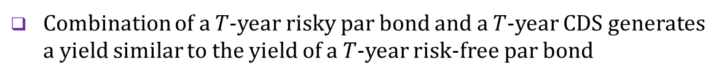

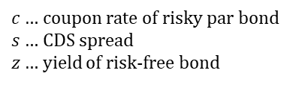




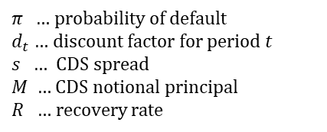

Pricing of CDS
Probability model
    CDS price is equal to the sum of present values of a series of cash flows, each of them weighted by the probability of their occurrence
$$π$$
$$M(1−R)d_{1}$$
$$M\left(1−R\right)d_{2}−sMd_{1}$$
$π$ … probability of default
$d_{t}$ … discount factor for period $t$
$s$ … CDS spread
$M$ … CDS notional principal
$R$ … recovery rate
$$π$$
$$(1−π)$$
$$π$$
$$M\left(1−R\right)d_{3}−sMd_{2}−sMd_{1}$$
$$(1−π)$$
$$(1−π)$$
$${−sMd}_{3}−sMd_{2}−sMd_{1}$$
    Price for the buyer
$$P_{CDS}=π×M\left(1−R\right)d_{1}+\left(1−π\right)π×M\left[\left(1−R\right)d_{2}−sd_{1}\right]$$
$$+ {(1−π)}^{2}π×M\left[\left(1−R\right)d_{3}−sd_{2}−sd_{1}\right]+ {(1−π)}^{3}×M\left[−sd_{3}−sd_{2}−sd_{1}\right]$$
    CDS price should be zero for a newly issued CDS on efficient markets (spread is a variable which makes the CDS price equal to zero)
No arbitrage argument
    Combination of a $T$-year risky par bond and a $T$-year CDS generates a yield similar to the yield of a $T$-year risk-free par bond
$M×\left[\frac{c−s}{z}×\left(1−\frac{1}{{\left(1+z\right)}^{T}}\right)+\frac{1}{{\left(1+z\right)}^{T}}\right]$
$=M$
$⇒ z=c−s$
$c$ … coupon rate of risky par bond
$s$ … CDS spread
$z$ … yield of risk-free bond
$⇒ s=c−z$

Slide 6
Total rate of return swap
Description of TROR contract
Total return
TROR buyer
Compensation for capital loss
TROR seller
Floating rate
    TROR buyer = total return receiver
    TROR seller = total return payer
TROR is an agreement to exchange the total return on a reference asset (bond, loan, equity index, etc.) for a floating rate plus a spread
Total return includes both the asset‘s income and any appreciation (paid by the seller) or depreciation (paid by the buyer) over the life of the swap
If a TROR terminates due to default, the buyer may take delivery of defaulted asset for the initial price (physical settlement) or pay the difference between the initial price and the recovery value (cash settlement)
Analogy with leasing
The TROR buyer gets all of the benefits of and responsibility for damages to the reference asset without being its legal owner
At maturity of the swap the TROR buyer may choose to purchase the asset at the prevailing market price

Slide 7

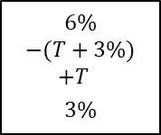



Applications of TROR
Hedging market and credit exposures
Total return
Floating rate
Bond
Hedger
Dealer
Total return
Hedger gets rid of all risks stemming from holding a reference bond (not only of credit risk) without divesting of the reference asset itself
Speculative use of financial leverage
Collateral’s yield
Bond
Total return
Dealer
Floating rate
Speculator
Total return
Collateral
Speculator makes no upfront payment for accessing the bond's total return; he/she pays a fee and puts up a collateral
Collateral compensates the dealer for losses in reference bond
Example
Purchasing a three-year par bond (coupon is 6%, face value is $100)
$$100=\frac{6}{1+\text{YTM}}+\frac{6}{{(1+\text{YTM})}^{2}}+\frac{106 \text{or} 96}{{(1+\text{YTM})}^{3}}$$
$\text{⇒ }\text{YTM}\text{ = 6\%}$ or 2.8%
$$6\%$$
$$−(T+3\%)$$
$$+T$$
$$3\%$$
Purchasing a three-year TROR (fee is 3pp above three-year Treasury, collateral is three-year Treasury in an amount of 10% of the face value of the bond)
$$10=\frac{3}{1+\text{YTM}}+\frac{3}{{(1+\text{YTM})}^{2}}+\frac{13 \text{or} 3}{{(1+\text{YTM})}^{3}}$$
$\text{⇒ }\text{YTM}\text{ = 30\%}$ or -5%

Slide 8












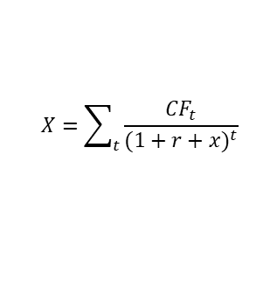



Credit options
Credit level and credit spread options
    Credit level options: the pay-off depends on the difference between the market price and the specified strike price of a reference bond
Long credit
level call
$$V_{level call}=max\left[S_{T}−X,0 \right]$$
$$V_{level put}=max\left[{X−S}_{T},0 \right]$$
$$X=\sum_{t}{\frac{{CF}_{t}}{{(1+r+x)}^{t}}}$$
$$X$$
$$S_{T}$$
$V$ … option payoff, $S_{T}$ … bond‘s price at option’s maturity,
$X$ … exercise price corresponding to a specified spread $x$ over a risk-free yield $r$
Long credit
spread call
    Credit spread options: the pay-off depends on the difference between the market spread and the specified strike spread of the yield of reference bond over a given risk-free bond
$$x$$
$$s_{T}$$
$V_{spread call}=max\left[D×M×\left({x−s}_{T}\right),0\right]$
$V_{spread put}=max\left[D×M×\left(s_{T}−x\right),0\right]$
$s_{T}$ … market spread, $x$ … strike spread, $D$ … bond’s modified duration, $M$ … bond’s face value
Links between credit level and credit spread options
    The two options have similar payoffs if the reference bond is a par bond ($P_{0}=M)$ and the yield of the risk-free bond remains unchanged
Long credit
level put
$$∆P\dot{=}−P_{0}×D×∆r$$
$$⇒ M×D×x\dot{=}−\left(X−M\right)$$
$$\text{and} M×D×s_{T}\dot{=}−(S_{T}−M)$$
$$X$$
$$S_{T}$$
${X \text{or} S}_{T}$… bond’s prices after the yield changed by the spread ${ x \text{or} s}_{T}$ respectively
Long credit
spread put
    Payoff similarity
$$V_{spread call}=max\left[−\left(X−M\right)−\left(−(S_{T}−M) \right),0 \right]=max\left[S_{T}−X,0 \right]=V_{level call}$$
$$x$$
$$s_{T}$$
$$V_{spread put}=max\left[−\left(S_{T}−M\right)−\left(−(X−M) \right),0 \right]=max\left[X−S_{T},0 \right]=V_{level put}$$

Slide 9



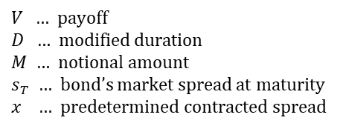


Credit forwards
Description
    Credit forwards can be constructed either on a level basis or on a spread basis
    Unlike credit options credit forwards do not limit potential loss and require no upfront payment
    Credit spread forwards allow investors to take bets on their credit view of declining or improving credit spreads of an underlying borrower
Long credit spread forward
Short credit spread forward
$V=D×M×\left({x−s}_{T}\right)$
$V=D×M×\left(s_{T}−x\right)$
$$x$$
$$s_{T}$$
$$x$$
$$s_{T}$$
$V$ … payoff
$D$ … modified duration
$M$ … notional amount
$s_{T}$ … bond’s market spread at maturity
$x$ … predetermined contracted spread

Slide 10




Credit linked notes
Description
    CLNs are hybrid instruments which combine elements of a debt instrument and credit derivatives (credit options, credit forward or both)
Examples
    CLN with embedded short credit level put option
CLN payoff
    Option premium provides an incremental income to the note’s coupon
    If the credit rating on the reference note declines below BBB the note buyer receives a lower total income
Note’s coupon
Short credit level put
$$BBB$$
    CLN with embedded credit spread put, credit spread call and credit spread forward
CLN payoff
    If the spread widens, the CLN generates income in excess of the bond’s principal value, capped at a spread of 300 bp
    If the spread narrows, the CLN generates income below the bond’s principal value, stopped at a spread of 100 bp
    Between the spread range of 100 and 300 pb the income is allowed to fluctuate in response to the spread change
Note’s face value
Short credit spread forward
Short credit spread put
$$100$$
$$200$$
$$300$$
Long credit spread call

Slide 11
Collateralized debt obligations
Subordination structure
    Subordination involves creating CDO classes (tranches) with a priority order (waterfall) for absorbing losses in the underlying pool of bonds
Collector (structurer)
Bond 1
Tranche 1 (Senior – 75%)
    Senior class is residual and is hit when the default rate rises above 25%
Tranche 2 (Mezzanine – 10%)
    Mezzanine class is hit when the default rate rises above 15% and is used up if defaults reach 25%
Tranche 3 (Junior – 10%)
    Junior class is hit when the default rate rises above 5% and is exhausted when defaults reach 10%
Bond N
Tranche 4 (Equity – 5%)
    Equity class is unrated and is completely wiped out if default losses exceed 5% of the principal
Properties
    The lower the tranche in the waterfall, the higher its default risk and yield
    CDO tranches provide a way of creating high-quality debt from average-quality debt
    The amount of default risk depends on the default correlation among bonds in the underlying pool; lower correlation results in lower default risk
    In a time of crisis, holders of senior bonds may be affected by downgrades even though the senior class does not absorb any default losses

Slide 12
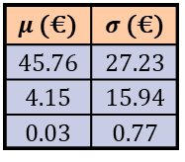
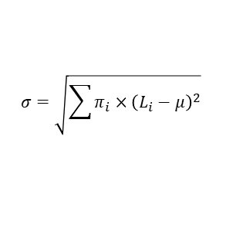
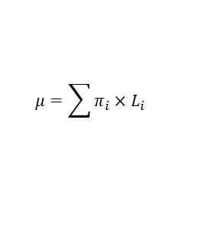

Subordination structure - example
Pool of 10 identical risky bonds
    Assumptions: face value of 100€, 10% probability of default, zero recovery value
$$μ=\sum{π_{i}×L_{i}}$$
Number of defaults | 0 | 1
Probability π_{i} (%) | 90 | 10
Loss L_{i} (€) | 0 | 100
Expected loss μ (€) | 10
Standard dev. σ (€) | 30
$$σ=\sqrt{\sum{π_{i}×{\left(L_{i}−μ\right)}^{2}}}$$
Subordination structure
$$P[X=k]=\left(\begin{matrix}n \\ k\end{matrix}\right)p^{k}{(1−p)}^{n−k}$$
Bond 1
Senior tranche – 6 CDOs
    Each bond and CDO has a face value of 100
    Defaults of bonds in the underlying pool are mutually independent ⇒ binomial distribution
Mezzanine tranche – 2 CDOs
Bond 10
Junior tranche – 2 CDOs
Number of defaults | 0 | 1 | 2 | 3 | 4 | 5 | 6 | 7 | 8 | 9 | 10
Probability (%) | 34.87 | 38.74 | 19.37 | 5.74 | 1.12 | 0.15 | 0.01 | 0.00 | 0.00 | 0.00 | 0.00
Loss per one junior CDO | 0 | 50 | 100 | 100 | 100 | 100 | 100 | 100 | 100 | 100 | 100
Loss per one mezzanine CDO | 0 | 0 | 0 | 50 | 100 | 100 | 100 | 100 | 100 | 100 | 100
Loss per one senior CDO | 0 | 0 | 0 | 0 | 0 | 17 | 33 | 50 | 67 | 83 | 100
$μ$ (€) | $σ$ (€)
45.76 | 27.23
4.15 | 15.94
0.03 | 0.77
    Risk-return properties of individual tranches critically depend on the assumption of mutually independent defaults

Slide 13
See you in the next semester
© O.D. Lecturing Legacy

