Slide 1

Essentials of futures trading
Institute of Economic Studies
Faculty of Social Sciences
Charles University in Prague
Financial markets instruments
Notes:
Ztlumené efekty: 2,3,4
Odstranit srážku kamionu: snímek 8, 1:33 – 1:45

Slide 2







Spot contract
Spot (prompt) contract
1 | 2 | 3 |  | T-1 | T
$S$… specification, $P$… payment, $D$… delivery
$$S$$
$$P$$
$$D$$
In a spot contract all essential components of the deal – specification of contract details, payment, delivery – take place at present
A delay of up to two days between the transaction date and the payment (settlement) date is usually allowed in a spot transaction
Future spot contract
1 | 2 | 3 |  | T-1 | T
$S$… specification, $P$… payment, $D$… delivery
$$S$$
$$P$$
$$D$$
A future spot contract is a spot contract that will take place at a given future point of time
A fundamental disadvantage of this contract is the uncertainty about what future spot price will prevail at the moment of the future trade
The uncertainty about the paid future price can be removed by using forward and futures contracts

Slide 3


Forward contract
Forward contract
1 | 2 | 3 |  | T-1 | T
$S$… specification, $P$… payment, $D$… delivery
$$S$$
$$P$$
$$D$$
A forward contract separates the time when the deal is specified and a later time when it is executed
Specified terms: the size of the traded asset, the price at which the exchange will take place, the future date in which the exchange will take place
By negotiating the future price now, forward contracts eliminate price risk
Forward transactions are tailor-made, allowing the parties to negotiate their details in accordance with their business needs
Tailor-made deals suffer from low liquidity; termination of the contract or sale of the contract to a third party is impossible or costly
Low liquidity is reflected in higher credit risk; the loosing party has an incentive to renege on obligations that were previously agreed upon
$S>F$⇨ sellers would be better off if they would default and sell the asset at a higher spot price than at the lower agreed upon forward price
$S<F$⇨ buyers would be better off if they would defaults and buy the asset at a lower price than at the higher agreed upon forward price

Slide 4
Futures contract
Description
    Futures contracts are highly standardized financial products traded on specialized exchanges (Eurex, London International Financial Futures and Options Exchange, Chicago Board of Trade, etc.)
Standardized specifications
Unit of trading, called an underlying asset
commodity futures: aluminium, barley, cattle, coffee, copper, cotton, crude oil, gold, palm oil, pork belly, potatoes, rice, silver, wool, etc.
financial futures: bonds, short-term deposit, foreign currency, stock index, etc.
Size of the contract; excessively large size discourages small investors and excessively small size increases transaction costs
Delivery date; usually four dates are available (March, June, September, December); contracts are referred to by their delivery month
Quotation of futures price and minimum price movement (called the tick)
Advantage of standardization
    High liquidity – details of contracts are not the subject of negotiations, traders can only buy and sell at existing futures prices

Slide 5
Opening of futures contract
Terminology
The buyer of a contract is said to be long the contract and the seller of a contract is said to be short the contract
Open interest is the number of all long or all short open positions
Margin account
    Initial margin is a prescribed amount that the long and the short have to deposit in their margin accounts each time they open a new futures position
IM is not a paid price; money in the margin account belong to traders
IM tends to be a fraction of the value of the trading asset that results in a substantial financial leverage (to be explained later)
    Maintenance margin is a floor below which the balance in the margin account is not allowed to fall; it may otherwise happen due to marking to market daily changes (to be explained later)
    Variation margin is an additional deposit in the margin account that prevents the margin balance from falling below the maintenance margin
    Margin call is a notice issued by the exchange to top up the margin balance to a required level (it could be the maintenance or the initial margin)
If a margin call is not met, the exchange is entitled to close the position of a delinquent trader at their cost by a reverse trade

Slide 6
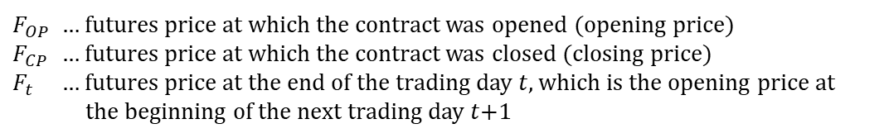
Marking to market
Description
Marking to market is an accounting procedure in which daily profits and losses resulting from changes in a futures price are recorded in the margin account
$F_{OP}$ … futures price at which the contract was opened (opening price)
$F_{CP}$ … futures price at which the contract was closed (closing price)
$F_{t}$ … futures price at the end of the trading day $t$, which is the opening price at the beginning of the next trading day $t$+1
The futures buyer (the long) benefits from rising futures price, while the futures seller (the short) benefits from falling futures price
$F_{t−1}<F_{t}$ ⇨ the buyer’s margin account is credited by an amount equal to the price change, and the seller’s margin account is debited by this amount
$F_{t−1}>F_{t}$ ⇨ the seller’s margin account is credited by an amount equal to the price change, and the buyer’s margin account is debited by this amount
Total gain or loss over the holding period
For the long: $\left(F_{1}−F_{OP}\right)+\left(F_{2}−F_{1}\right)+…+\left(F_{CP}−F_{t−1}\right)=F_{CP}−F_{OP}$
For the short: $\left(F_{OP}−F_{1}\right)+\left(F_{1}−F_{2}\right)+…+\left(F_{t−1}−F_{CP}\right)=F_{OP}−F_{CP}$
Marking to market breaks down the total loss into incremental day-to-day losses, thereby reducing credit risk

Slide 7
Termination of futures contracts
Closing out
Closing out consists of taking out an offsetting positon prior to maturity
Closing out allows the trader to unwind an open position at any time, which is another important source of high liquidity of futures trading
A large majority of financial futures are terminated by closing out
Cash settlement
Contract is held to maturity and then terminated by a reverse trade; traders’ margin accounts are adjusted according to the final marking to market
Closing price used in the final marking to market is called exchange delivery settlement price (EDSP)
Cash settlement is used when physical delivery is impractical, abnormally costly or is required by the contract specification
Physical delivery
Rule-based process in which a short delivers the underlying asset to a long
Steps of physical delivery
A long notifies the exchange about the intention to take delivery
The exchange assigns a short to make delivery to the long
The short arranges delivery of an eligible asset
The exchange determines a final invoice amount

Slide 8

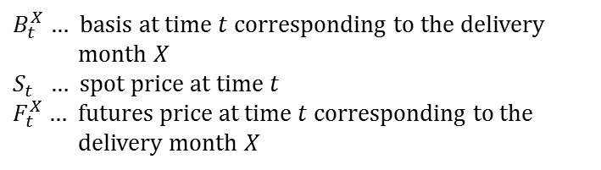

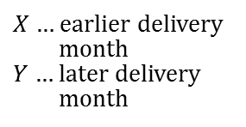



Futures basis and spread
Basis
  Basis in futures trading denotes the difference between the spot and futures prices (the opposite convention is used in some markets)
$B_{t}^{X}$ … basis at time $t$corresponding to the delivery month $X$
$S_{t}$ … spot price at time $t$
$F_{t}^{X}$… futures price at time $t$ corresponding to the delivery month $X$
$$B_{t}^{X}=S_{t}−F_{t}^{X}$$
  Contango (negative basis)
$X$… earlier delivery month
$Y$… later delivery month
$F_{t}^{X}>S_{t}$ ⇨ contango
$$F_{t}^{Y}>F_{t}^{X}>S_{t} \text{⇨} \text{normal} \text{contango}$$
  Backwardation (positive basis)
$F_{t}^{X}<S_{t}$ ⇨ backwardation
$$F_{t}^{Y}<F_{t}^{X}<S_{t} \text{⇨} \text{normal} \text{backwardation}$$
Spread
  Spread in futures trading denotes the difference between two futures prices; usually futures price of a later maturity (Y) is subtracted from futures price of an earlier maturity (X)
$D_{t}^{X,Y}$= $F_{t}^{X}−F_{t}^{Y}$
$D_{t}^{X,Y}$… spread of futures contracts $X$and $Y$at time $t$
The opposite convention in defining the spread is used in some markets (an earlier maturity price is subtracted from a later maturity price)

Slide 9
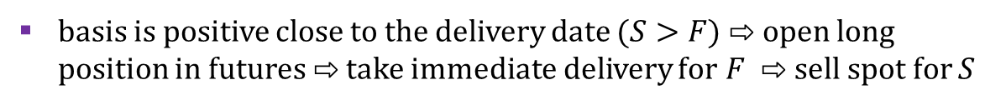






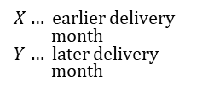
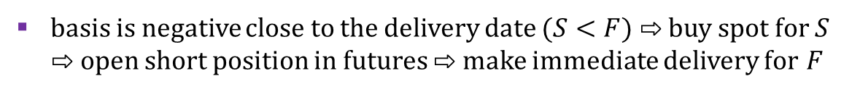


Zero basis at delivery
Convergence of spot and futures prices
On delivery date the basis must be zero, otherwise arbitrage opportunities would exist
basis is positive close to the delivery date $(S>F)$ ⇨ open long position in futures ⇨ take immediate delivery for $F$ ⇨ sell spot for $S$
basis is negative close to the delivery date $(S<F)$ ⇨ buy spot for $S$ ⇨ open short position in futures ⇨ make immediate delivery for $F$
Exchange Delivery Settlement Price (EDSP)
EDSP is an average of individual spot prices prevailing at the delivery date that is calculated from quotes of selected financial institutions
The way of determining the EDSP ensures zero basis at delivery date
Patterns of convergence
$$F_{0}^{Y}$$
$$S_{0}$$
$$F_{0}^{X}$$
Normal backwardation
$X$… earlier delivery month
$Y$… later delivery month
Normal contango
$$F_{0}^{X}$$
$$S_{0}$$
$$F_{0}^{Y}$$
$$D^{X}$$
$$D^{Y}$$
$$D^{X}$$
$$D^{Y}$$

Slide 10
Mechanics of futures hedge
Description of hedging strategy
    If the long holds the futures contract until maturity, then they can buy the underlying asset at a know-in-advance opening price
Gain or loss resulting from marking to market: $F_{CP}−F_{OP}$
Equality between closing and spot prices upon delivery: $F_{CP}=S_{T}$
Purchase of the underlying asset on the spot market: ${−S}_{T}$
Buyer’s net expenditure
$$\left(F_{CP}−F_{OP}\right)−S_{T}={−F}_{OP}−\left(S_{T}−F_{CP}\right)={−F}_{OP}−B_{T}={−F}_{OP}$$
Seller’s net revenue resulting from analogous trading strategy
$$\left(F_{OP}−F_{CP}\right)+S_{T}=F_{OP}+\left(S_{T}−F_{CP}\right)=F_{OP}+B_{T}=F_{OP}$$
Basis risk
Price uncertainty can be removed only at maturity when the basis is zero; prior to maturity the hedging strategy is exposed to basis risk
Buyer’s net expected expenditure: $\left(F_{t}−F_{OP}\right)−S_{t}={−F}_{OP}−B_{t}$
Seller’s net expected revenue: $\left(F_{OP}−F_{t}\right)+S_{t}=F_{OP}+B_{t}$
    Basis risk means that the trader does not know the future size of the basis prior to maturity

Slide 11
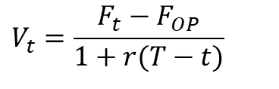

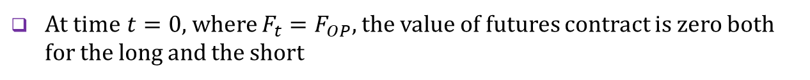

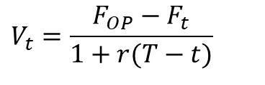
Value of futures contract
Value at expiration
1 | … | t | … | T
    At maturity, the long buys the underlying asset at the opening futures price $F_{OP}$ and sells it immediately at the existing spot price $S_{T}$, locking the value
$$V_{T}=S_{T}−F_{OP}$$
    By analogy, the short can lock the value
$$V_{T}=F_{OP}−S_{T}$$
Value before expiration
1 | … | t | … | T
    At time $t$, the long can sell the futures at the existing futures price $F_{t}$, locking the net income at maturity $F_{t}−F_{OP}$, whose present value at $t$is
$$V_{t}=\frac{F_{t}−F_{OP}}{1+r(T−t)}$$
    By analogy, the short can lock the present value
$$V_{t}=\frac{F_{OP}−F_{t}}{1+r(T−t)}$$
Value at inception
1 | … | t | … | T
    At time $t=0$, where ${F_{t}=F}_{OP},$the value of futures contract is zero both for the long and the short

Slide 12
Elimination of counterparty risk
Direct relationship
Client L (Long)
Broker of client L
Broker of client S
Client S (Short)
  Client L instructs their broker to buy and Client S instructs their broker to sell
Brokers arrange a deal on behalf of their clients
  Both clients are exposed to counterparty risk (damage caused by the default of the other side of an agreed upon transaction)
Interposing role of the Exchange
Client L (Long)
Broker of client L
Exchange
Broker of client S
Client S (Short)
After brokers intermediate the deal, the exchange becomes the official counterparty to every transaction; it honours obligations of defaulted clients
The arrangement does not protect clients against default of their brokers
The arrangement increases clients’ security, which is another important source of high liquidity of futures trading

Slide 13
See you in the next lecture
© O.D. Lecturing Legacy

