Slide 1

Examples of financial futures
Institute of Economic Studies
Faculty of Social Sciences
Charles University in Prague
Financial markets instruments
Notes:
Ztlumené efekty: 2,3,4
Odstranit srážku kamionu: snímek 8, 1:33 – 1:45

Slide 2
Introduction
Broad categories of financial futures
Short-term interest rate futures
Long-term interest rate futures
Currency futures
Stock index futures
General remarks
Examples used are hypothetical and are for illustrative purpose only; they do not coincide with specifications of currently traded contracts
Futures exchanges are constantly introducing new contracts, deleting contracts or changing specifications of existing contracts
Some large exchanges trading futures contracts
United States: Chicago Board Options Exchange (CBOE), Chicago Board of Trade (CBOT), New York Mercantile Exchange (NYMEX), New York Board of Trade (NYBOT)
United Kingdom: London International Financial Futures and Options Exchange (LIFFE), part of Intercontinental Exchange
Continental Europe: Eurex Exchange (Germany), Euronext (Netherlands)

Slide 3
Stock index futures (1)
Specification
Name of the contract | Stock Index Futures Tutorial 500 - SIFT 500¹⁾
Unit of trading | Value of 10 euros per one index point²⁾
Quotation | Index points
Tick size | One half of index point³⁾
Tick value | 5 EUR⁴⁾
Initial margin | 1000 EUR⁵⁾
Delivery months | March, June, September, December
Last trading day | Last business day of the delivery month, 10:30 a.m.
Delivery day | First business day after the last trading day
EDSP | Average of the values of the underlying stock index, measured every 15 seconds between 10:10 and 10:30 a.m. inclusively on the last trading day, of which the highest 12 and the lowest 12 values are discarded.⁶⁾
Underlying index is composed of share prices of 500 largest companies by market capitalization.
For example, an index value of 5,433 index points represents the contract value of 54,330 euros.
Two ticks are equivalent to one full index point.
5 EUR = ½ × 10 EUR.
With an index value of 5,433, the initial margin is about 1.8% of the value of the contract.
The averaging procedure aims at smoothing out excessive price fluctuations shortly before maturity.

Slide 4




Stock index futures (2)
Closing out
Today
Five days later
Maturity
$$F_{0}=5825.0$$
Buy 20 contracts
$$F_{5}=5812.5$$
Sell 20 contracts
EDSP = 5810.0
The futures price decreased by $2×\left(5812.5−5825.0\right)=2×(−12.5)=−25$ ticks
The long, who purchased 20 contracts, incurred a net loss
number of contracts × tick change × value of tick = $20×\left(−25\right)×5=−€2,500$
Rate of return
$${ROR}_{Periodic}=\frac{−2,500}{20×1,000}=−0.125=−12.5\%$$
$${ROR}_{Annualized}=−0.125×\frac{365}{5}=−912\%$$
Cash settlement
Stock index futures are settled in cash because physical delivery of the underlying stock index would entail extremely high transaction costs
Physical delivery would require delivering all shares included in the index and in proportions corresponding to the shares’ weights in the index
The final settlement takes into account the last marking to market based on the difference between EDSP and the closing price on the day before the last trading day; the trader’s loss deepened by €500

Slide 5
Currency futures (1)
Specification
Name of the contract | Euro Currency Futures Tutorial – ECFT¹⁾
Unit of trading | 25,000 EUR traded against the US dollar²⁾
Quotation | USD/EUR exchange rate, quoted to four decimal places^{3,4)}
Tick size | One hundredth of USD cent per one euro (0.0001 dollars per one euro)
Tick value | 2.5 USD⁵⁾
Initial margin | 1000 USD⁶⁾
Delivery months | March, June, September, December
Last trading day | Third Wednesday in a delivery month, @10:30 a.m.
Delivery day | First business day after the last trading day
EDSP | Average of spot exchange rates quoted at 10:30 a.m. by 15 reference banks, of which the highest 3 and the lowest 3 values are discarded.
The euro is the underlying asset, priced in terms of dollars. So, the euro is the traded currency and the dollar is the invoice currency.
The long buys 25,000 EUR and pays in USD for this. The short buys USD worth 25,000 EUR.
The euro is the base currency as it is represented in an exchange rate by one unit.
The dollar is the variable currency as it is represented in an exchange rate by a certain number of its units.
2.5 USD = 25,000 EUR × 0.0001 USD/EUR.
With an exchange rate of 1.1345 USD/EUR, the initial margin is about 3.5% of the value of the contract.

Slide 6
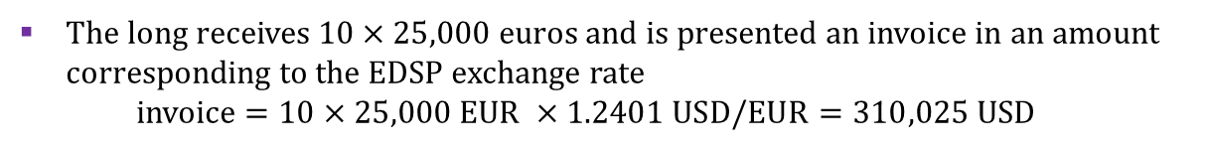




Currency futures (2)
Closing out
Today
Ten days later
Delivery
$$F_{0}=1.2311$$
Buy 10 contracts
$$F_{10}=1.2383$$
Sell 10 contracts
EDSP = 1.2401
The futures price increased by $\left(2383−2311\right)=72$ ticks
The long who purchased 10 contracts earned a net profit
number of contracts × tick change × value of tick = $10×72×2.5=1,800$ USD
Rate of return
$${ROR}_{Periodic}=\frac{1,800}{10×1,000}=0.18=18\%$$
$${ROR}_{Annualized}=0.18×\frac{365}{10}=6.57=657\%$$
Physical delivery
The long receives $10×25,000$ euros and is presented an invoice in an amount corresponding to the EDSP exchange rate
invoice $=10×25,000 \text{EUR} ×1.2401 \text{USD}\text{/}\text{EUR}=310,025$ USD
The implied exchange rate at which the long purchases euros reflects the invoiced amount and the gain in futures trade
$$\frac{\text{dollars} \text{paid}}{\text{euros} \text{received}}=\frac{310,025−10×(2401−2311)×2.5}{10×25,000}=\frac{310,025−2250}{250,000}=1.2311 \text{USD}\text{/}\text{EUR}$$
The long pays a known-in-advance opening futures price

Slide 7
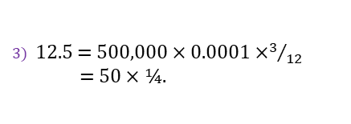
Short-term interest rate futures (1)
Long = Buyer of CD = Lender
Specification
Short = Seller of CD = Borrower
Name of the contract | Three-Month Euro Interest Rate Futures Tutorial – IRF3T
Unit of trading | 500,000 EUR¹⁾
Quotation | 100.00 minus futures rate of interest²⁾
Tick size | One basis point (0.01% on annual basis)
Tick value | 12.5 EUR³⁾
Initial margin | 500⁴⁾
Delivery months | March, June, September, December
Last trading day | Third Wednesday in a delivery month, @11:00 a.m.
Delivery day | First business day after the last trading day
EDSP | Three-month spot rate on the last trading day⁵⁾
In the case of physical delivery, the long places 500,000 euros in a three-month deposit account at an eligible bank, arranged by the short.
For example, a futures price of 90.50 implies a three-month interest rate of 9.5%.
12.5 = 500,000 × 0.0001 ×$3/{12}$
= 50 × ¼.
Initial margin represents 0.1% of the contract value.
The exchange contacts a sample of 16 banks offering a 3M euro deposit, eliminates the three top and bottom quotes and calculates the average of the remaining interest rates.

Slide 8







Short-term interest rate futures (2)
Closing out
Today
Two weeks later
Delivery
Three-month deposit period
End of deposit
$$F_{0}=90.50$$
Buy 1 contract
$$F_{14}=90.55$$
Sell 1 contract
$$EDSP=91.25$$
The futures price increased by $\left(9055−9050\right)=5$ ticks
The long earned a net profit = $1×5×12.5=62.5$ EUR
Rate of return
$${\text{ROR}}_{\text{Periodic}}=\frac{62.5}{1×500}=0.125=12.5\%$$
$${\text{ROR}}_{\text{Annualized}}=0.125×\frac{365}{14}=3.26=326\%$$
Cash settlement
The long earned a net profit = $1×(9125−9050)×12.5=937.5$ EUR
Implied deposit rate
$$500,000×r×\frac{91}{365}=937.5$$
$$⇒r=0.00752$$
$$\left(100−EDSP\right)+\frac{937.5}{500,000}×\frac{365}{91}=8.75\%+0.75\%=9.5\%=100−F_{0}$$
$$\frac{500,000×r×\frac{91}{365}}{1+r×\frac{91}{365}}=937.5$$
$$⇒r=0.00753$$
Physical delivery
The short arranges three-month deposit bearing an interest rate of 8.7%
The short compensates the long for the difference of 5 bp between the arranged deposit rate 8.70% and EDSP rate 8.75%
invoice = $0.0005×500,000×(91/365)\text{ = 62.33 }\text{EUR}$
The compensation allows the long to make a deposit at the opening rate 9.5%

Slide 9
Long-term interest rate futures
Specification
Name of the contract | Long-term Treasury Bond Futures Tutorial
Unit of trading | Notional 20-year Treasury bond with a nominal value of 100,000 USD and a yield to maturity of 7%
Quotation | Price per 100 USD nominal value^{1,2)}
Tick size | One cent (0.01 USD)
Tick value | 10 USD³⁾
Initial margin | 2,000 USD⁴⁾
Delivery months | March, June, September, December
Last trading day | Two business days prior to the last business day in the delivery month
Delivery day | Any business day in the delivery month
EDSP | Contract‘s futures price at 11:00 a.m. on the second business day prior to the last trading date⁵⁾
Quoted price (QP) = contract value (CV)/1,000
Futures prices are quoted clean (no allowance for accrued coupon).
CV = QP × 1,000
CV + tick value (TV) = (QP + 0.01) × 1,000
⇨ TV = 10 USD
Initial margin is equal to 2% of the contract value.
Due to the notional nature of the underlying asset, the rule of zero base at maturity is theoretically applicable for the CTD bond.

Slide 10





LTIRF – delivery options
Closing out
Today
45 days later
 | Delivery month
$$F_{0}=91.38$$
Sell 10 contracts
$$F_{45}=91.23$$
Buy 10 contracts
The futures price decreased by $\left(9123−9138\right)=−15$ ticks
The short earned a net profit = $10×15×10=1,500$ USD
Rate of return
$${ROR}_{Periodic}=\frac{1,500}{10×2,000}=0.075=7.5\%$$
$${ROR}_{Annualized}={ROR}_{Periodic}×\frac{365}{45}=60.83\%$$
Physical delivery
18 November
previous coupon day
$S_{0}=99.13$(dirty)
$F_{0}=88.19$(clean)
$$r=8\%$$
1 April
today
18 May
next coupon day
Beginning of
delivery month
18 November
after next coupon day
11 | 12 | 1 | 2 | 3 | 4 | 5 | 6 | 7 | 8 | 9 | 10 | 11
134 days
14 days
30 days
60 days
170 days
11 years to maturity
Properties of the exercise bond
Nominal value: 100 USD; annual coupon: 8% paid semi-annually
Remaining time to maturity: 12 years from the previous coupon day
Spot price is dirty and futures price is clean

Slide 11


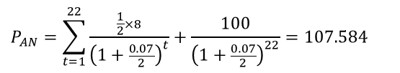
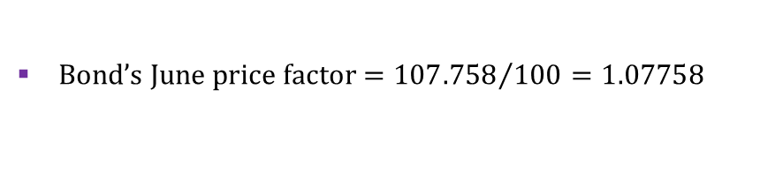
LTIRF – price factor
Price (conversion) factor
Futures price of deliverable bond = bond’s price factor × contract‘s futures price
Price factor is calculated as a bond’s clean price of 1 unit of face value at which the bond has a yield to maturity of 7% (as the contract’s notional bond)
Price factors are calculated for the first day of the delivery month (so they differ for each delivery month) and remain constant during the delivery cycle
Price factors are calculated and published by the exchange
Numerical example
previous coupon day
today
next coupon day
after-next coupon day
11 | 12 | 1 | 2 | 3 | 4 | 5 | 6 | 7 | 8 | 9 | 10 | 11
14 days
170 days
11 years to maturity
Bond’s price on the after-next coupon day (22 semi-annual coupon payments)
$$P_{AN}=\sum_{t=1}^{22}{\frac{\frac{1}{2}×8}{{\left(1+\frac{0.07}{2}\right)}^{t}}+\frac{100}{{\left(1+\frac{0.07}{2}\right)}^{22}}=107.584}$$
Bond’s dirty price at the beginning of the delivery month
$$P_{D}=\frac{1}{{\left(1+\frac{0.07}{2}\right)}^{170/182.5}}×\left(107.584+\frac{1}{2}×8\right)=108.065$$
Bond’s clean price at the beginning of the delivery month
$$P_{C}=108.065−\frac{14}{182.5}×\frac{8}{2}=107.758$$
Bond’s June price factor ${=107.758}/{100=1.07758}$

Slide 12
LTIRF – cost-of-carry transaction
Cost-of-carry transaction
Cost-of-carry is the trading strategy used by the short when delivering the bond to the long
③
②
①
Futures market
The short
Bond market
Money market
④
⑤
⑥
①
The short takes a loan on the money market
②
The short uses the loan to pay for the bond
③
The short acquires the bond
HOLDING PERIOD
④
The short delivers the bond to the long
⑤
The long pays for the bond
⑥
The short repays the loan
The holding period generates carry
positive carry: collection of accrued coupon provided by the bond
negative carry: payment of interest on borrowed funds

Slide 13


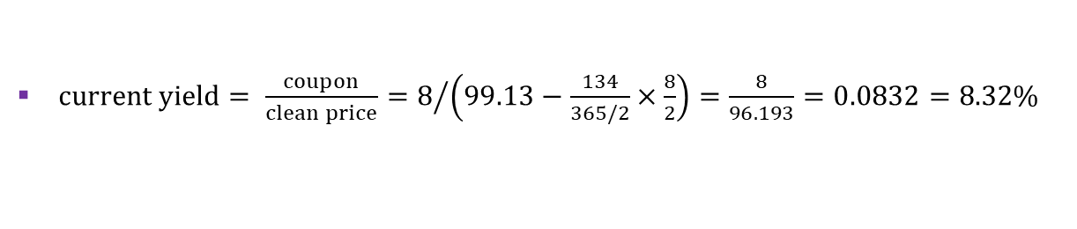
LTIRF – delivery date
Choosing the delivery date
The short is allowed to deliver a bond any business day in the delivery month
In reality, only the first or the last business day in delivery month is chosen, depending on the nature of the carry
current yield > interest rate ⇨ delivery will be on the last business day
current yield < interest rate ⇨ delivery will be on the first business day
Numerical example
$S_{0}=99.13$(dirty)
$F_{0}=88.19$(clean)
$$r=8\%$$
previous coupon day
today
next coupon day
after-next coupon day
11 | 12 | 1 | 2 | 3 | 4 | 5 | 6 | 7 | 8 | 9 | 10 | 11
134 days
$current yield= \frac{coupon}{clean price}=8/{\left(99.13−\frac{134}{365/2}×\frac{8}{2}\right)}=\frac{8}{96.193}=0.0832=8.32\%$
$interest rate=8\%$
Carry is a positive number (the coupon income from holding the bond exceeds the interest cost of the loan), so delivery day is the last business day

Slide 14

LTIRF – CTD bond
Cheapest-to-deliver bond (CTD bond)
The short may choose any bond for delivery from a given list compiled by the exchange
The cheapest-to-deliver bond gives the largest rate of return from the cost-of-carry transaction, called implied repo rate
Repo transaction (collateralized loan)
Cost-of-carry transaction
Bond collateral
Bond purchase
Loan
Cash
Cash outflow
Repo buyer
Repo market
Futures market
The short
Bond market
Money market
Cash inflow
Bond
Bond delivery
Loan repayment
Implied repo rate formula
$$\text{loan}\text{ (}\text{cash} \text{outflow}\text{) ×}\left(1+\text{implied} \text{repo} \text{rate}×\frac{\text{implied} \text{repo} \text{term}}{365}\right)=\text{repayment}\text{ (}\text{cash} \text{inflow}\text{)}$$
$\text{cash} \text{outflow}\text{ = }\text{purchasing} \text{price}\text{ (}\text{dirty}\text{) }\text{of} \text{the} \text{bond}$
$\text{cash} \text{inflow}\text{ =}$
$$\text{anticipated} \text{bond}\text{′}\text{s} \text{selling} \text{price}\text{ (}\text{clean}\text{) }\text{on} \text{delivery} \text{day}\text{ (}\text{equal} \text{to} \text{the} \text{product} \text{of} \text{current} \text{futures} \text{price} and \text{b}\text{ond}\text{′}\text{s} \text{price} \text{factor}\text{)}$$
$$\text{+ }\text{accrued} \text{coupon} \text{in} \text{the} \text{period} \text{from} \text{acquiring} \text{the} \text{bond} \text{to} \text{delivery} \text{day}$$
$$\text{ + }\text{coupon} \text{received} \text{and} \text{reinvested} \text{from} \text{next} \text{coupon} \text{day} \text{to} \text{delivery} \text{day}\text{ (}\text{if} \text{there} \text{is} \text{coupon} \text{day} \text{between} \text{ac}\text{quiring} \text{a}\text{nd} \text{delivering} \text{the} \text{bond}\text{)}$$
$$−\text{interest} \text{cost} \text{of} \text{the} \text{money} \text{market} \text{loan}$$

Slide 15
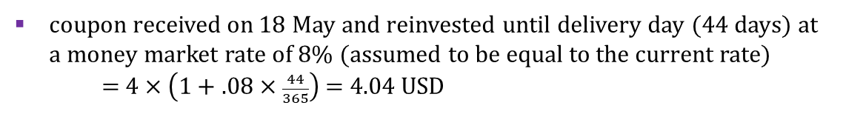
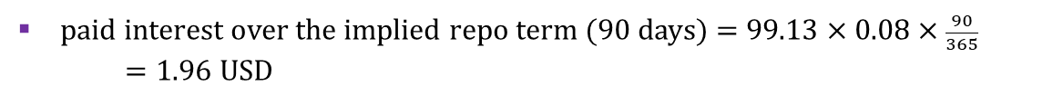
LTIRF – calculation of implied repo rate
Implied repo rate - numerical example
18 November
previous coupon
$S_{0}=99.13$(dirty)
$F_{0}=88.19$(clean)
$$r=8\%$$
1 April
today
18 May
next coupon
30 June
delivery
18 November
after next coupon
11 | 12 | 1 | 2 | 3 | 4 | 5 | 6 | 7 | 8 | 9 | 10 | 11
46 days
14 days
30 days
Cash outflow on 1 April (extension of the ‘implied repo loan’)
payment of the dirty price of the bond = 99.13 USD
Cash inflow on 30 June (repayment of the ‘implied repo loan’)
Invoice
(paid by the long to the short)
anticipated clean selling price = 88.19 × 1.07758 = 95.03 USD
accrued coupon from 18 May to 30 June (44 days) = $8×\frac{44}{365}$ =0.96 USD
coupon received on 18 May and reinvested until delivery day (44 days) at a money market rate of 8% (assumed to be equal to the current rate)
= 4 × $\left(1+.08×\frac{44}{365}\right)$ = 4.04 USD
paid interest over the implied repo term (90 days) = 99.13 × 0.08 × $\frac{90}{365}$
$=1.96$USD
Implied repo rate - results
$$\left(\frac{\text{inflow}}{\text{outflow}}−1\right)×\frac{365}{implied repo term}=\left(\frac{95.03+0.96+4.04−1.96}{99.13}−1\right)×\frac{365}{90}=−0.043=−4.3\%$$

Slide 16
See you in the next lecture
© O.D. Lecturing Legacy

