Slide 1

Cost-of-carry model
Institute of Economic Studies
Faculty of Social Sciences
Charles University in Prague
Financial markets instruments
Notes:
Ztlumené efekty: 2,3,4
Odstranit srážku kamionu: snímek 8, 1:33 – 1:45

Slide 2
Introduction
Motivation
Cost-of-carry (also called cash-and-carry) is a model that determines the fair futures price of an underlying asset
Fairness is associated with no-arbitrage conditions
a risk-free investment strategy must yield at most a risk-free rate of return
a zero-investment risk-free strategy must yield a zero return
Variables
$S_{0}$ . . . current spot price of the underlying asset
$F_{0}$ . . . current futures price of the underlying asset
$T$ . . . time to maturity of the futures contract
$d$ . . . annual rate of return from holding the underlying asset (coupons, dividends,
convenience yield, etc.)
$r$ . . . annual rate of cost incurred by holding the underlying asset (interest,
insurance, storage, quality deterioration, etc.)
Carry
Carry is the net cash flow associated with holding the asset
Carry helps explain why some futures markets are in contango while others are in backwardation

Slide 3



Borrowing-cash strategy
Cash flows of borrowing-cash strategy
$+S_{0}$ taking the loan to buy the asset
today
$−S_{0}$ purchasing the asset on the spot market
$0$ opening short futures position
$+F_{0}$ making delivery to futures position
maturity
$−S_{0}$ repaying the loan
$+dS_{0}T$ positive carry: receiving the asset’s income
$−rS_{0}T$ negative carry: paying interest on the loan
Cost-of-carry formula
This strategy involves no initial investment and is completely risk-free, so its net gain must be zero, based on no-arbitrage argument
$$0=\left(F_{0}+dS_{0}T\right)−\left(S_{0}+rS_{0}T\right)$$
$$⇨{ F}_{0} =S_{0}+S_{0}\left(r−d\right)T$$
cash inflow
cash outflow
Alternative representation
$$S_{0}−F_{0}=S_{0}\left(d−r\right)T$$
futures basis
carry
a positive carry $\left(d>r\right)$ implies a positive basis $\left(S_{0}>F_{0}\right)$, so the market is in backwardation
a negative carry $\left(d<r\right)$ implies a negative basis $\left(S_{0}<F_{0}\right)$, so the market is in contango

Slide 4


Borrowing-asset strategy
Cash flows of borrowing-asset strategy (short selling)
$+S_{0}$ borrowing the asset and selling it on the spot market
today
$−S_{0}$ putting the revenue in a time deposit
$0$ opening long futures position
$−F_{0}$ taking delivery from futures contract
maturity
$+S_{0}$ terminating the time deposit
$+rS_{0}T$ positive carry: earning interest on time deposit
$−dS_{0}T$ negative carry: transferring the asset’s income to the asset’s owner
Cost-of-carry formula
The strategy involves no initial investment and is completely risk-free, so its net gain must be zero based on no-arbitrage argument
$$0=\left(S_{0}+rS_{0}T\right)−\left(F_{0}+dS_{0}T\right)$$
$$⇨{ F}_{0} =S_{0}+S_{0}\left(r−d\right)T$$
cash inflow
cash outflow
Alternative representation
$$S_{0}−F_{0}=S_{0}\left(d−r\right)T$$
futures basis
carry
a positive carry $\left(d>r\right)$ implies a positive basis $\left(S_{0}>F_{0}\right)$, so the market is in backwardation
a negative carry $\left(d<r\right)$ implies a negative basis $\left(S_{0}<F_{0}\right)$, so the market is in contango

Slide 5

Carry with two futures contracts
Variables
$F_{0}^{1}$ . . . current price of an earlier maturing futures contract
$F_{0}^{2}$ . . . current price of a later maturing futures contract
$T^{1}$ . . . delivery of the earlier maturing futures contract
$T^{2}$ . . . delivery of the later maturing futures contract
$d$ . . . annual rate of return from holding the underlying asset
$r$ . . . annual rate of cost incurred from holding the underlying asset
Cash flows of cost-of-carry strategy
$0$ opening long position in the earlier delivery contract
today
$0$ opening short position in the later delivery contract
$0$ arranging forward loan for the period ${[T}^{1},T^{2}]$
earlier
delivery
$+F_{0}^{1}$ taking the loan to buy the asset
$−F_{0}$ taking delivery from earlier maturing futures contract
$+F_{0}^{2}$ making delivery to later maturing futures contract
later
delivery
$−F_{0}^{1}$ repaying the loan
$+dF_{0}^{1}(T^{2}− T^{1})$ positive carry: receiving the asset’s income
$−rF_{0}^{1}(T^{2}−{ T}^{1})$ negative carry: paying interest on the loan
Cost-of-carry formula
$$0=\left[F_{0}^{2}+dF_{0}^{1}\left(T^{2}−T^{1}\right)\right]−\left[F_{0}^{1}+rF_{0}^{1}\left(T^{2}−T^{1}\right)\right]$$
$${⇨F}_{0}^{1}−F_{0}^{2}=F_{0}^{1}(d−r)\left(T^{2}−T^{1}\right)$$
cash inflow
cash outflow
futures spread
carry
Cost-of-carry model
5

Slide 6

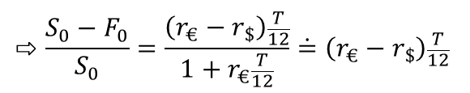


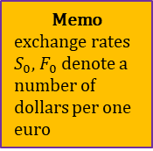
Application for currency forwards
Cash flows of cost-of-carry strategy
$+S_{0}$ borrowing one euro and selling it for dollars at spot exchange rate $S_{0}$
Memo
exchange rates $S_{0}$, $F_{0}$denote a number of dollars per one euro
today
$−S_{0}$ putting dollars in $T$-month dollar time deposit
$0$ arranging a forward sale of time deposit balance at current forward rate $F_{0}$
$+S_{0}$ getting back the principal of the dollar time deposit
maturity
$−1×F_{0}$ converting dollars to repay the principal of the one-euro loan
$+r_{\$}S_{0}\frac{T}{12}$ positive carry: receiving interest on the dollar time deposit
$−(1×r_{€}\frac{T}{12})F_{0}$ negative carry: converting dollars to pay interest on the euro loan
Covered interest rate parity
$$⇨\frac{S_{0}−F_{0}}{S_{0}}=\frac{\left(r_{€}−r_{\$}\right)\frac{T}{12}}{1+r_{€}\frac{T}{12}}\dot{=}\left(r_{€}−r_{\$}\right)\frac{T}{12}$$
$$0=\left(S_{0}+r_{\$}S_{0}\frac{T}{12}\right)−\left(F_{0}+r_{€}F_{0}\frac{T}{12}\right)$$
cash inflow
cash outflow
forward discount or premium
interest rate differential
CIRP states that the percentage size of forward discount or premium is related to the size of the interest rate differential
higher euro interest rate must be offset by weaker forward euro exchange rate (forward discount of euro against dollar or forward premium of dollar against euro)
$$r_{€}>r_{\$}⇨S_{0}>F_{0}$$
lower euro interest rate must be offset by stronger forward euro exchange rate (forward premium of euro against dollar or forward discount of dollar against euro)
$$r_{€}<r_{\$}⇨S_{0}<F_{0}$$

Slide 7
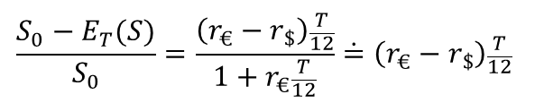


Uncovered interest rate parity
Description
UIRP is a speculative strategy similar to CIRP, in which the forward exchange rate is replaced by the anticipated spot exchange rate
$$\frac{S_{0}−E_{T}(S)}{S_{0}}=\frac{\left(r_{€}−r_{\$}\right)\frac{T}{12}}{1+r_{€}\frac{T}{12}}\dot{=}\left(r_{€}−r_{\$}\right)\frac{T}{12}$$
Expected exchange rate changes are linked to interest rate differentials
Non-deliverable forward
NDF is financial instrument which benefits from inconsistency between interest rate differential and fixed exchange rate regime
CIRP: higher interest rates in former Czechoslovakia than in Germany implied weaker forward exchange rate of Czech koruna against German mark
$r_{DEM}<r_{CSK}$ ⇨ $S_{CSK/DEM}<F_{CSK/DEM}$
fixed exchange rate implied equality between the current and the expected spot exchange rates
$$E_{T}\left(S\right)=S$$
Trading strategy offered by banks as one deal
today: arranging forward sale of 1 DEM
later: purchase of 1 DEM spot and sale of 1 DEM forward generates a risk-free positive income $−E_{T}\left(S\right)+F=−S+F>0$
practical complications: fluctuation bands, peg to a currency basket

Slide 8
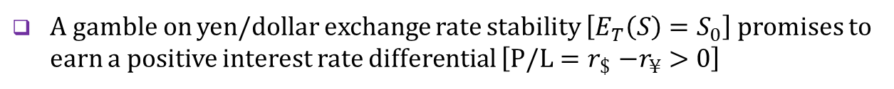
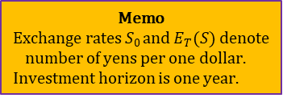
Carry trade
Description
Currency carry trade consists of borrowing a low-yield currency (funding currency) to buy a high-yield currency (investment currency) in an attempt to capture the difference between the two yields
Profit/loss from carry trade (yen is the funding currency and dollar is the investment currency)
$S_{0}$ . . . current yen/dollar spot exchange rate
$E_{T}(S)$ . . . expected yen/dollar spot exchange rate
Memo
Exchange rates 𝑆₀ and $E_{T}(S)$ denote number of yens per one dollar.
Investment horizon is one year.
$r_{¥}$ . . . yield of a yen-denominated asset
$r_{\$}$ . . . yield of a dollar-denominated asset
$$\text{P}\text{/}\text{L}=\left[(1/{S_{0}})×(1+r_{\$})\right]×E_{T}(S)−\left(1+r_{¥}\right)=\frac{E_{T}(S)}{S_{0}}\left(1+r_{\$}\right)−\left(1+r_{¥}\right)$$
Remarks
A gamble on yen/dollar exchange rate stability $\left[E_{T}\left(S\right)=S_{0}\right]$ promises to earn a positive interest rate differential $\left[\text{P}\text{/}\text{L}{=r}_{\$}−r_{¥}>0\right]$
Carry trade strategy is exposed to the risk of a sharp appreciation of funding currency $\left[E_{T}\left(S\right)<S_{0}\right]$
No profit/loss condition in the carry trade payoff [P/L = 0] is equivalent to the equation of uncovered interest rate parity

Slide 9
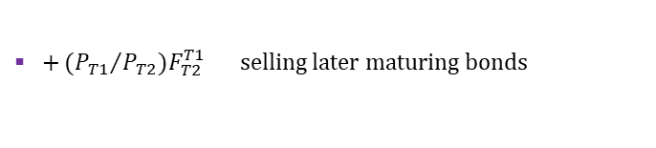

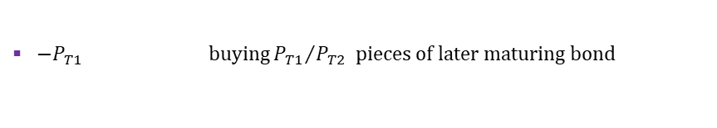
Application for zero-coupon bonds
Variables
$T_{1},T_{2}$ . . . times to maturity of earlier and later maturing bonds
$P_{T1},P_{T2}$ . . . current prices of earlier and later maturing zero-coupon bonds
$F_{T2}^{T1}$ . . . forward price of the later maturing bond at time of earlier maturity
$r_{T1},r_{T2}$ . . . current yields to maturity of earlier and later maturing bonds
${}_{T1}^{ }{f_{T2}}$ . . . yield to maturity of the later maturing bond over the period ${[T}_{1},T_{2}]$
$M$ . . . nominal value of earlier and later maturing bonds
$$P_{T1}=\frac{M}{{\left(1+r_{T1}\right)}^{T_{1}}}, { P}_{T2}=\frac{M}{{\left(1+r_{T2}\right)}^{T_{2}}}, { F}_{T2}^{T1}=\frac{M}{{\left(1+{}_{T1}^{ }{f_{T2}}\right)}^{T_{2}−T_{1}}}$$
Cash flows of cost-of-carry strategy
${+P}_{T1}$ issuing one piece of earlier maturing bond
today
${−P}_{T1}$ buying ${P_{T1}}/{P_{T2}}$ pieces of later maturing bond
$0$ selling forward later maturing bonds with delivery time $T_{1}$
earlier
maturity
$−M$ repaying the earlier maturing bond
$+{{(P}_{T1}}/{P_{T2})F_{T2}^{T1}}$ selling later maturing bonds
Interest rate parity
$$0={+\left(P_{T1}/P_{T2}\right)F}_{T2}^{T1}−M=\left(\frac{M}{{\left(1+r_{T1}\right)}^{T_{1}}}:\frac{M}{{\left(1+r_{T2}\right)}^{T_{2}}}\right)×\frac{M}{{\left(1+{}_{T1}^{ }{f_{T2}}\right)}^{T_{2}−T_{1}}}−M$$
$${\left(1+r_{T2}\right)}^{T_{2}}={\left(1+r_{T1}\right)}^{T_{1}}×{\left(1+{}_{T1}^{ }{f_{T2}}\right)}^{T_{2}−T_{1}}$$
left hand side: outcome of $T_{2}$–year investment
right hand side: outcome of $T_{1}$–year investment rolled over for ${(T}_{2}−T_{1})$–year period
Cost-of-carry model
9

Slide 10

Fair price of stock-index futures
Variables
$S_{0}$ . . . current market price of stock portfolio
$S_{1}$ . . . market price of stock portfolio at delivery of futures contract
$F_{0}$ . . . current price of stock-index futures
$T$ . . . time to maturity of stock-index futures contract
$d$ . . . dividend yield of stock portfolio
$r$ . . . current money market borrowing rate
Cash flows of cost-of-carry strategy
${+S}_{0}$ taking a loan to purchase shares included in the stock index
today
${−S}_{0}$ purchasing shares at quantities corresponding to the index's composition
$0$ opening short position in the stock-index futures
$+S_{1}$ selling shares at market price
delivery
$−S_{0}\left(1+rT\right)$ repaying the loan with an interest
${dTS}_{0}$ dividends from stock portfolio
$F_{0}−S_{1}$ balance on the margin account
Stock-index parity
$$0=S_{1}−S_{0}\left(1+rT\right)+dTS_{0}+\left(F_{0}−S_{0}\right)$$
$$⇨ F_{0}=S_{0}+\left(r−d\right)TS_{0}$$
Sources of market imperfections: costs of forming and maintaining tracking portfolio, taxation of dividends, uncertain timing of dividends, etc.
Transaction costs can be lowered by investing in Exchange Traded Funds (ETF) which copy the composition of an underlying stock index
Cost-of-carry model
10

Slide 11
See you in the next lecture
© O.D. Lecturing Legacy

