Slide 1

Speculation with futures
Institute of Economic Studies
Faculty of Social Sciences
Charles University in Prague
Financial markets instruments
Notes:
Ztlumené efekty: 2,3,4
Odstranit srážku kamionu: snímek 8, 1:33 – 1:45

Slide 2



Introduction
Description of speculative trade
Speculators open short-term risky positons with the aim of making quick profit from supposed mispricing
underpricing results in opening long positions that benefit from price increase
overpricing results in opening short positions that benefit from price decline
Attractiveness of futures contracts
High liquidity (futures contracts can be opened and closed rapidly thanks to high levels of standardization)
Easy speculation on falling prices (short selling on spot markets can be subject to regulation, avoiding disruptive effect on prices)
Financial leverage (initial margin is a fraction of the value of the futures contract)
unlevered rate of return (the underlying asset must be purchased to get access to its price change)
$$r_{U}=\frac{∆P}{P}$$
levered rate of return (access to expected price change is made possible by paying a much smaller amount than the asset price)
$$r_{L}=\frac{∆P}{αP}=\frac{1}{α}×r_{U}$$
$$α=2\%⇨r_{L}=50×r_{U}$$

Slide 3


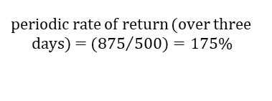

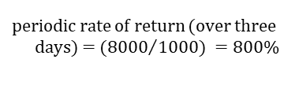
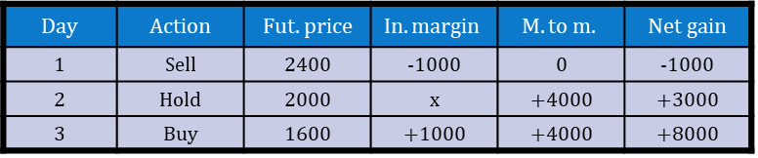
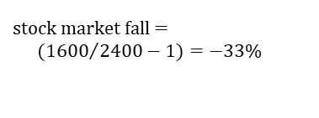
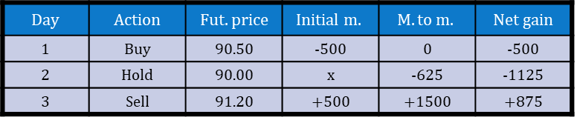
Open position trading
Description
Open position trading (directional trading) takes a view on the expected direction of price change
long OPT benefits from price increase (speculators want to buy futures contracts)
short OPT benefits from price decline (speculators want to sell futures contracts)
Examples
Long open position trading
Contract: three-month euro interest rate futures
Memo
Contract size: 500,000 EUR
Tick size: one basis point
Tick value: 12.5 EUR
Initial margin: 500 EUR
$$Day$$ | Action | $$Fut. price$$ | $$Initial m.$$ | $$M. to m.$$ | Net gain
1 | Buy | 90.50 | -500 | 0 | -500
2 | Hold | 90.00 | x | -625 | -1125
3 | Sell | 91.20 | +500 | +1500 | +875
interest rates drop = $\left(100−91.2\right)−\left(100−90.5\right)=−70 bp$
periodic rate of return (over three days) = $({875}/{500)}=175\%$
annual rate of return = $175×\frac{365}{3}=$
$$=21,292\%$$
Short open position trading
Contract: stock index futures
Memo
Tick size: ½ index point
Tick value: 5 EUR
Initial margin: 1,000 EUR
$$Day$$ | Action | $$Fut. price$$ | $$In. margin$$ | $$M. to m.$$ | Net gain
1 | Sell | 2400 | -1000 | 0 | -1000
2 | Hold | 2000 | x | +4000 | +3000
3 | Buy | 1600 | +1000 | +4000 | +8000
stock market fall = $({1600}/{2400−1)=−33\%}$
periodic rate of return (over three days) = $({8000}/{1000}) =800\%$
annual rate of return = $800×\frac{365}{3}$
$$=97,333\%$$

Slide 4


Spread trading (1)
Description
Spread trading consists of the simultaneous purchase and sale of two futures contracts, taking a view on the expected change in the difference between prices of these contracts
Intra-contract spread is formed by simultaneous long and short positions in the same futures contract using different maturities
buying a spread means to be long in earlier maturing and short in later maturing contracts; speculator expects that the spread will widen (it will become more positive or less negative)
selling a spread means to be short in earlier maturing and long in later maturing contracts; speculator expects that the spread will narrow (it will become less positive or more negative)
Inter-contract spread combines different types of futures contracts
Risk profile
Spread trades are less risky because losses in one leg of the spread tend to be offset by gains in the other leg of the spread and vice versa
$$S_{1}$$
$$S_{2}$$
September futures price
June futures price
spot price
June
September
Lower risk is reflected in a lower initial margin compared with open position trading, so the leverage in spread trades is also very high

Slide 5
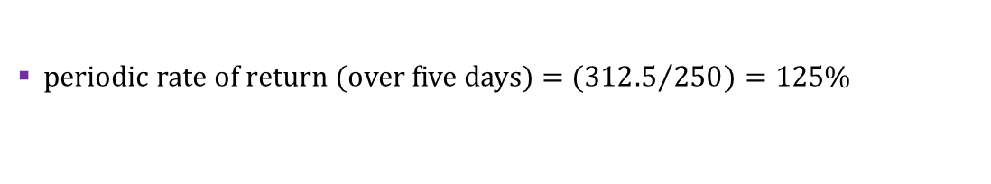
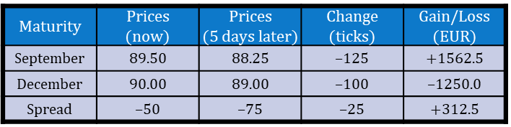
Spread trading (2)
Example
$$Maturity$$ | Prices (now) | $$Prices$$ (5 days later) | Change (ticks) | Gain/Loss (EUR)
September | 89.50 | 88.25 | ‒125 | +1562.5
December | 90.00 | 89.00 | ‒100 | ‒1250.0
Spread | ‒50 | ‒75 | ‒25 | +312.5
Memo
Contract: three-month interest rate futures
Tick size: one basis point
Tick value: 12.5 EUR
Spread initial margin: 250 EUR
speculator expects the spread to narrow (by becoming more negative)
speculator sells the September­‒December spread
speculator is short in September futures and long in December futures contract
Results
new spread (after five days) is more negative as a result of the September contract declining faster than the December contract
a decline in the price of the September futures contract makes a profit while a decline in the price of the December futures contract makes a loss
periodic rate of return (over five days) = $({312.5}/{250)}=125\%$
annual rate of return = $125×\frac{365}{5}=9,125\%$

Slide 6
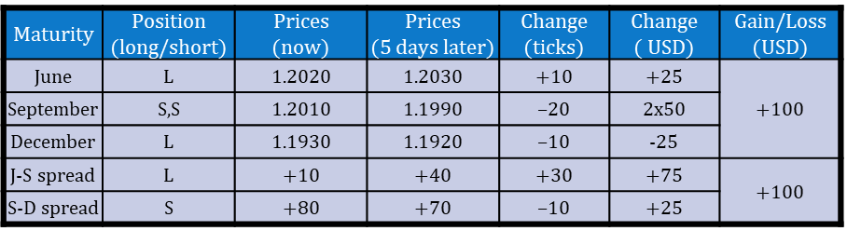
Butterfly spread
Description
Butterfly spread trade is composed of three futures contracts that form two spreads, one long and the other short, with a common middle contract
Speculator takes a view on the relationship between two spreads, unsure which price will adjust to correct the price anomaly
Example
$$Maturity$$ | Position (long/short) | Prices (now) | Prices (5 days later) | Change (ticks) | Change ( USD) | Gain/Loss (USD)
June | L | 1.2020 | 1.2030 | +10 | +25 | +100
September | S,S | 1.2010 | 1.1990 | ‒20 | 2x50
December | L | 1.1930 | 1.1920 | ‒10 | -25
J-S spread | L | +10 | +40 | +30 | +75 | +100
S-D spread | S | +80 | +70 | ‒10 | +25
Memo
Contract size: 25,000 EUR
Tick size: one basis point
Tick value: 2.5 USD
Speculator discovers spread anomaly in euro currency futures contract
the Jun-Sep spread looks too narrow while the Sep-Dec spread looks too wide
a long butterfly trade assumes that the two spreads will converge irrespective of which futures prices will adjust
total gain
1) 10×2.5 ‒ 2×(-20)×2.5 + (-10)×2.5 = 100 USD
2) [(40‒10) ‒ (70‒80)] × 2.5 = 100 USD
Speculation with futures
6

Slide 7
See you in the next lecture
© O.D. Lecturing Legacy

