Slide 1

Hedging with futures
Institute of Economic Studies
Faculty of Social Sciences
Charles University in Prague
Financial markets instruments
Notes:
Ztlumené efekty: 2,3,4
Odstranit srážku kamionu: snímek 8, 1:33 – 1:45

Slide 2
Typology of hedging
Price-fixing hedge
Removing uncertainty by determining a price for a given future transaction
forward contract: a known-in-advance price is negotiated between the provider and the user of hedging transaction
futures contract: a known-in-advance price is equal to the opening futures price at the contract’s maturity (due to marking-to-market and zero base at maturity)
Offsetting hedge
Mitigating uncertainty by using a futures contract whose price movements offset possible price losses on the hedged asset
change in the asset’s spot value = offsetting change in the futures contract’s value
long/short short/long
Terminology
perfect hedge: price movements of the hedging futures contract are perfectly correlated with the price movement of the hedged asset
direct hedge: perfect hedge when the underlying asset of the hedging futures contract is the same as the hedged asset
partial hedge: price movements of the hedging futures contract are imperfectly correlated with the price movement of the hedged asset
cross hedge: partial hedge when the underlying asset of the hedging futures contract is different from the hedged asset

Slide 3



Price-fixing hedge with spot trades
Examples
Interest rate parity – synthetic creation of forward rates by combining spot borrowing and lending
    5M borrowing
    Cash inflow
Combination of two-month lending and five-month borrowing creates synthetic three-month borrowing in two months’ time at a known-in-advance interest rate
1 | 2 | 3 | 4 | 5
    2M lending
    Cash outflow
$${}_{2}^{ }{f_{5}=\left(\frac{1+\frac{5}{12}r_{5M}}{1+\frac{2}{12}r_{2M}}−1\right)×\frac{12}{3}}$$
Natural hedge of the exchange rate risk
    EUR export earnings (Ex)
Natural exchange rate hedge effectively shifts future spot currency conversion to the present at a current spot exchange rate
    Buying CZK for EUR
    EUR 5M loan
1 | 2 | 3 | 4 | 5
    Selling EUR for CZK
    CZK 5M deposit
$$implied exchange rate=\frac{1+\frac{5}{12}r_{CZK}}{1+\frac{5}{12}r_{EUR}}e_{CZK/EUR}$$
    EUR 5M loan repayment
$$borrowed EUR amount=\frac{Ex}{1+\frac{5}{12}r_{EUR}};$$
$$CZK amount after conversion and earned interest =\frac{Ex×e_{CZK/EUR}}{1+\frac{5}{12}r_{EUR}}×\left(1+\frac{5}{12}r_{CZK}\right)$$
Disadvantages of synthetic forwards
a higher number of spot transactions increases transaction costs, so synthetic hedge is more expensive to implement
spot borrowing may adversely affect the company’s leverage

Slide 4










Price-fixing hedge with estimated basis
Basis risk
A price-fixing hedge with futures only works at a contract’s maturity when the basis is zero; prior to the contract’s expiration the hedge is exposed to the basis risk because the size of the basis is not known in advance
Buyer’s and seller’s risk exposures
buyer’s net expenditure:
$$\left(F_{t}−F_{OP}\right)−S_{t}={−F}_{OP}−\left(S_{t}−F_{t}\right)={−(F}_{OP}+B_{t})$$
seller’s net revenue:
$$\left(F_{OP}−F_{t}\right)+S_{t}=F_{OP}+\left(S_{t}−F_{t}\right)=F_{OP}+B_{t}$$
Linear interpolation of basis
The method of linear interpolation of the basis assumes linear convergence of the spot and futures prices
$$B_{0}$$
    Solving similar triangles
$$\frac{B_{t}}{T−t}=\frac{B_{0}}{T}$$
$$⇒ B_{t}=B_{0}×\frac{T−t}{T}$$
$$B_{t}$$
$T$ … time to the futures contract’s maturity
$$B_{T}$$
$$0$$
$$t$$
$$T$$
$t$ … effective date of the hedge
Effective hedged price
$$S_{H}=F_{OP}+B_{t}=F_{OP}+B_{0}×\frac{T−t}{T}$$

Slide 5
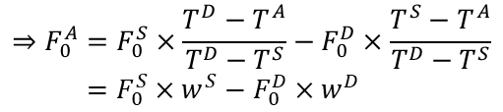









Price-fixing hedge with notional futures
Background idea
A price-fixing hedge using futures contracts can be simulated with a notional futures contract whose maturity is equal to the date of the effective hedge
$$F_{0}^{D}$$
    Solving similar triangles
$$\frac{F_{0}^{D}−F_{0}^{A}}{T^{D}−T^{A}}=\frac{F_{0}^{S}−F_{0}^{A}}{T^{S}−T^{A}}$$
$A$ … August
$$J …June$$
$$S…September$$
$$F_{0}^{S}$$
    futures price
$$F_{0}^{A}$$
$$⇒F_{0}^{A}=F_{0}^{S}×\frac{T^{D}−T^{A}}{T^{D}−T^{S}}−F_{0}^{D}×\frac{T^{S}−T^{A}}{T^{D}−T^{S}}$$
$$=F_{0}^{S}×w^{S}−F_{0}^{D}×w^{D}$$
    time to maturity
$$T^{A}$$
$$T^{S}$$
$$T^{D}$$
$$w^{S}−w^{D}=1$$
Opening price of the notional futures contract is estimated from opening prices of later maturing real contracts, using linear extrapolation
one long August contract = ($w^{S}$long September contracts) & ($w^{D}$short December contracts)
Effective future price
The true hedger’s cash flow must be compiled from long and short positions of effectively opened futures contracts
Effective price comprises a known-in-advance component, which can be interpreted as the opening price of the notional August contract, and the sum of partially offsetting September and December futures bases
$${−S}_{Exp}={w^{S}\left(F_{A}^{S}−F_{0}^{S}\right)−w^{D}\left(F_{A}^{D}−F_{0}^{D}\right)−1×S}_{A}=w^{S}\left(F_{A}^{S}−F_{0}^{S}\right)−w^{D}\left(F_{A}^{D}−F_{0}^{D}\right)−\left(w^{S}−w^{D}\right)S_{A}$$
$$=−{(w}^{S}F_{0}^{S}−w^{D}F_{0}^{D})−\left[w^{S}\left(S_{A}−F_{A}^{S}\right)−w^{D}\left(S_{A}−F_{A}^{D}\right)\right]={−F}_{0}^{A}−\left[w^{S}B_{A}^{S}−w^{D}B_{A}^{D}\right]{\dot{=}−F}_{0}^{A}$$

Slide 6
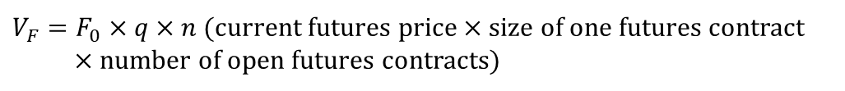
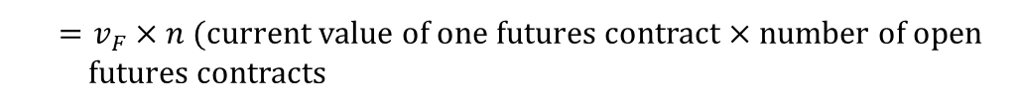

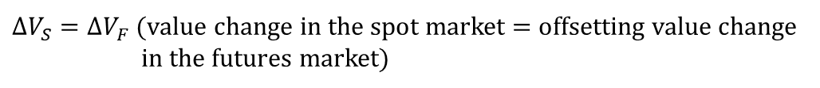
Elements of offsetting hedge
Basic concepts
Hedger’s current exposure in the spot market
$V_{S}=S_{0}×Q$ (current spot price × quantity of assets)
Hedger’s current exposure in the futures market
$V_{F}=F_{0}×q×n$ (current futures price × size of one futures contract
× number of open futures contracts)
$=v_{F}×n$ (current value of one futures contract × number of open futures contracts
Objective of offsetting hedge
$∆V_{S}=∆V_{F}$ (value change in the spot market = offsetting value change in the futures market)
It is not a fault of the offsetting hedge if the spot exposure generates a profit and the futures exposure wipes out this profit with its loss
What has to be determined
$hedge ratio \left(h\right)=\frac{futures exposure}{spot exposure}=\frac{V_{F}}{V_{S}}=\frac{F_{0}×q×n}{S_{0}×Q}=\frac{v_{F}×n}{V_{S}×Q}$
$number of futures contract (n) =h×\frac{V_{S}}{v_{F}}$
$hedge efficiency (\%) =\frac{gain in futures market}{ loss in spot market}$
Hedging with futures
6

Slide 7
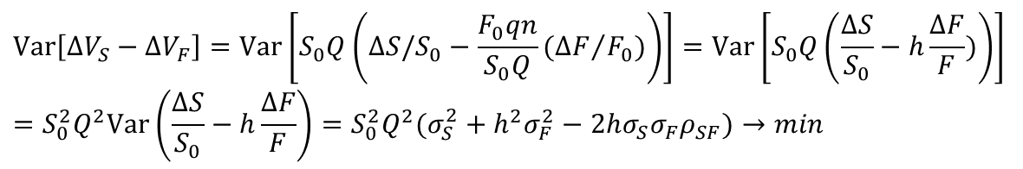

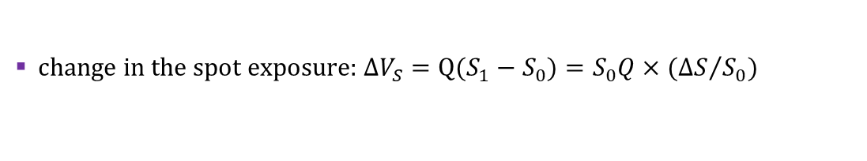


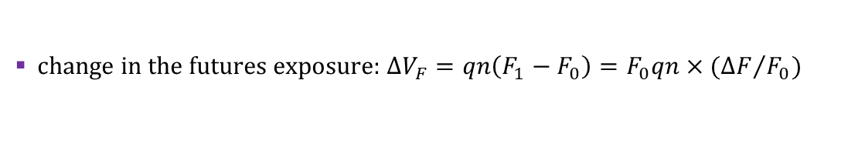
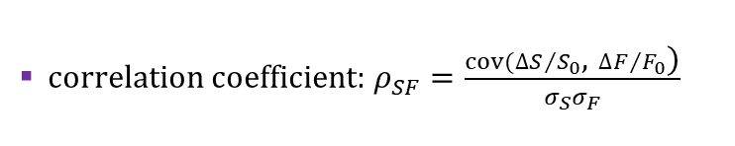
Minimum variance hedge ratio
Description of the model
MVHR is an approach to an offsetting hedge whose hedged ratio minimizes the variance of the value of the hedged portfolio
change in the spot exposure: $∆V_{S}=Q(S_{1}−S_{0})=S_{0}Q×({∆S}/{S_{0}})$
change in the futures exposure: $∆V_{F}=qn\left(F_{1}−F_{0}\right)=F_{0}qn×({∆F}/{F_{0}})$
variances of the spot and futures prices: $σ_{S}^{2}=var{(∆S}/{S_{0})},σ_{F}^{2}=var{(∆F}/{F_{0})}$
correlation coefficient: $ρ_{SF}=\frac{cov({∆S}/{S_{0}}\text{,} {∆F}/{F_{0}}\text{)}}{σ_{S}σ_{F}}$
Optimal hedge ratio
$$Var\left[∆V_{S}−∆V_{F}\right]=Var\left[S_{0}Q\left(∆S/S_{0}−\frac{F_{0}qn}{S_{0}Q}({∆F}/{F_{0}})\right)\right]=Var\left[S_{0}Q\left(\frac{∆S}{S_{0}}−h\frac{∆F}{F})\right)\right]$$
$$=S_{0}^{2}Q^{2}Var\left(\frac{∆S}{S_{0}}−h\frac{∆F}{F}\right)={S_{0}^{2}Q}^{2}(σ_{S}^{2}+h^{2}σ_{F}^{2}−2hσ_{S}σ_{F}ρ_{SF})→min$$
$$\frac{∂}{∂h}\left[{S_{0}^{2}Q}^{2}(σ_{S}^{2}+h^{2}σ_{F}^{2}−2hσ_{S}σ_{F}ρ_{SF})\right]={S_{0}^{2}Q}^{2}\left(2hσ_{F}^{2}−2σ_{S}σ_{F}ρ_{SF}\right)=0$$
$$h^{∗}=\frac{σ_{S}}{σ_{F}}ρ_{SF};$$
$$n^{∗}=h^{∗}\frac{V_{S}}{v_{F}}$$
[optimal hedge ratio is equal to the regression coefficient in the least square regression between ∆𝑆/𝑆 and ∆𝐹/𝐹]
Implications
a higher volatility of the futures price relative to the volatility of the spot price reduces the number of futures contracts needed to hedge a given spot exposure
in a direct hedge ($σ_{S}^{2}=σ_{F}^{2}, ρ_{SF}=1)$ the optimal hedge ratio is equal to 1
Hedging with futures
7

Slide 8
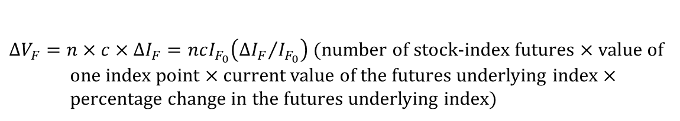
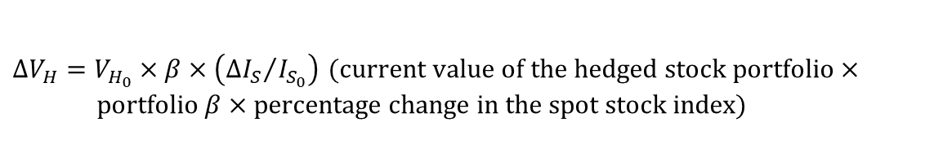


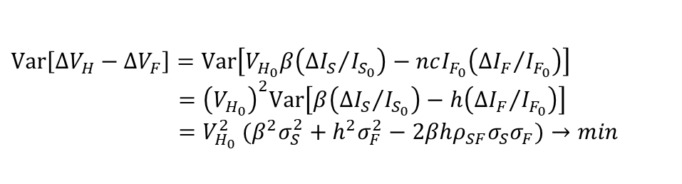
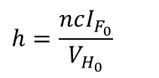
Hedging stock portfolio
Adaptations to MVHR model
Change in the portfolio’s spot exposure
portfolio 𝛽 measures the responsiveness of the portfolio value to the percentage change in the spot market stock index
$∆V_{H}=V_{H_{0}}×β×\left({∆I_{S}}/{I_{S_{0}}}\right)$ $\text{(}\text{current} \text{value} \text{of} \text{the} \text{hedged} \text{stock} \text{portfolio}\text{ × }\text{portfolio} β \text{× }\text{percentage} \text{change} \text{in} \text{the} \text{spot} \text{stock} \text{index}\text{)}$
Change in the futures exposure
$∆V_{F}=n×c×∆I_{F}=ncI_{F_{0}}\left({∆I_{F}}/{I_{F_{0}}}\right)$ (number of stock-index futures × value of one index point × current value of the futures underlying index × percentage change in the futures underlying index)
Hedge ratio
$$h=\frac{ncI_{F_{0}}}{V_{H_{0}}}$$
Optimal hedge ratio
$$Var\left[∆V_{H}−∆V_{F}\right]=Var\left[V_{H_{0}}β\left({∆I_{S}}/{I_{S_{0}}}\right)−ncI_{F_{0}}\left({∆I_{F}}/{I_{F_{0}}}\right)\right]$$
$${ =\left(V_{H_{0}}\right)}^{2}Var\left[β\left({∆I_{S}}/{I_{S_{0}}}\right)−h\left({∆I_{F}}/{I_{F_{0}}}\right)\right]$$
$$=V_{H_{0}}^{2} ({β^{2}σ}_{S}^{2}+h^{2}σ_{F}^{2}−2βhρ_{SF}σ_{S}σ_{F})→min$$
$$h^{∗}={β×ρ}_{SF}\frac{σ_{S}}{σ_{F}}$$
$$h^{∗}\dot{=}β$$
the spot stock index and the underlying index of the stock index futures are the same indexes, so they have the same variances and are perfectly correlated
Hedging with futures
8

Slide 9



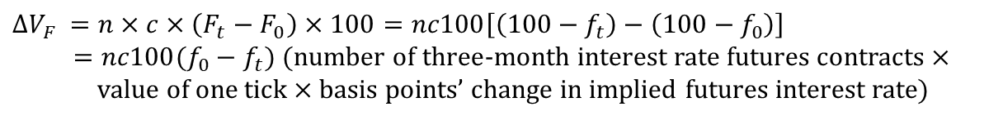
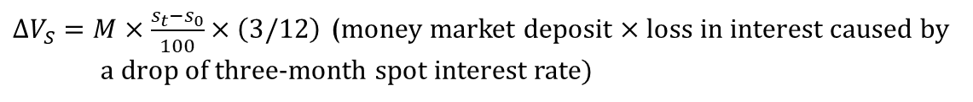
Hedging interest rate risk
Adaptations to MVHR model
Change in the spot exposure
$∆V_{S}=M×\frac{s_{t}−s_{0}}{100}×\left(3/12\right)$ (money market deposit × loss in interest caused by a drop of three-month spot interest rate)
Change in the futures exposure
$$∆V_{F} =n×c×\left(F_{t}−F_{0}\right)×100=nc100\left[\left(100−f_{t}\right)−\left(100−f_{0}\right)\right]$$
$=nc100(f_{0}−f_{t})$ (number of $three$-month interest rate futures contracts × value of one tick × basis points’ change in implied futures interest rate)
$c=q×0.0001×\left(3/12\right)$ (size of one futures contract × interest rate change by one basis point)
Hedge ratio
$$h=\frac{futures exposure}{spot exposure}=\frac{nq}{M}$$
Optimal hedge ratio
$$Var\left[∆V_{S}−∆V_{F}\right]=Var\left[M\frac{∆s}{100}\frac{3}{12}−nq\frac{100}{10000}\frac{3}{12}∆f\right]={\left(\frac{M}{100}\frac{3}{12}\right)}^{2}\text{Var}\text{(}∆s−h∆f)→min$$
direct hedge (the $three$-month spot interest rate is also the underlying interest rate of the $three$-month interest rate futures contract)
$$h^{∗}=1;$$
$$M=n^{∗}×q$$

Slide 10
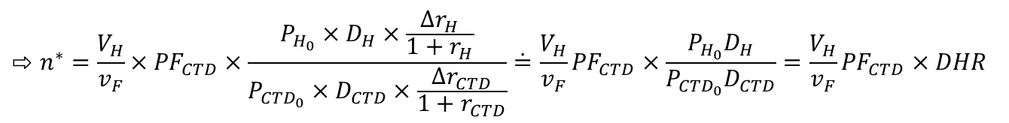




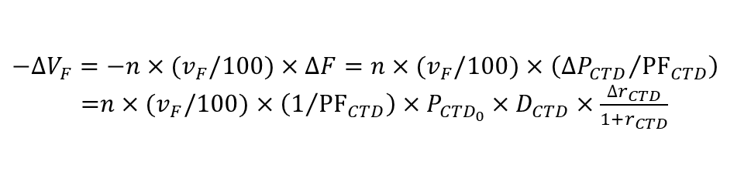

Hedging bond portfolio
Adaptations to MVHR model
Change in the long spot exposure
approximation of a change of bond price using duration
$\left[∆P=−P×D×\frac{∆r}{1+r}\right]$
$$∆V_{H}={(V}_{H}/100)×∆P_{H}={−(V}_{H}/100)×P_{H_{0}}×D_{H}×\frac{∆r_{H}}{1+r_{H}}$$
$V_{H}…$ nominal value of the hedged bond portfolio, $P_{H_{0}}…$ current price of the bond, $D_{H}…$bond’s duration,
$r_{H}…$bond’s yield
Change in the short futures exposure
CTD bond is delivered
price factor link between the futures and bond prices
$\left[∆P=PF×∆F\right]$
$$−∆V_{F}=−n×{(v}_{F}/100)×∆F=n×{(v}_{F}/100)×\left({∆P_{CTD}}/{{PF}_{CTD}}\right)$$
=$n×{(v}_{F}/100)×\left(1/{{PF}_{CTD}}\right)×P_{{CTD}_{0}}×D_{CTD}×\frac{∆r_{CTD}}{1+r_{CTD}}$
$n…$ number of futures contracts, $v_{F}…$ size of one futures contract, ${PF}_{CTD}…$price factor of the CTD bond,
${P_{{CTD}_{0}}… \text{current} \text{price} \text{of} \text{the} \text{the} \text{CTD} \text{bond}, D}_{CTD}…$ the CTD bond’s duration, $r_{CTD}…$ the CTD bond’s yield
Optimal number of futures contracts
$$∆V_{H}+∆V_{F}=0$$
$DHR…$ duration hedge ratio
$$⇨n^{∗}=\frac{V_{H}}{v_{F}}×{PF}_{CTD}×\frac{P_{H_{0}}×D_{H}×\frac{∆r_{H}}{1+r_{H}}}{P_{{CTD}_{0}}×D_{CTD}×\frac{∆r_{CTD}}{1+r_{CTD}}}\dot{=}\frac{V_{H}}{v_{F}}{PF}_{CTD}×\frac{P_{H_{0}}D_{H}}{P_{{CTD}_{0}}D_{CTD}}=\frac{V_{H}}{v_{F}}{PF}_{CTD}×DHR$$
Hedging with futures
10

Slide 11
See you in the next lecture
© O.D. Lecturing Legacy

