Slide 1

Trading strategies with options
Institute of Economic Studies
Faculty of Social Sciences
Charles University in Prague
Financial markets instruments

Slide 2









Trading advantages of options
Asymmetric payoff
Unlimited upside potential and downside protection make options a suitable hedging instrument
Volatility trading
Dependence of the option premium on the volatility of the underlying price
$$C=f(S,X,T,r,σ)$$
High leverage
An option premium changes approximately one-for-one with the price of the underlying security
Long call
$$∆C$$
$$∆C\dot{=}∆S$$
$$r_{U(unlevered)}=\frac{∆S}{S}$$
$$r_{L(levered)}=\frac{∆C}{C}\dot{=}\frac{1}{α}×\frac{∆S}{S}=\frac{1}{α}×r_{U}>r_{U}$$
$$∆S$$
$$C=αS<S$$
$$α≪1$$
$$X$$
$$∆S$$
A capital gain is accessible at a low initial investment, equal to the payment of the option premium being a fraction of the underlying price
Financial leverage of futures contract originates from low initial margins required upon opening these contracts

Slide 3
Open position trading
Description
The strategy bets on the direction of an option’s premium change
Speculator buys options whose premiums are expected to rise and sells options whose premiums are expected to fall
Profit or loss = change in option premium × number of option contracts ×
number of assets in one contract
Maximum loss = initial option premium × number of option contracts ×
number of assets in one contract
Example
Initial information
Current share price = ¢115, current June 135 call = ¢1 (the option is out of the money), number of option contracts = 10, number of shares in one option contract = 1000. Share price is expected to rise, so the trader opens a long option position
New information (10 days later)
New share price ¢125 (share price has risen by 8.7%, the option is still out of the money), new option premium ¢5 (consequence of higher time value)
Gain
Revenue – initial costs = (¢5 ‒ ¢1) × 10 × 1000 = $400
Annualised rate of return = 400 × (365/10) = 14.600%

Slide 4
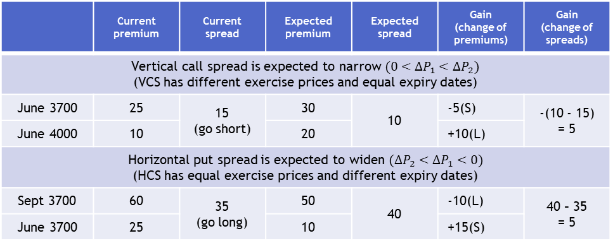
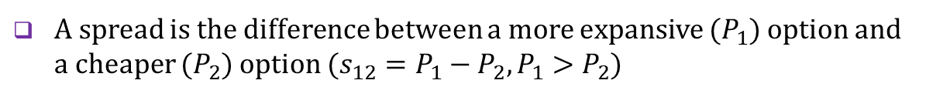
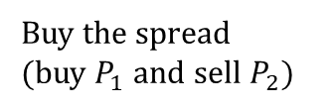
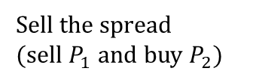
Spread trading
Description
A spread is the difference between a more expansive ($P_{1})$ option and a cheaper ($P_{2})$ option ($s_{12}=P_{1}−P_{2},P_{1}>P_{2}$)
Spread widening
$P_{1}$ rises more than $P_{2} (∆P_{1}>∆P_{2}>0 \text{or} {∆P}_{1}>0>{∆P}_{2})$
Buy the spread
(buy $P_{1}$ and sell $P_{2})$
$P_{1}$ falls less than $P_{2} (0>∆P_{1}>∆P_{2})$
Spread narrowing
$P_{1}$ falls more than $P_{2} (0>∆P_{2}>∆P_{1} \text{or} ∆P_{2}>0>{∆P}_{1})$
Sell the spread
(sell $P_{1}$ and buy $P_{2})$
$P_{1}$ rises less than $P_{2} \left(0<∆P_{1}<∆P_{2}\right)$
Examples
 | Current premium | Current spread | Expected premium | Expected spread | Gain (change of premiums) | Gain (change of spreads)
Vertical call spread is expected to narrow $(0<∆P_{1}<∆P_{2})$ (VCS has different exercise prices and equal expiry dates)
June 3700 | 25 | 15 (go short) | 30 | 10 | -5(S) | -(10 - 15) = 5
June 4000 | 10 |  | 20 |  | +10(L)
Horizontal put spread is expected to widen $(∆P_{2}<∆P_{1}<0)$ (HCS has equal exercise prices and different expiry dates)
Sept 3700 | 60 | 35 (go long) | 50 | 40 | -10(L) | 40 – 35 = 5
June 3700 | 25 |  | 10 |  | +15(S)
= 5
= 5

Slide 5
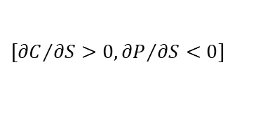
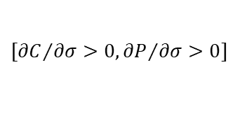
Volatility trading
Single option trade
Option premium is related positively to the change in volatility of an underlying asset
$$[{∂C}/{∂σ}>0,{∂P}/{∂σ>0}]$$
Volatility trading consists of buying options whose volatility is expected to rise and selling options whose volatility is going to fall
Direction risk in single option trade
$$[{∂C}/{∂S}>0,{∂P}/{∂S}<0]$$
The positive impact of higher volatility on the option premium can be undone by the negative impact caused by the undesirable direction of the price movement
Protection against direction risk
Long straddle and long strangle are option combinations generating profit, irrespective of the direction of greater price changes of the underlying asset
Inconsistent implied volatilities
Volatility is the attribute of the underlying asset so two different options written on the same underlying asset should have, according to the BS formula, the same implied volatilities
Trading strategy based on a bet that the two volatilities will converge
Sell the option whose volatility, and therefore its premium, is going to fall
Buy the option whose volatility, and therefore its premium, is going to rise

Slide 6









Credit box arbitrage
Description
A CBA seeks to identify a specific option portfolio whose revenue (plus interest earned) will more than cover the loss when options expire
$${X_{1}}_{ }$$
long $X_{1}$put
long $X_{2}$call
$${X_{2}}_{ }$$
$$S_{T}$$
$$0$$
short $X_{1}$call
short $X_{2}$put
loss at expiry = $X_{2}−X_{1}$
synthetic long share
synthetic short share
Example
Initial information
Option premiums: 105 call (short) = 12, 105 put (long) = 6, 125 call (long) = 3, 125 put (short) = 21; risk-free deposit rate = 12%; time to expiry = 60 days
Guaranteed gain/loss
$$\text{Net} \text{gain}=\text{initial} \text{revenue} ×\left(1+r×\frac{60}{365}\right)−\text{loss} \text{at} \text{expiry}$$
$$=\left[\left(12−6\right)+\left(−3+21\right)\right]×\left(1+0.12×\frac{60}{365}\right)−\left[125−105\right]=24×1.02−20=4.48$$

Slide 7






Debit box arbitrage
Description
A DBA seeks to identify a specific option portfolio whose initial outlay (plus interest paid) will be more than offset by the gain at the expiry date
synthetic short share
synthetic long share
gain at expiry = $X_{2}−X_{1}$
$$0$$
long $X_{1}$call
long $X_{2}$put
$$S_{T}$$
$${X_{1}}_{ }$$
short $X_{1}$put
short $X_{2}$call
$${X_{2}}_{ }$$
Example
Initial information
Option premiums: 105 call (long) = 12, 105 put (short) = 6, 125 call (short) = 3, 125 put (long) = 21; borrowing rate = 12%; time to expiry = 60 days
Guaranteed gain/loss
$$\text{Net} \text{loss}=\text{initial} \text{outlay} ×\left(1+r×\frac{60}{365}\right)+\text{gain} \text{at} \text{expiry}$$
$$=\left[\left(−12+6\right)+\left(−21+3\right)\right]×\left(1+0.12×\frac{60}{365}\right)+\left[125−105\right]=−24×1.02+20=−4.48$$

Slide 8


Covered call
Description
A covered call consists of a long position in the underlying security coupled with a short call option written on the security
At-the-money covered call
Limited protection, thanks to premium received, against falling price of the underlying asset in exchange for giving up the unlimited gain potential when the price of the underlying rises
short call
covered call (synthetic short put)
$$X$$
$$S_{T}$$
The complete P/L profile must take into account the carry of the trade (interest on deposit, received dividends, etc.)
long stock
Example
today (1 April)
option’s expiry (30 June)
Initial information
91 days
Current stock price = ¢115, annual dividend yield = 16% (paid at the beginning of each quarter), call option’s premium = ¢12, time to expiry = 91 days, lending rate = 10%
Carry in a covered call
Income from received and deposited option premium$=12×\left(1+\frac{91}{365}0.1\right)=¢12.3$
Income from deposited dividend$=\frac{1}{4}0.16×115×\frac{91}{365}0.1=¢0.11$ (the share price is lower by the dividend paid)
Net revenue$=12.3+0.11=¢12.41$ (the cover call shows a loss only after the stock falls by more than 12.41 cents)

Slide 9

Fixed-hedge protective put
Description
A fixed-hedge protective put consists of a long position in one underlying security coupled with one put option written on this security
At-the-money protective put
Protection, at the cost of the paid premium, against the falling price of the underlying asset while keeping the gain when the price of the underlying asset rises
long stock
$$X$$
protective put (synthetic long call)
The complete P/L profile must take into account the carry of the trade (interest on borrowed money, received dividends etc.)
$$S_{T}$$
long put
Example
today (1 April)
option’s expiry (30 June)
Initial information
91 days
Current stock price = ¢115, annual dividend yield = 16% (paid at the beginning of each quarter), put option’s premium = ¢10, time to expiry = 91 days, borrowing rate = 10%, lending rate = 8%
Carry in a protective put
Cost of loan that finances the purchase of the put $=10×\left(1+\frac{91}{365}0.1\right)=\text{¢}10.25$
Income from the deposited dividend = $\frac{1}{4}0.16×115×\frac{91}{365}0.08=\text{¢}0.09$
Net cost $=10.25−0.09=\text{¢}10.16$

Slide 10


Dynamic maturity protective put
Description
The strategy regularly rebalances the stock-bond portfolio with the aim to replicate the protective put’s payoff at maturity
Example: prevent the portfolio value from falling below USD 100,000; share price can rise or fall by 10% and bond yield is 5% (over a 6 months period)
100,000
$$S\text{… }\text{number} \text{of} \text{shares}$$
$B$… number of bonds
0.90S + 1.05B = 95,238
1.10S + 1.05B = 110,238
S = 75,000
B = 26,417
V = 101,417
Cost of protective put
$$101,417−100,000 =\text{USD} 1,417$$
90,000
110,000
81,000
(100,000)
99,000
(100,000)
99,000
(100,000)
121,000
(121,000)
0.90S + 1.05B = 100,000
1.10S + 1.05B = 100,000
S = 0
B = 95,238
V = 95,238
0.90S + 1.05B = 100.000
1.10S + 1.05B = 121.000
S = 105,000
B = 5,238
V = 110,238
Embedded instability
V = 100,000
V = 100.000
V = 100.000
V = 121000
The strategy may lead to higher stock market volatility (falling stock market triggers orders to sell shares and vice versa)
Potentially destabilising effect on stock and bond markets if the strategy is applied automatically using computerised program trading

Slide 11


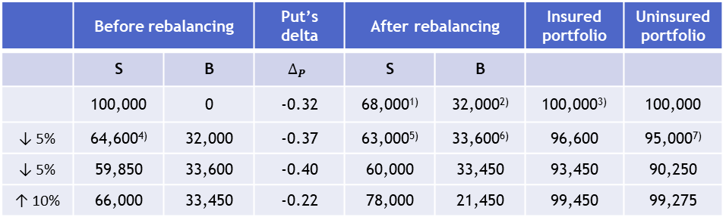
Dynamic short-term protective put
Description
The strategy maintains a stock-bond portfolio whose delta is equal to the value of the delta of a notional protective put
$${(∆}_{P}<0)$$
$$V=\left(1−\left|∆_{P}\right|\right)S+\left|∆_{P}\right|B$$
$$\frac{∂V}{∂S}=1−\left|∆_{P}\right|=1−{(−∆}_{P})=1+∆_{P}=\frac{∂}{∂S}\left(S+P\right)$$
Option markets may not have enough liquidity to absorb large trades needed or suitable options may not exist
 | Before rebalancing |  | Put’s delta | After rebalancing |  | Insured portfolio | Uninsured portfolio
 | S | B | $$∆_{P}$$ | S | B
 | 100,000 | 0 | -0.32 | 68,000¹⁾ | 32,000²⁾ | 100,000³⁾ | 100,000
↓ 5% | 64,600⁴⁾ | 32,000 | -0.37 | 63,000⁵⁾ | 33,600⁶⁾ | 96,600 | 95,000⁷⁾
↓ 5% | 59,850 | 33,600 | -0.40 | 60,000 | 33,450 | 93,450 | 90,250
↑ 10% | 66,000 | 33,450 | -0.22 | 78,000 | 21,450 | 99,450 | 99,275
100,000 × (1 – 0,32)
100,000 – 68,000
68,000 + 32,000
68,000 × (1 – 0.05)
100,000 × (1 – 0.37)
32,000 + (64,600 – 63,000)
100,000 × (1 – 0.05)
Embedded instability
Value of the stock declines ⇨ delta of the put decreases ⇨ representation of shares decreases ⇨ excess shares are sold and bonds are purchased
Value of the stock rises ⇨ delta of the put increases ⇨ representation of shares increases ⇨ bonds are sold and shares purchased

Slide 12
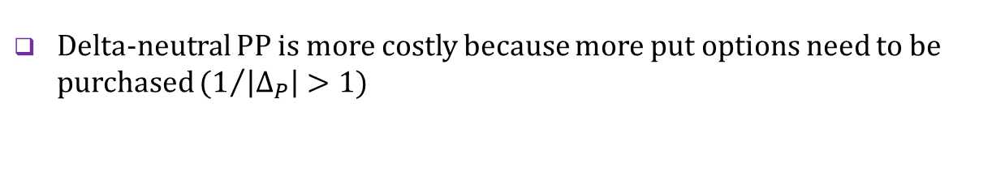





Delta-neutral protective put
Composition of delta-neutral protective put
$$V=n_{P}×P+n_{S}×S$$
$$\frac{∂V}{∂S}=n_{P}×∆_{P}+n_{S}=0$$
$$⇨n_{P}=−\frac{n_{S}}{∆_{P}} \left(∆_{P}<0\right)$$
$$\left[\text{number} \text{of} \text{puts}=−\frac{\text{number} \text{of} \text{shares}}{\text{put}\text{′}\text{s} \text{delta}}\right]$$
At-the-money fixed-hedge protective put
At-the-money delta-neutral protective put
1 long stock
1 long stock
protective put
(synthetic long call)
$$X$$
$$X$$
delta-neutral protective put
$$S_{T}$$
$$S_{T}$$
1 long put
Properties
(1/$\left|∆_{P}\right|)$ long puts
Delta-neutral PP is more costly because more put options need to be purchased $(1/{\left|∆_{P}\right|}>1)$
The price of the underlying asset needs to rise relatively more for the delta-neutral PP to be in the money
A delta-neutral PP can be in the money if the price of the underlying asset drops enough while a fixed-hedge PP loses value when the price of the underlying asset falls

Slide 13

See you in the next lecture
© O.D. Lecturing Legacy
dedekold@gmail.com
Visit dedeklegacy.cz or TALKING SLIDES for the animated version of this presentation
(with English narrations and English/Czech subtitles)

